Slide 1
What Is
The True Duty
Of
Man?

Slide 2
In the Name of God,
the Merciful, the Compassionate
“Indeed, God is with those
who fear Him and those who do good.”
(Qur’an, 16:128)

Slide 3
The following story shows how necessary it is to pray, to avoid serious sins, that both duties are directly related to our own nature.

Slide 4
His well-trained friend warned him:
“Your basic duty is training and fighting. You were brought here for that. The king will not let you go hungry. This is a time of war; he will tell you that you are rebellious and will punish you.”

Slide 5
There are two duties which concern us:
One is the king’s duty: he feeds us for it.
The other is our duty; that is training and fighting.

Slide 6
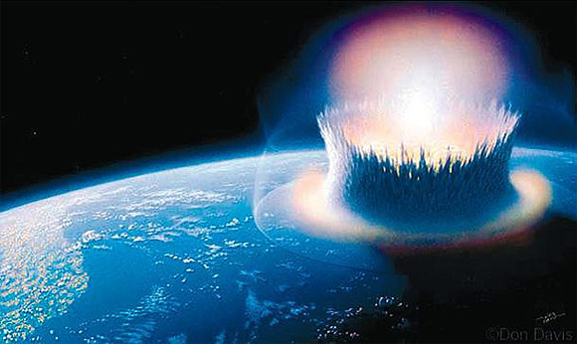
Most certainly, you understand in what kind of great danger the second soldier would be if he did not pay attention to his friend’s advice.

Slide 7
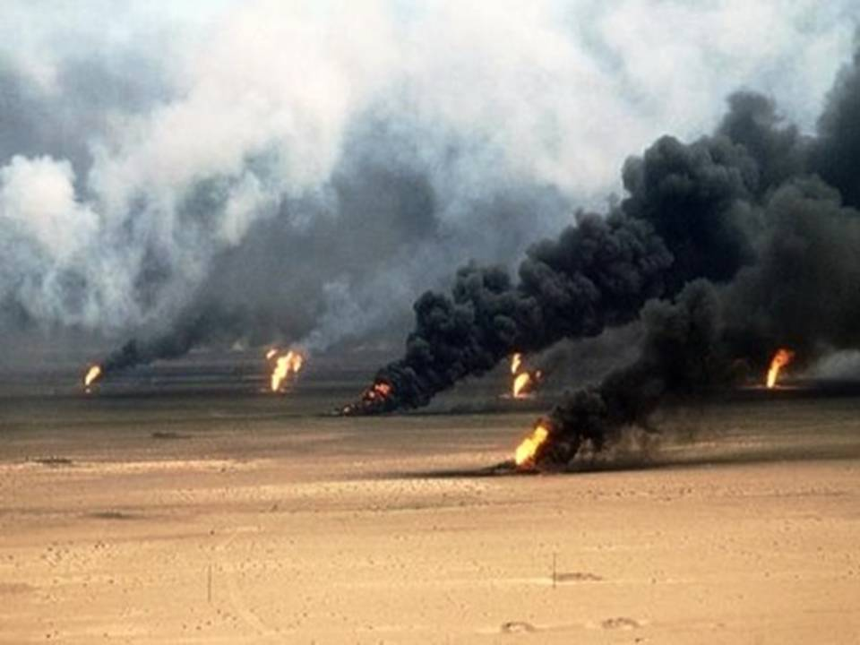
O my lazy soul !
That place of
war is This worldly life

Slide 8
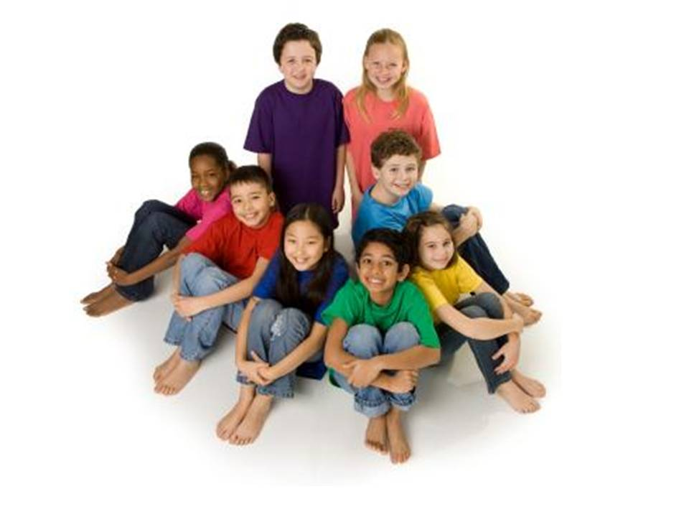
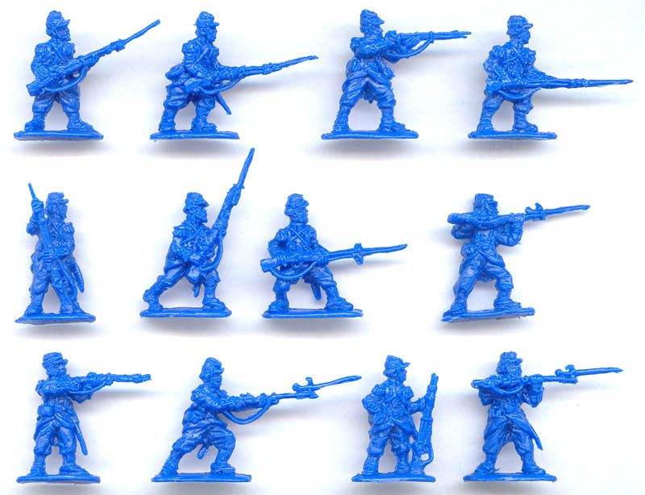
That military unit is
human
society

Slide 9
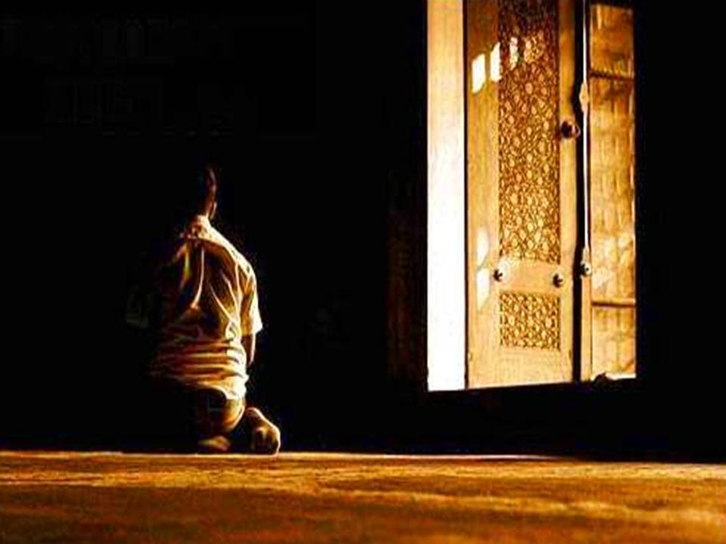
One of the two soldiers is
a devout man who knows the obligations of his religion and performs them, and struggles with his own soul
and Satan

Slide 10
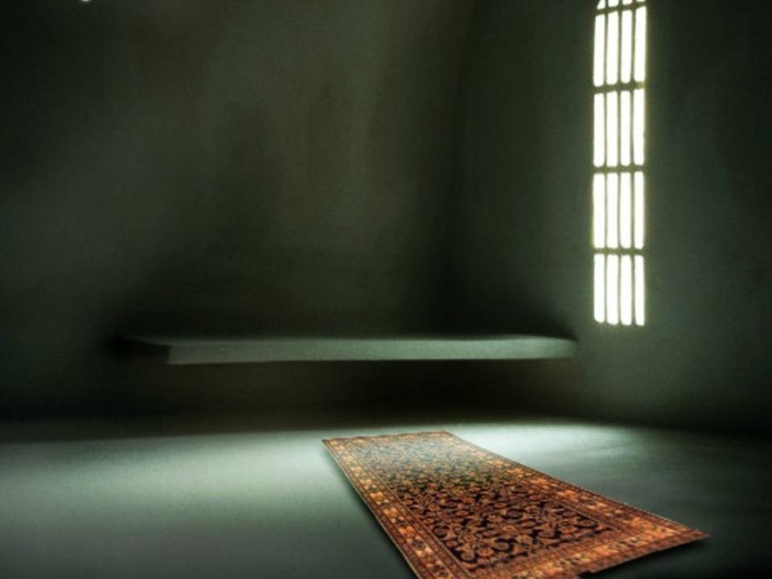
The training and instruction is prayer and worship

Slide 11
The war is the struggle against the soul and its desires, and against Satan, and saving the heart and spirit from eternal hell.

Slide 12
The first of the two duties is to give and maintain life with sustenance which is the responsibility of God.
.

Slide 13
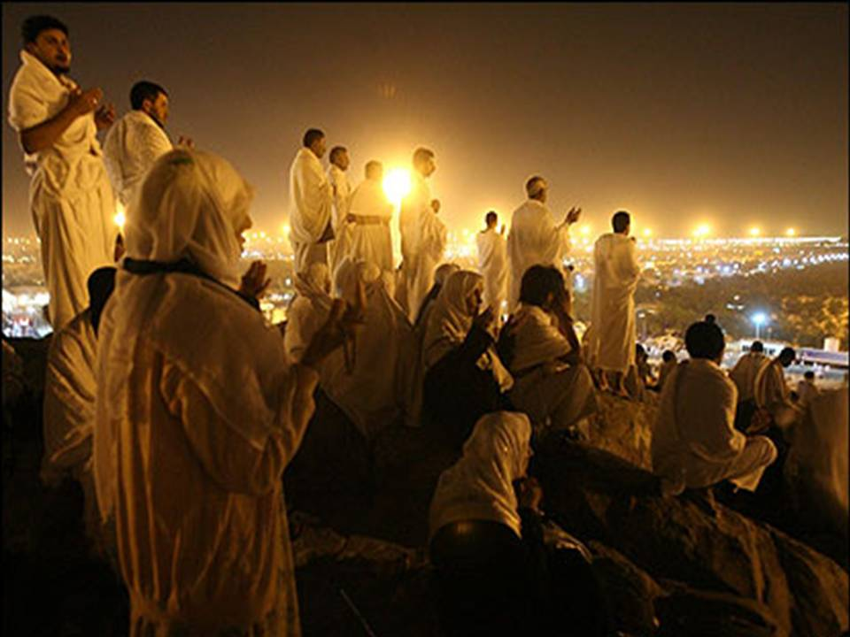
The other is to worship and supplicate to the Giver and Sustainer of life. It is to trust and rely on Him. This duty is ours.

Slide 14
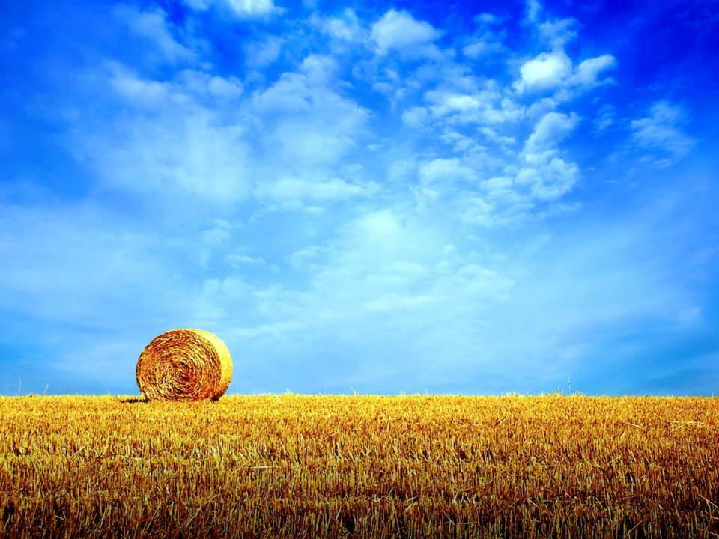
Indeed, whoever made and bestowed life is the One who maintains and preserves it through sustenance. It cannot be another

Slide 15
So someone
who gives up performing the prescribed prayers because of the struggle for livelihood resembles the soldier who abandoned his training and begged in the market.

Slide 16
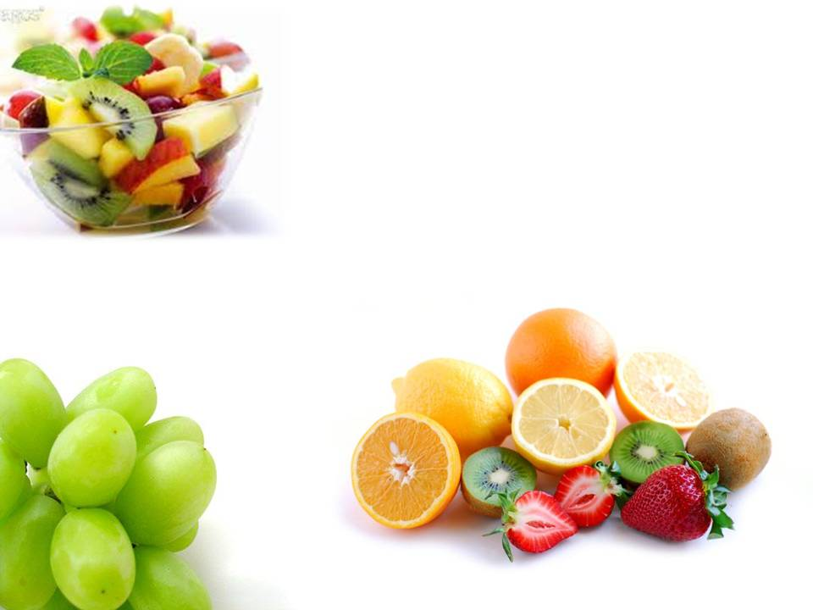
Seeking ones rations from the kitchens of God’s mercy after performing the prayers, and
not burdening others is fine and proper.
It too is a sort of worship.

Slide 17
Furthermore, man’s nature and spiritual faculties show that
he has been created for worship.

Slide 18
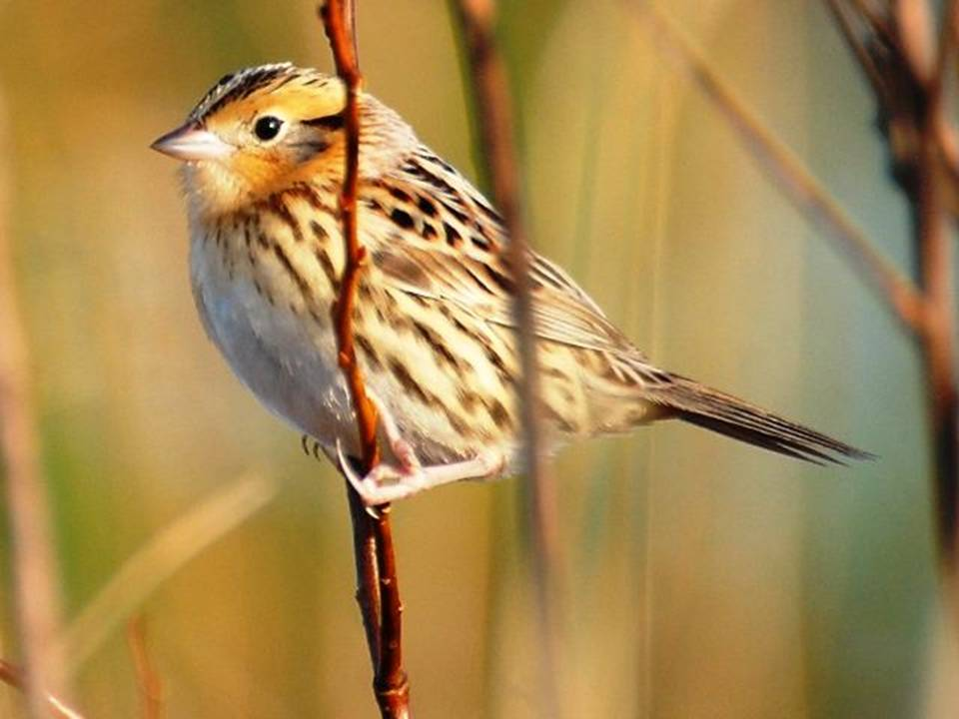
In terms of the power and actions that are necessary for the life on Earth , he cannot compete with the most smallest sparrow.

Slide 19
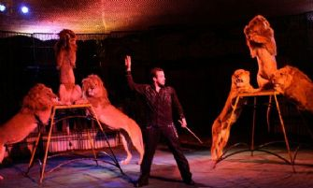
He is like the commander of the animals in terms of knowledge, need, worship and supplication, which are necessary for spiritual life and the life in the hereafter.

Slide 20
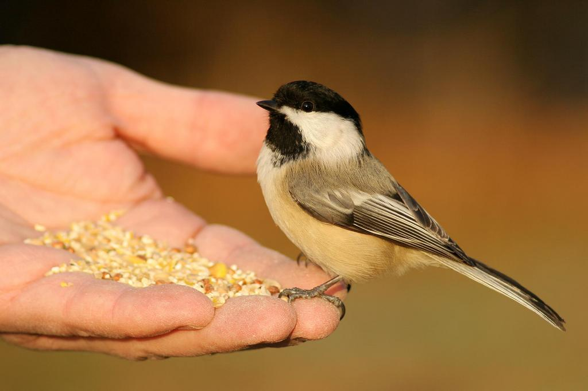
O my soul!
If you make the life of this world your priority and work continuously for that, you will become like the lowest sparrow

Slide 21
If you aim for the hereafter and make this life the means of it, you will be like a commander of the animals, and a dear servant of God Almighty, and His honored guest

Slide 22
There are the two ways open to you!
You can choose whichever you wish...
So ask for guidance and success from the Most Compassionate of the Compassionate...

