Slide 1
Islamic Classes Through Tughra Publishing’s Books

Slide 2
27 Different Classes in 5 Levels

Slide 3
1-2 Hours a week 40 weeks a year for each class 18 Hours Class 15 Hours Counseling 5 Hours Practice – Jumuah and other 2 Hours Management and misc.

Slide 4
Classes
First Level (Beginner)
Basic Principles of Islam
Good Character and etiquette
Basic Islamic Fiqh (Daily Prayers)
Seerah of The Last Prophet(PBUH)
Alifba and Tajweed
Arabic for Beginners

Slide 5
Classes
Second Level (Elementary)
Aqaid al-Islam (Islamic Creed)
Islamic Fiqh (Islamic Jurisprudence)
Good Character and Etiquette 2
Seerah of The Last Prophet(PBUH) 2
Tajweed and Memorization of The Qur’an
Introduction to Hadith and 40 Hadith
Knowledge of The Qur’an
Arabic for Elementary

Slide 6
Classes
Third Level (Intermediate)
Aqaid al-Islam 2 (Islamic Creed)
Islamic Fiqh 2 (Islamic Jurisprudence)
Islamic Morality and Ethics 1
Seerah 3
Tajweed and Memorization of The Qur’an and Selected Prayers
Hadith Science - Ahadith from Riyad us-Salihin
Introduction to Tafsir
Arabic for Elementary – 160 Hours

Slide 7
Classes
Fourth Level (Upper Intermediate)
Aqaid al-Islam 3 (Islamic Creed)
Islamic Fiqh 3 (Islamic Jurisprudence)
Islamic Morality and Ethics 2
Seerah 4
Memorization of The Qur’an and Selected Prayers – Memorization of Selected chapters and the prayers
Usul al-Fiqh 1
Usul al-Tafseer 1
Interfaith – Get to Know the Other Faiths and the Other Faith Members
Arabic for Pre-Intermediate – 160 Hours – Second part of the elemantary

Slide 8
Classes
Fifth level (Advanced)
Aqaid al-Islam 4 (Islamic Creed)
Islamic Fiqh 3 (Islamic Jurisprudence)
Islamic Morality and Ethics 2
Seerah 4
Memorization of The Qur’an and Selected Prayers
Usul al-Fiqh 2 - Ahadith from Kutub al-Sittah
Usul al-Tafseer 2 – Tafsir Ibn Kathir
Interfaith – Get to Know the Other Faiths and the Other Faith Members
Arabic for Pre-Intermediate – 160 Hours

Slide 9
BEGINNER’S LEVEL CLASSES

Slide 10
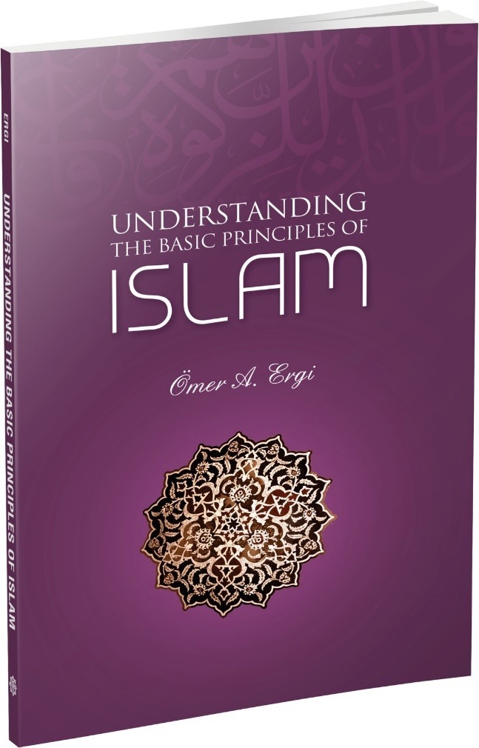
Basic Principles of Islam (Beginner Level)
Understanding the Basic Principles of Islam
Six Articles of Faith
Belief in God
Belief in The Prophets
Belief in Hereafter
Belief in Angels
Belief in Destiny
Belief in The Divine Books
Pilars of Faith
-Testimony of Faith
…
Sunnah, Worship in Islam,…

Slide 11
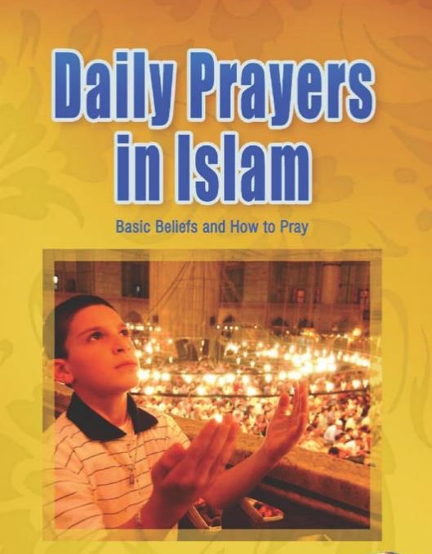
Basic Islamic Fiqh (Daily Prayers) (Beginner Level)
Daily Prayers in Islam
Wudu
Ghusl
Adhan
Salat

Slide 12
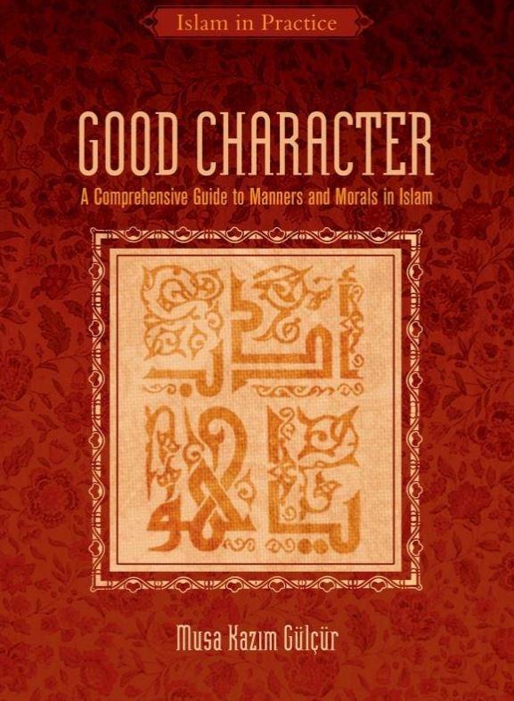
Good Character (Beginner Level)
Good Character
Building Good Character
Divinely Ordained Duties
Individual Duties
Family Duties
Social Duties
Good Education and Upbringing
Teacher Student Relations
Practicing Good conduct in the family

Slide 13
Seerah of The Last Prophet(PBUH) (Beginner Level)
The Luminous Life of Our Prophet(PBUH)
His(PBUH) life Chronological Base
His(PBUH) Life Before the Irsalat
The Years with the Wet Nurses
The Damascus Trip and Priest Bahira
…
Meccan Period
At the Home of Ibn Arqam
Umar Accepts Islam
The Migration to Abyssinia
…
Medinan Period
The First and Last Pilgrimage
…

Slide 14
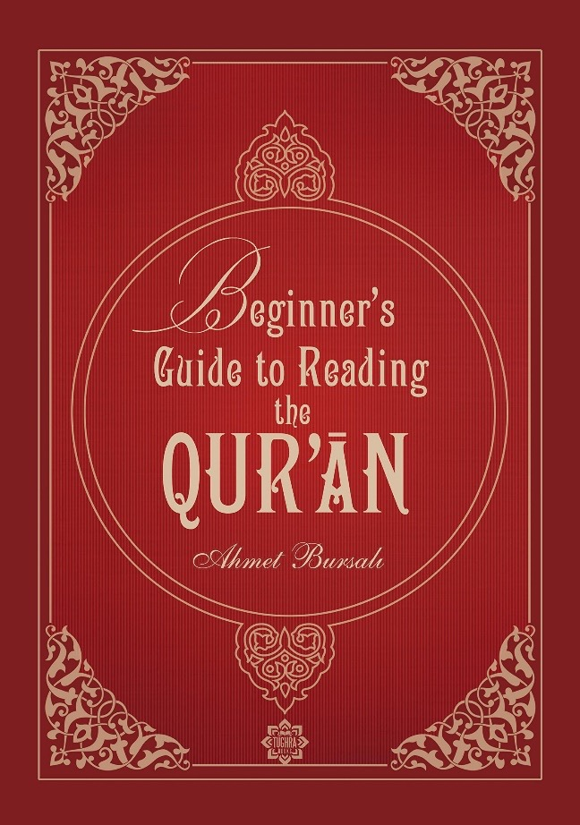
Alifba and Tajweed (Beginner Level)
Beginner's Guide to Reading
The Qur'an (Alif-Ba)
Recognition of Letters and Sounds
Arabic Alphabet
…
Articulation of Letters with Short Vowels
Fat-hah
Kasrah
…
Prolongation and Articulation of Madd…
Alif Madd
…
…

Slide 15
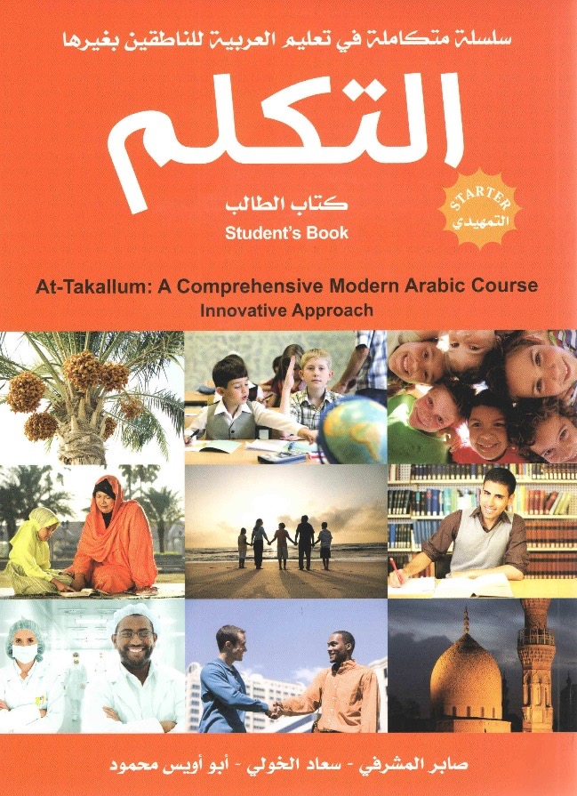
Arabic 1 (Beginner Level)
At-Takallum (Comprehensive
Modern Arabic Course) Starter
Recommended for 30-50 hours
All Pictures suits with Islamic Adab
Designed for Foreigners to Arabic Lang.
Starter Level consists of:
1 Study book
- 1 work book
- 2 audio CD’s
…

Slide 16
Elemantary 2nd LEVEL

Slide 17
Aqaid al-Islam (Islamic Creed) (Elementary Level)
An Introduction to Islamic Faith
and Thought -1 (Page1-85)
Aqeedah of Ahlus Sunnah
Articles of Faith in More Detail
Existence of Allah and Tawheed
Hereafter
Angels

Slide 18
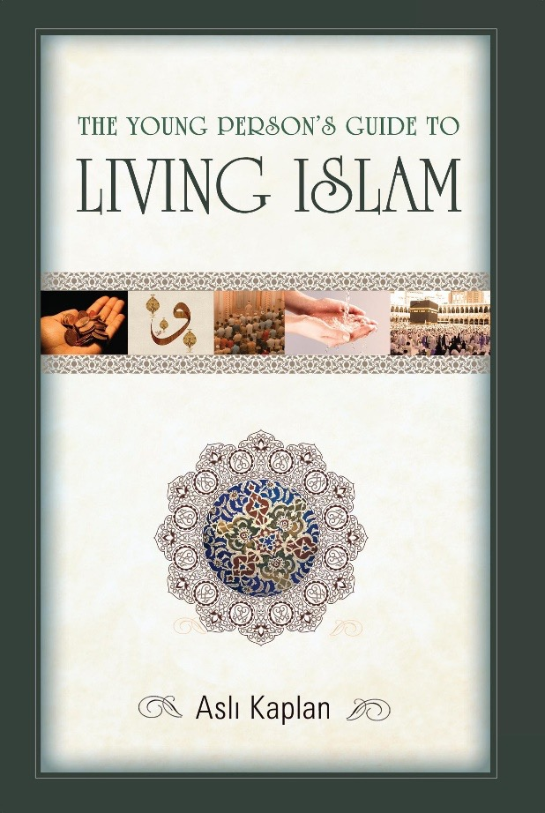
Islamic Fiqh (Islamic Jurisprudence) (Elementary Level)
The Young Person’s Guide to
Living Islam
Why Do We Worship
-…
Physical an Spiritual Purity
- Purification of Material Impurities
Matters Specifically Regarding Women
-…
Daily Prayers
What is the Prayer
Adhan
The Conditions of Prayer
The Sunnah Acts of Prayer
Tarawih Prayer
…
Fasting, Zakah, Hajj…

Slide 19
Good Character and Etiquette 2 (Elementary Level)
Good Character
What Good Character Requires
- Care of Kin
- Cleanliness
- Hilm (Gentleness')
- Truthfulness
- Trustworthiness
- Envy
- Teasing and Mocking
- Verifying What One Hears
- Showing Off
- Greetings
The Right of Neighbors
…

Slide 20
Seerah of The Last Prophet(PBUH) 2 (Elementary Level)
The Messenger of God:
Muhammad(PBUH) (Page 1-289)
The Prophet(PBUH) Sent As A Mercy
- The Dark Period of Ignorance
- The Awaiting Prophet(PBUH)
- ….
Why Prophets Are Sent
- …
Characteristic of The Prophets(A.S.)
- Trustworthiness and asking no wage
…
The Essentials of Prophethood
Prophet as Husband and Father
…
A Universal Leader
…

Slide 21
Tajwid and Memorization of The Qur’an 1 (Elementary Level)
Tajwid: The Art of the Recitation of the Qur'an 1
Phonetics
- ….
The Rules of Tajwid
- …
The Rules of Recitation
- Stopping and Initation
- The Pause or Sakta
The Methods of Recitation
…

Slide 22
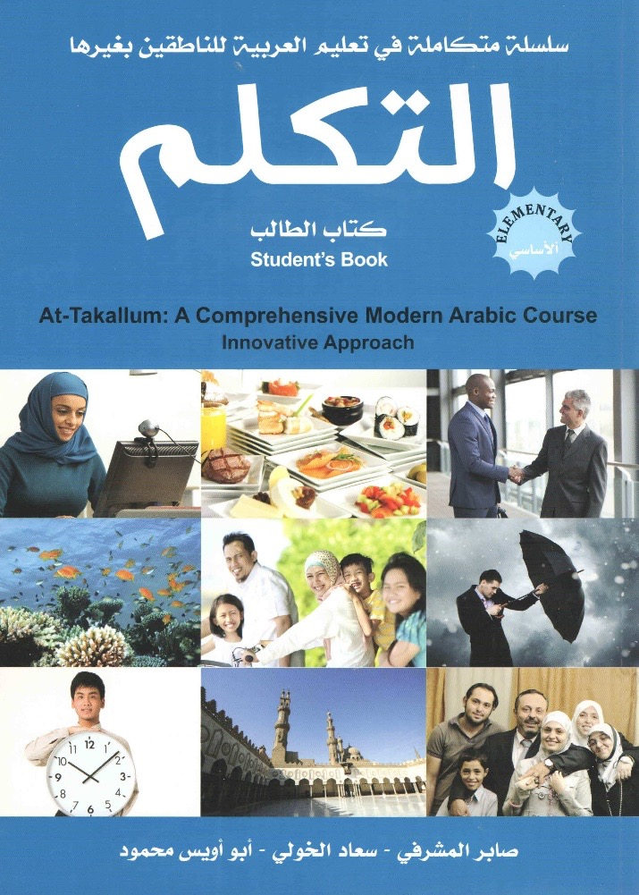
Arabic 2A (Elementary Level)
At-Takallum (Comprehensive
Modern Arabic Course) Elementary 1
Chapter (1-4)
- Recommended for between 120 hours
- Designed for Foreigners to Arabic Lang.
- Elementary Level consist of :
- 1 Study book
1 work book and
2 audio CD’s

Slide 23
Introduction to Hadith and 40 Hadith (Elementary Level)
Introduction to Hadith
The Hadith Studies and The Sunnah
Role of The Companions and The Successors
in Hadith Transmitting and preservation
Hadith Terms Such as Hadith Qudsi,
Sahih Hadith, Maqbul Hadith, Hasan Hadith,
Weak Hadith, Fabricated or Forged Hadith
16 Hadith Class Hadith

Slide 24
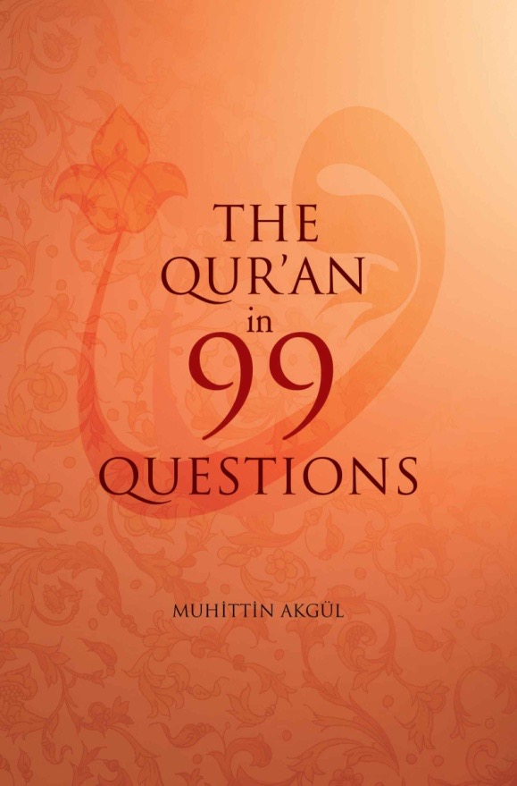
Knowledge of The Qur’an (Elementary Level)
The Qur’an in 99 Questions
The Definition of The Qur’an
The Definition of The Revelation
How Does The Qur’an Preserved Until Today
…

Slide 25
Intermediate (3rd LEVEL)

Slide 26
Aqaid al-Islam 2 (Islamic Creed) (Intermediate Level)
An Introduction to Islamic Faith and Thought -2 (Page 89-194)
Aqeedah of Ahlus Sunnah
Articles of Faith in More Detail
Cardinal Articles of Islamic Faith…
(1st chapter of Living of Shade of Islam)
Divine Destiny
The Resurrection...
The Qur’an
Prophethood and The Prophet (SAW)

Slide 27
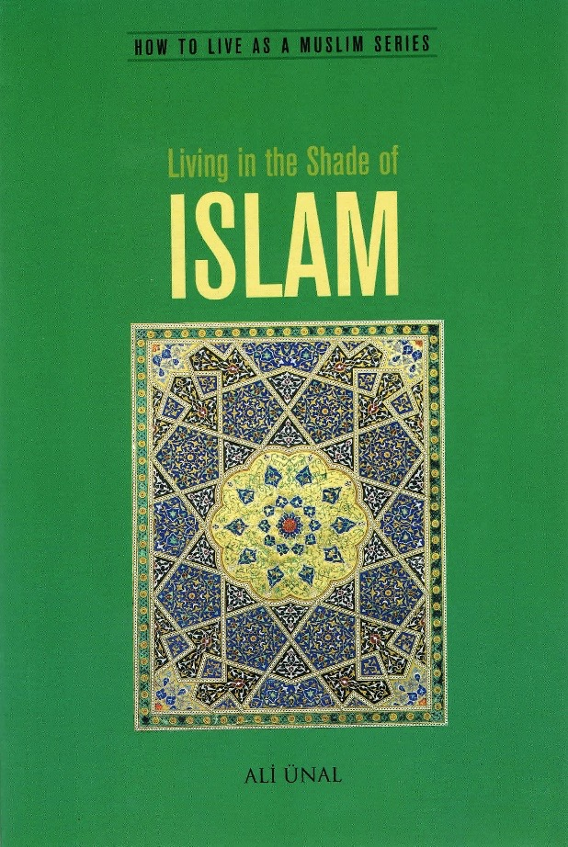
Islamic Fiqh (Islamic Jurisprudence) 2 (Intermediate Level)
Living In The Shade of Islam 1 (Page 15-102)
At-Tahara (Cleanliness of Purification)
- Types of impurities
- Menstruation and …
- Ghusl…
- Tayammum
- Wudu
As-Salah
- The Times of The Five Daily Prayers
- Adhan
- Obligatory Acts
- Necessary Acts
- ….

Slide 28
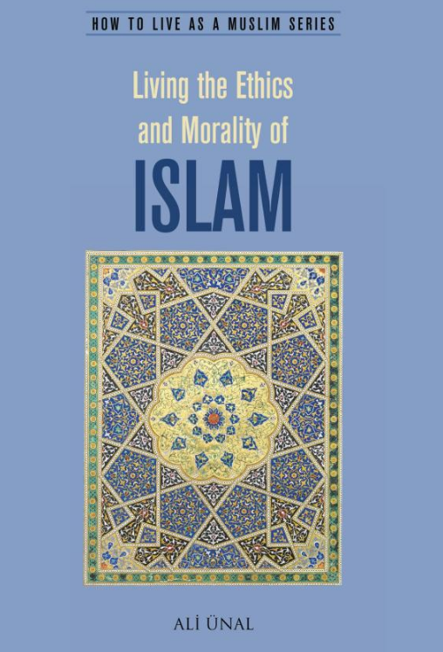
Ethics and Morality in Islam 1 (Intermediate Level)
Living In The Ethics and Morality of Islam (Page 1-87)
Islamic Morality
- Our duties towards …
…
Social Relationships
- The Sacredness of Life
...
Human Rights in Islam
...
Humanity…
Hopeless in The Face of Calamities
…

Slide 29
Seerah 3 (Intermediate Level)
Forth Coming book - Translation of “Sefkat Gunesi”
The one whom all ice-bergs melts by
The reflection of all-encompassing mercy.

Slide 30
Tajwid and Memorization of The Qur’an 2 (Intermediate Level)
Tajwid: The Art of the Recitation of the Qur'an 2
…
Most Common Errors
Manners of Recitation
Practices on The Qur’an with the selected Chapters and memorization of the Selected Chapters and Prayers

Slide 31
Arabic 2B (Intermediate Level)
At-Takallum (Comprehensive
Modern Arabic Course) Elementary 2
Chapter 5-8
- Recommended for between 120 hours
- Designed for Foreigners to Arabic Lang.
- Elementary Level consist of :
- 1 Study book
1 work book and
2 audio CD’s

Slide 32
Hadith Science – Hadith Reading (Intermediate Level)
The Messenger of God(SAW) (Page 289-371),
Riyad us-Salihin
The Sunnah and Its Place in Islamic Legislation
-Verbal Sunnah
…
Establishing The Sunnah
- Literal Narrations
- Ensuring the Authenticity
The Companions and The Tabiun
Selected Ahadith from Riyad us-Salihin

Slide 33
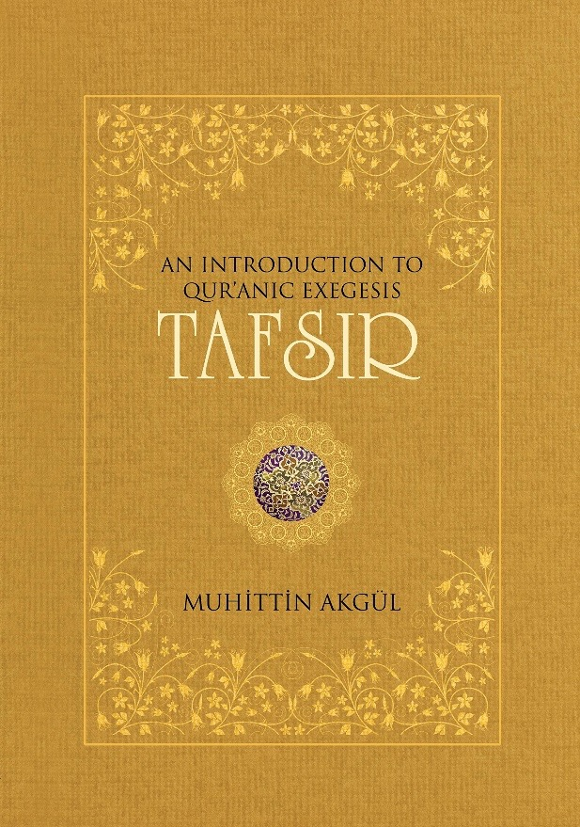
Introduction to Tafsir (Intermediate Level)
Introduction to Tafsir
The Definition of The Revelation
The Miraculousness of The Qur’an
The Writing, Gathering and Copying of
The Qur’an
The Definition of Surah and Ayah
Short Commentaries

Slide 34
Upper Intermediate 4th LEVEL

Slide 35
Aqaid al-Islam 3 (Islamic Creed) (Upper - Intermediate Level)
Risale-I Nur Collection
The Words, The Gleams
Selected Topics From Risale-i Nur Collection
- 23th Word
- 22nd Word
- 10th Word
- 19th Word
- …

Slide 36
Islamic Fiqh (Islamic Jurisprudence) 3 (Upper - Intermediate Level)
Living In The Shade of Islam 2 (Page 103 - 198)
Sawm ar-Ramadan
…
Az-Zakah
…
al-Hajj
…

Slide 37
Ethics and Morality in Islam – Virtuous and Values (Upper-Intermediate Level)
Living In The Ethics and Morality of Islam (Page 87- 211)
Certain Virtues Encouraged in The Qur’an and Sunnah
Sincerity or Purity of Intention
…
Justice…
…
Overcoming Anger
Speaking Kindly
Friendship
Consultation
Verses from The Qur’an and Collection of Hadith Concerning Good, Islamic Morals

Slide 38
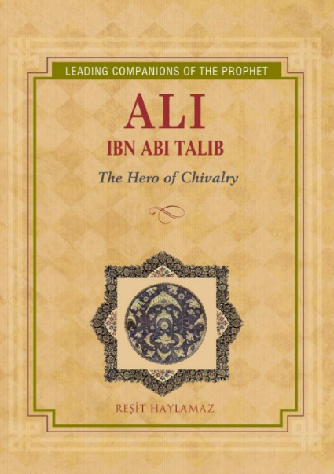
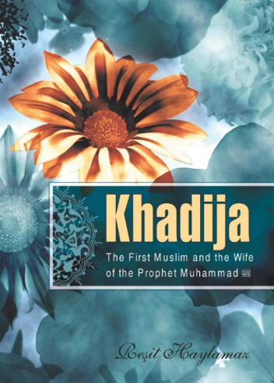
Seerah 4 (Upper-Intermediate Level)
Book Discussion
Each Month Read A Shabah’s (RA) Life
- Khulafai Rashidin (RAm)
- Khadija (RA)
- Aisha (RA)
- Zayd
- Bilal al-Habashi
…

Slide 39
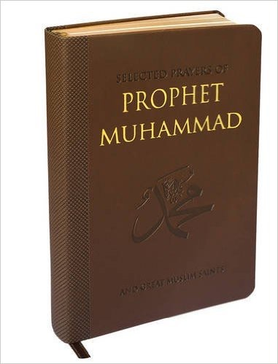
Tajwid and Memorization of The Qur’an 3 (Upper-Intermediate Level)
The Qur’an, Selected Prayers
Ta’lim
Practices on The Qur’an and Selected Supplications with The selected Chapters and memorization of the Selected Chapters and Prayers

Slide 40
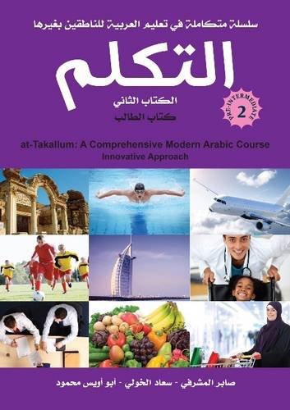
Arabic 3A (Upper-Intermediate Level)
At-Takallum (Comprehensive
Modern Arabic Course) Pre-Intermediate 1
Chapter 1-4
Recommended for between 160 hours
Pre-Elementary Level consist of :
- 1 Study book
1 work book and
2 audio CD’s

Slide 41
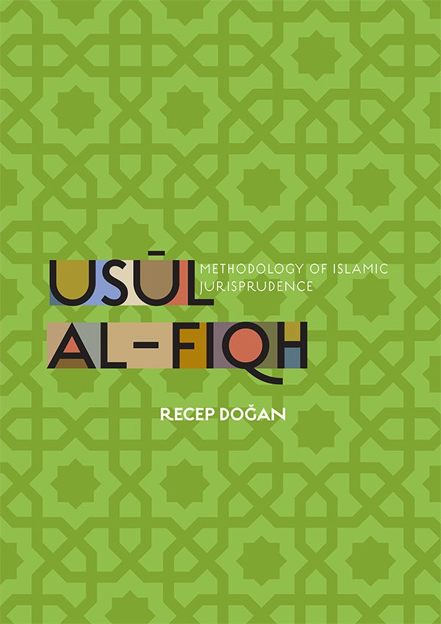
Usul al-Fiqh 1 (Upper - Intermediate Level)
Usul Al-Fiqh (Page 1-104)
Chapter I - Introduction Usul al-Fiqh
…
Chapter 2 - Kitab (The Qur’an)
…
Chapter 3 – Sunnah
…
Living In The Shade of Islam (201-307)
Chapter 7, 8, 9

Slide 42
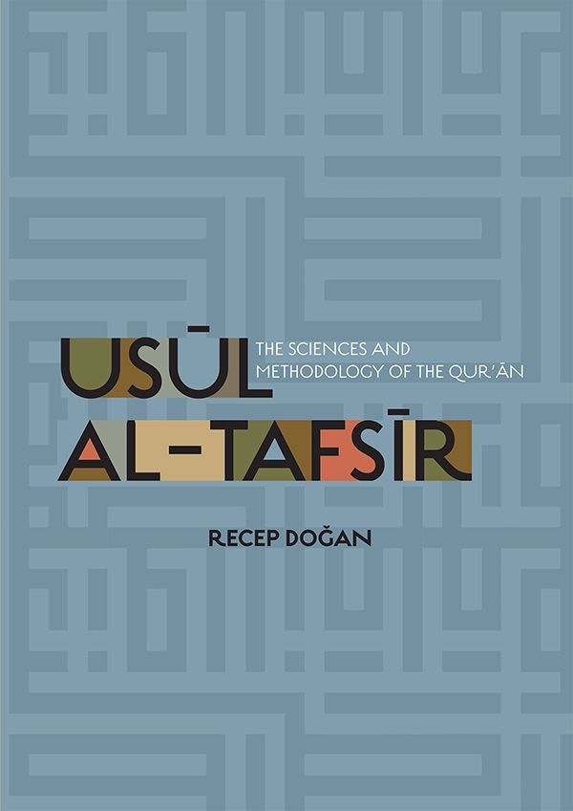
Usul al-Tafseer 1 – Tafsir Reading (Upper-Intermediate Level)
Usul Al-Tafsir (Page 1-197), Reflections on The Qur’an(reading)
Introduction to Methodology of Qur’anic exegises
-General topics of Ulum al-Qur’an
The Notion of Revelation (Wahy)
-Meaning of Revelation
-Forms of Revelation
Transmission of The Qur’anic Revelation
- Memorization…
- The Collection of The Quran during…
History of The Interpretaions of The Qur’an
…

Slide 43
Advanced 5th LEVEL

Slide 44
Aqaid al-Islam 4 (Islamic Creed) (UIntermediate Level)
Risale-I Nur Collection
The Letters, The Gleams
Selected Topics From Risale-i Nur Collection
- …

Slide 45
Tajwid and Memorization of The Qur’an (Upper-Intermediate Level)
The Qur’an, Selected Prayers
Ta’lim
Practices on The Qur’an and Selected Supplications with The selected Chapters and memorization of the Selected Chapters and Prayers

Slide 46
Arabic 3B (Elementary Level)
At-Takallum (Comprehensive
Modern Arabic Course) Pre-Intermediate 2
Chapter 5-8
Recommended for between 160 hours
Pre-Elementary Level consist of :
- 1 Study book
1 work book and
2 audio CD’s

Slide 47
Usul al-Fiqh 2 (Advanced Level)
Usul Al-Fiqh (Page 104-..)
Chapter 4 –
…

Slide 48
Usul al-Tafseer 2 – Reading A Riwayah Based Tafsir (Intermediate Level)
Usul Al-Tafsir (Page 197-End of The Book),
Tafsir Ibn Kathir

