Slide 1
Awaken to Presence Transform your life
Despair
Despair is the #1 enemy in our spiritual growth.
Do we have this feeling deep inside us?
How can we get rid of it?
workshop series

Slide 2
4 deep ailments of our psyche
I am independent from God
Despair
Self-admiration
Vanity
Mistrust

Slide 3
Getting rid of despair is easy, only if we want to! (intention)

Slide 4
…وَلَا تَيْأَسُوا مِن رَّوْحِ اللَّهِ ۖ إِنَّهُ لَا يَيْأَسُ مِن رَّوْحِ اللَّهِ إِلَّا الْقَوْمُ الْكَافِرُونَ
And do not lose hope of God's life-giving mercy: verily, none but people who deny the truth can ever lose hope of God's life-giving mercy.
(Quran 12:87)

Slide 5
What is the dictionary meaning of despair?
Dictionary:
to lose, give up, or be without hope

Slide 6
Satan’s name in the Quran is Iblis..
It comes from the root (b l s)
It means “he despaired”
Iblis means “the one that causes despair”

Slide 7
Change your thoughts through intention, change your life
The real cause of despair
Beliefs (Ingrained Thoughts)
Emotions
Actions
Intention
Motivational only

Slide 8
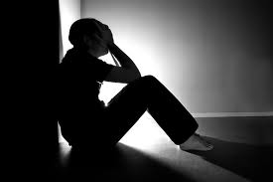
Is despair ingrained in me? (established ) (rooted)

Slide 9
We need to choose
God’s mercy encompasses everything
There’s no mercy, no purpose in creation
Reality
Illusion
If we can change this thought pattern (belief system), our emotions and actions will change automatically.

Slide 10
Background: I want everything to be as I please (with my limited mind) Reality: I didn’t create life, I can’t control it..
Illusion
There’s no mercy, no purpose in creation

Slide 11
My reaction: I don’t like the outcome I don’t care, I don’t want to think if there is a higher purpose in my life Conclusion: OK, fine, I am not playing this game!
Illusion
There’s no mercy, no purpose in creation

Slide 12
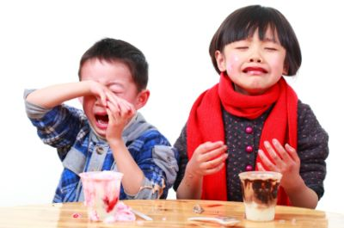
Kid #1 : “I want ice cream, Mommy.”
Kid #2 :“Ice cream is yummy. I wannit.”
Mom: “It is winter time. How about a yogurt?”

Slide 13
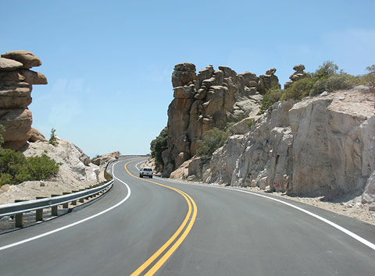
It is either my way, or
Illusion
There’s no mercy, no purpose in creation

Slide 14
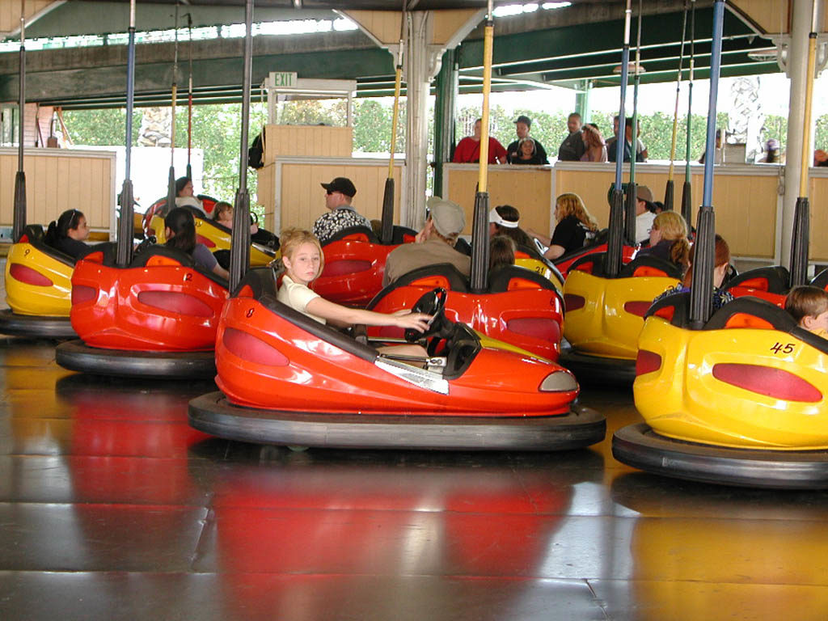
There’s no purpose and no plan in creation.. It’s all chance
Illusion
There’s no mercy, no purpose in creation

Slide 15
Outcome:
I am very lonely
No one cares for me
There is no way out
It is all finished
Life is painful
God hates me!
pessimistic
gloomy
spread negativity
Illusion
There’s no mercy, no purpose in creation

Slide 16
Destroys every possibility of becoming better, we’re doomed end of story!
Outcome in action:
reduced positive energy
inability to act positively (nothing will change! there’s no point, don’t waste your time!)
anger and resentment
Illusion
There’s no mercy, no purpose in creation

Slide 17
Let’s say you want to become a better person, and you think that you are not doing enough to reach to your goal…

Slide 18
Let’s say you want the world to be a better place, and you think that you don’t have ability to change it…

Slide 19
Let’s say you want to come closer to God, and you think that you are not doing enough to reach to your goal…

Slide 20
We feel disheartened.
That’s normal, but what can we do with this feeling?
There are two possibilities, and we are to make the choice…

Slide 21
When we “think/believe” we are by ourselves and there is nobody to help us…
First, we might start to doubt such a possibility to feel closer to the Divine, looking for any small argument we might find around.

Slide 22
We hear a friend belittling it, and we feel strength to do the same.
Or we might just say that this is a difficult age, and this is not possible anymore; friends of God lived in the old days; it was possible, then, not anymore!

Slide 23
Once we confirm your illusion through any of these arguments, without even questioning the truth in them, we come to the conclusion:
it is impossible to experience Divine Presence!
We’re basically doomed!

Slide 24
This is the heart of despair, since you have just shut all the doors for such a possibility.
Despair means I am by myself, and no one can help me out…
There’s no need to do any action, nothing will work!

Slide 25
How did we get there?
We thought we are by ourselves and no one can help us!
We looked for any argument that would support our belief
We decided it is impossible!
We are done!
We’re now wired for despair for that specific issue…

Slide 26
Solution
Make an intention to change your deeply ingrained thought…

Slide 27
Choose your way…
God’s mercy encompasses everything
There’s no mercy, no purpose in creation
Reality
Illusion

Slide 28
How?
قُلْ يَا عِبَادِيَ الَّذِينَ أَسْرَفُوا عَلَىٰ أَنفُسِهِمْ لَا تَقْنَطُوا مِن رَّحْمَةِ اللَّهِ ۚ إِنَّ اللَّهَ يَغْفِرُ الذُّنُوبَ جَمِيعًا ۚ إِنَّهُ هُوَ الْغَفُورُ الرَّحِيمُ
Say: “[Thus speaks God:] ‘O you servants of Mine who have transgressed against your own selves!
Despair not of God’s mercy:
behold, God forgives all sins –
for, verily, He alone is much-forgiving, a dispenser of grace!’”
(Quran 39:53)

Slide 29
By falling into despair through our choice to follow our illusions, we have only wronged ourselves!
What’s the way out?
Even if we really think we are not doing enough, what should we do?

Slide 30
How can we get out?
“My loving mercy has encompassed every thing.” (Quran 7:56)
even me..
even my sins..
even all my worries..
It is all, alright!
We look for arguments that would support our new belief!
The whole creation is witness to God’s all encompassing mercy…

Slide 31
Reality
God’s mercy encompasses everything
Background:
I want everything to be as I please (with my limited mind)
My reaction:
The infinite compassionate mind must be on to something better

Slide 32
Now,
We feel our weakness (yes, weakness) and helplessness to reach our goal.
But we don’t feel bad..
Because we know someone is there to help!
Someone will show be a better way!
We throw ourselves to the Loving Compassionate with our weakness as our envoy to Him…
We feel we’re taken care of..
We feel hope..
We are done!
We’re now wired for hope…

Slide 33
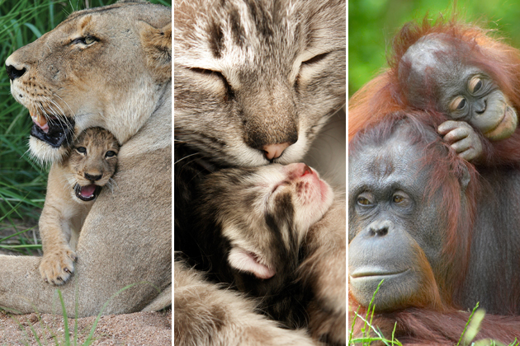
The baby knows and experience her loving mother when she throw herself with her neediness to her…

Slide 34
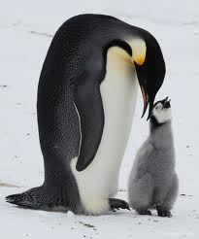
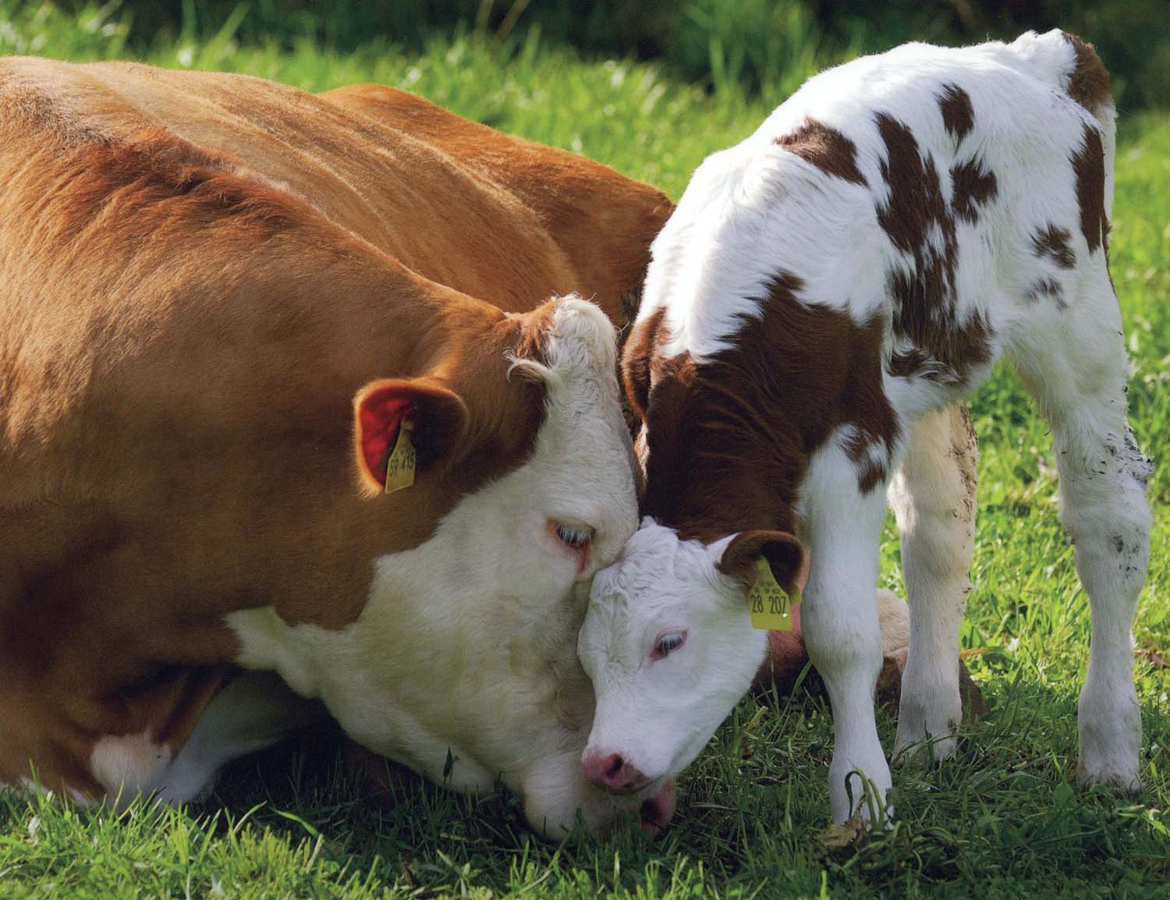
The same way, we can experience the Loving Compassionate, the Source of the Love all the mothers, only if we feel our neediness to Him.
When we surrender and throw our selves like a baby to Him, we find the one who dispenses of grace…

Slide 35
Recognizing our helplessness and rushing to the Loving womb of the Compassionate prevents us from falling into despair.
When we feel our weaknesses, inabilities, and mistakes, instead of feeling despair, we can now rush to the one who helps the helpless.
Isn’t Divine Presence what we were looking for? Here it is.. Hidden in our weakness, hidden in our tears…

Slide 36
Calling out to the Divine with our weakness is the most empowering and transforming act:
“O my Sustainer, I am powerless and helpless!
And you are the Powerful Compassionate!
Help me, hold my hands and heart, I am in dire need of you!”

Slide 37
Beliefs (Ingrained Thoughts)
Emotions
Actions
Intention
I intend to look for alternative, for a better explanation, to look for the Source
God’s mercy encompasses everything.
God loves me! He takes care of me.
Hope
Inner Peace
Worry-free energy to solve my problems
Become agent of Hope
Even if I did it wrong, I can try again!
Excitement

Slide 38
Having hope is finding God…
The Prophet (p) said, “God the Most High said, ‘I am as My servant thinks (expects) I am…”

Slide 39
Losing hope is loosing God…
Losing hope is killing determination…
Losing hope is killing love…
Losing hope is loosing the ability to forgive…
Losing hope is loosing our happiness…
Losing hope is dying spiritually…
Despair is the cancer of the society
And do not lose hope of God's life-giving mercy: verily, none but people who deny the truth can ever lose hope of God's life-giving mercy.
(Quran 12:87)

Slide 40
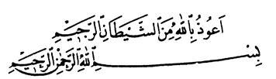
Easy Reminder…
I seek refuge in God from Satan, the accursed (Despair)
In the name of God, the Compassionate, the Loving

Slide 41
If you don’t have wings to fly to the Ka’ba of Grace,
Show your powerlessness and helplessness to the Reliever.
Cries and groans are a powerful means,
And they are filled with the All-Merciful, Compassionate nurse.
The nurse and the mother keep waiting their child’s crying to feed.
In you too has God created infant needs;
So that milk is brought to them, when they cry out;
God said, “Call on me;”
Keep on crying and groaning,
So that the milk of Love and Compassion may overflow!
-Rumi

Slide 42
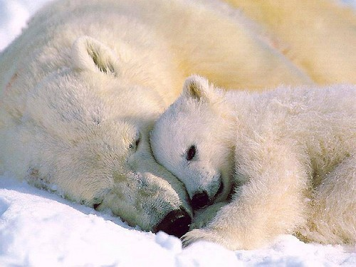
How is despair destroying our lives?
work, marriage, spirituality, happiness, friendships…
any activity we are about to do…

