Slide 1
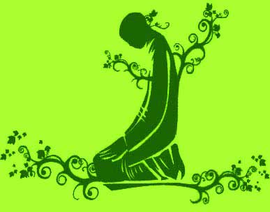
The Fourth Word
The Value of the Prescribed Prayers

Slide 2
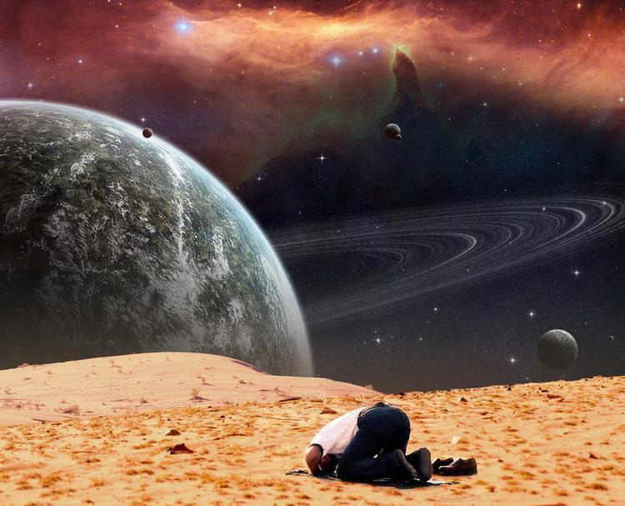
In the Name
of God, the Merciful, the
compassionate. The prescribed prayers (salat) are the pillar of religion.
TirmidhI, Iman, 8; Ibn Maja, Fitan, 12; Musnad, v, 231; al-Hakim, al-Mustadrak, ii, 76

Slide 3
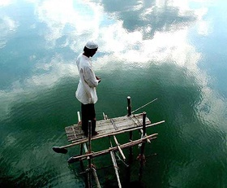
If you want to understand the value and importance of the prescribed prayers (salat), and how they are gained with little expense,
and how crazy and harmful is the person who neglects them, pay attention to the following story which is in the form of a comparison and allegory.

Slide 4
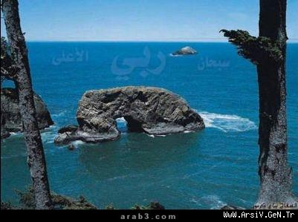
It employs comparison in a way that makes clear even the most obscure questions.

Slide 5
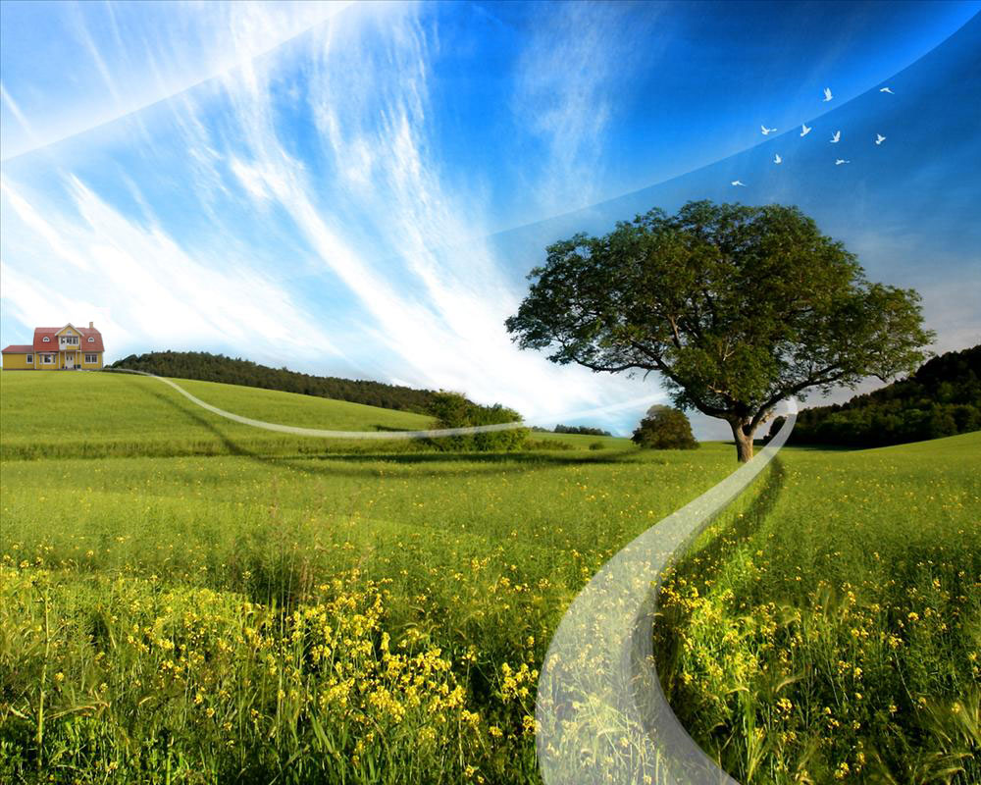
One time, a ruler gave each of two of his servants 24 gold coins and sent them to settle on one of his beautiful farms two months‘ distance away.

Slide 6
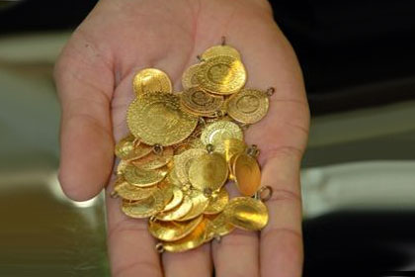
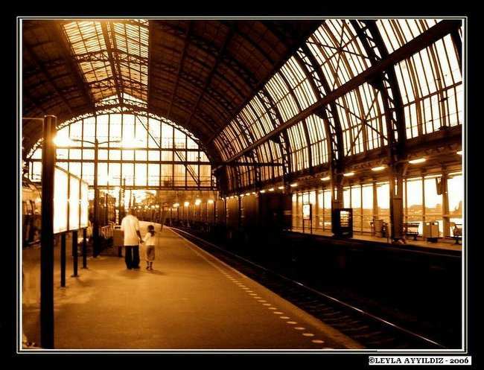
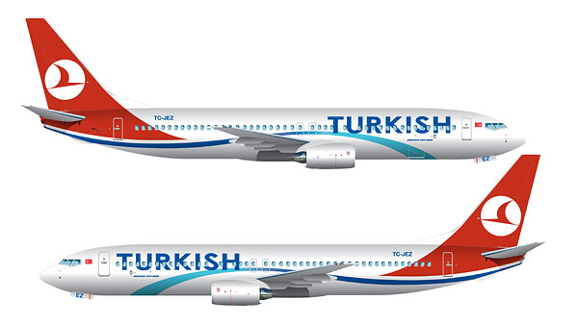
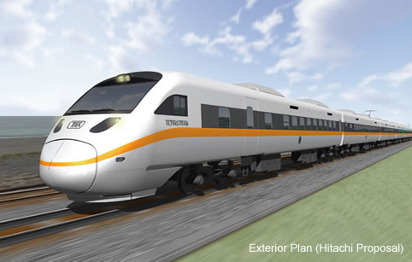
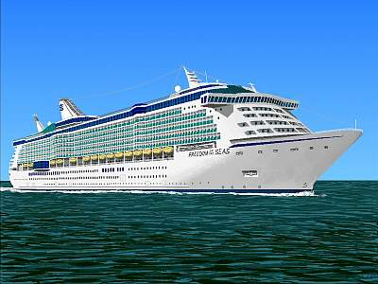
He commanded them “Use this money for your tickets and buy whatever is necessary for your house.
There is a station one day's distance from here.
You will find there both bus, train, ship and plane. You can use one of them according to your money.”

Slide 7
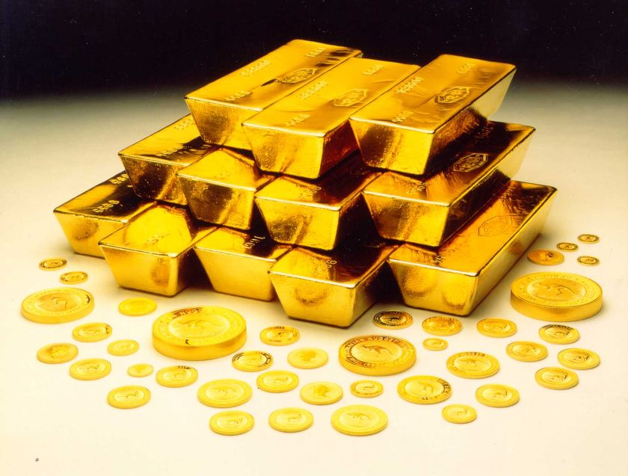
The two servants set off after receiving these instructions.
One of them was fortunate so that he spent a small amount of money on the way to the station for some profitable trade, so his capital increased a thousand fold.

Slide 8
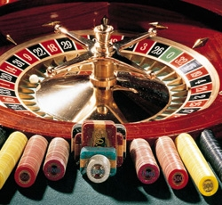
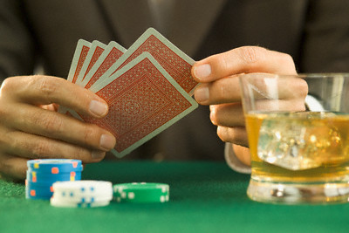
The other servant spent 23 of the 24 gold coins on the way to the station, wasting them on gambling and amusements.

Slide 9
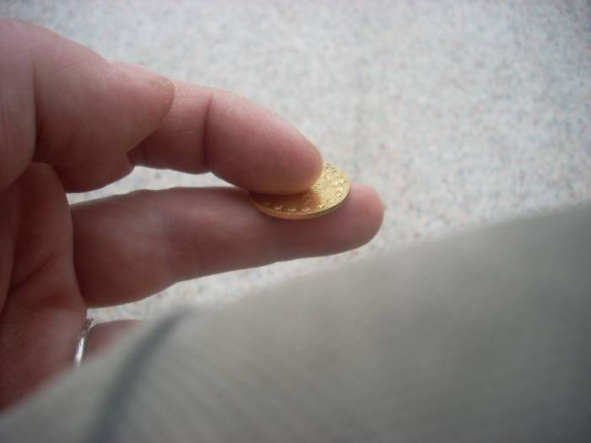
A single gold coin remained.

Slide 10
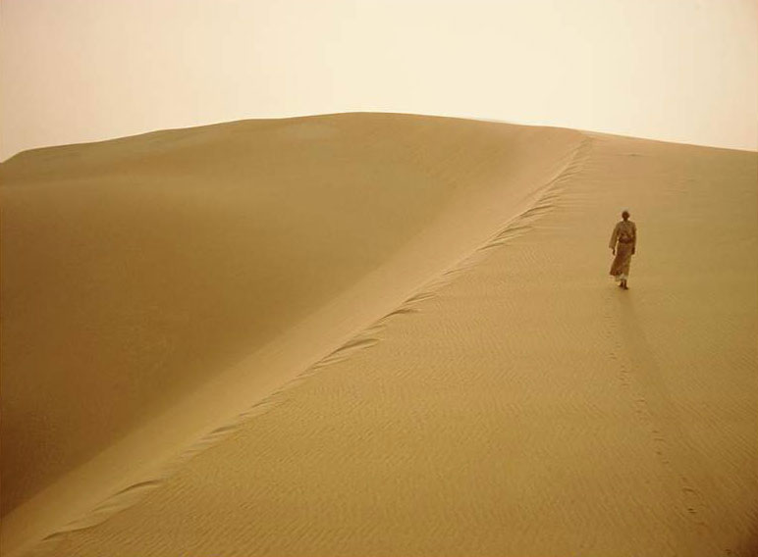
His friend said to him: "Spend this last gold coin to buy a ticket so that you will not have to walk the long journey and starve. Moreover, our master is generous; perhaps he will forgive you for your faults, and put you on a plane. Then we shall reach our destination in one day. Otherwise you will be compelled to walk across a desert, hungry and alone, for two months."

Slide 11
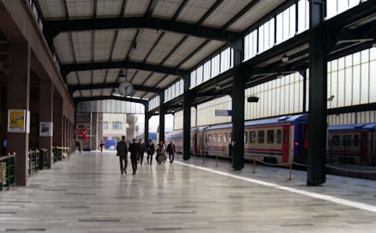
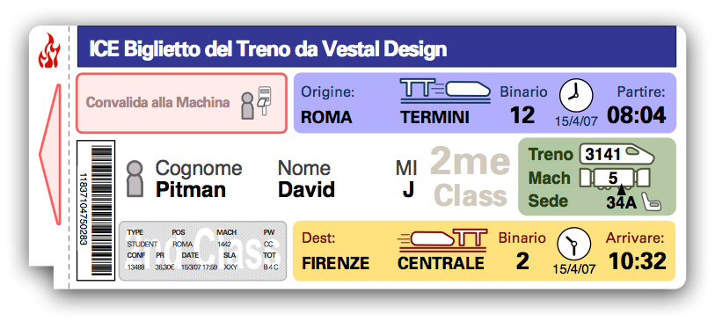
What will happen if this stubborn man does not spend that single gold coin to buy a ticket, which is like the key to a treasury and instead spends it for passing pleasures? Will not the most senseless person realize how foolish and senseless this man is ?
UNKNOWN
WORLD
EVERYBODY
HEREAFTER

Slide 12
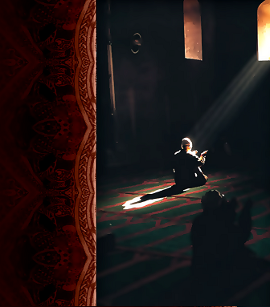
The realities of this story are as follows:
O you who do not perform the prescribed prayers!
And O my own soul, which does not like to pray!

Slide 13
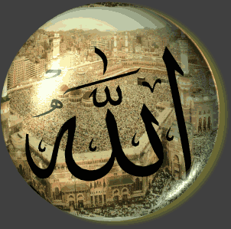
The ruler in the comparison is
our Sustainer, our Creator

Slide 14
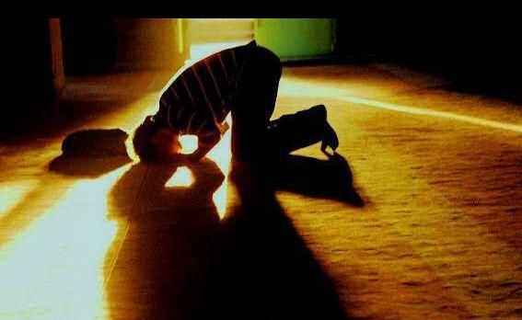
One servant represents
the devout, who perform their prayers with fervor,

Slide 15
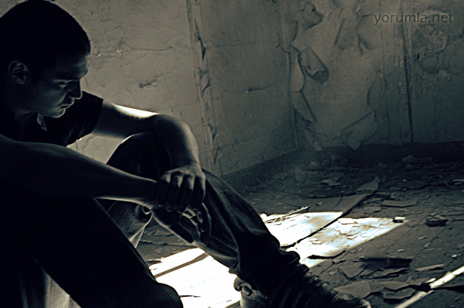
The other servant represents
the heedless who neglect
their prayers.

Slide 16
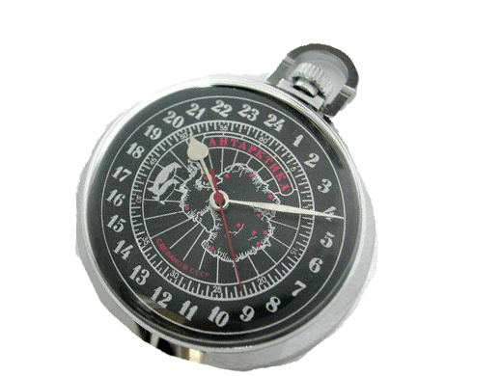
The 24 gold coins are
24 hours of a day

Slide 17
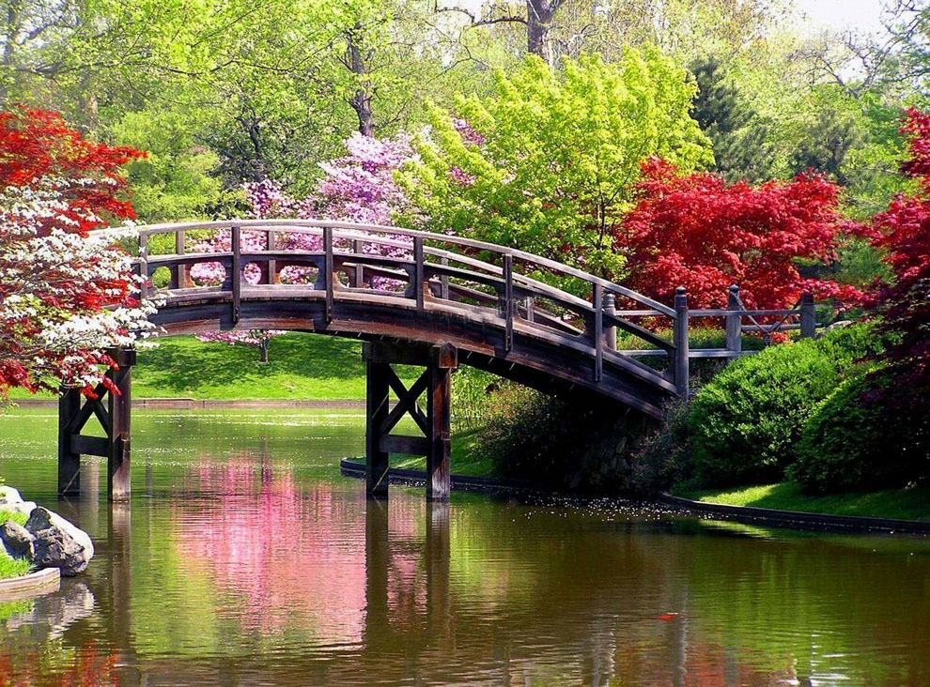
The farm is
Paradise.

Slide 18
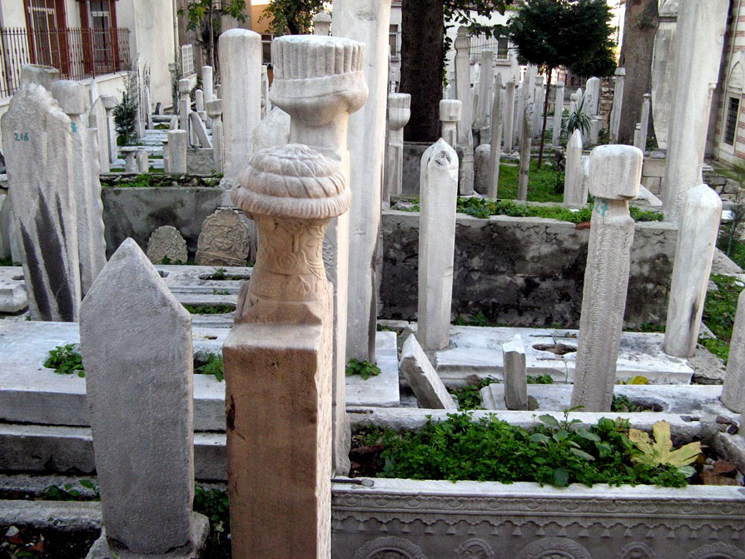
The station is
the grave.

Slide 19
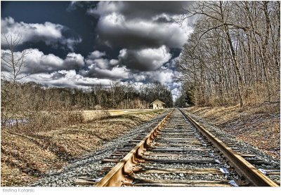
The journey is
man’s journey passing through the grave, the Resurrection, and the Hereafter.

Slide 20
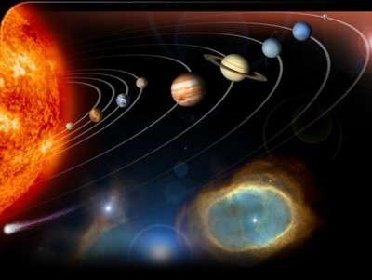
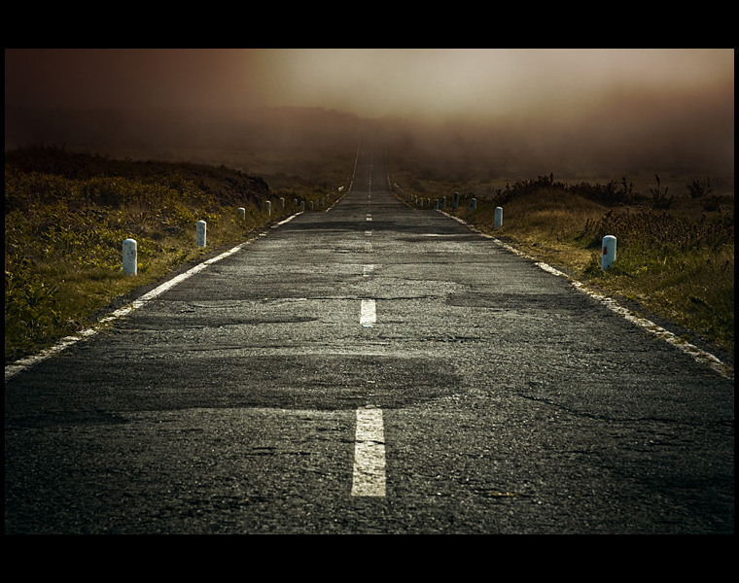
People cover that long journey to different degrees according to their good and bad actions. Some of the truly devout cross a thousand year distance in a day, like lightening. And some traverse a fifty-thousand year distance in a day, at the speed of imagination. The Qur'an alludes to this truth in two of its verses.2
2. (Quran 22:47 and 70:4)

Slide 21
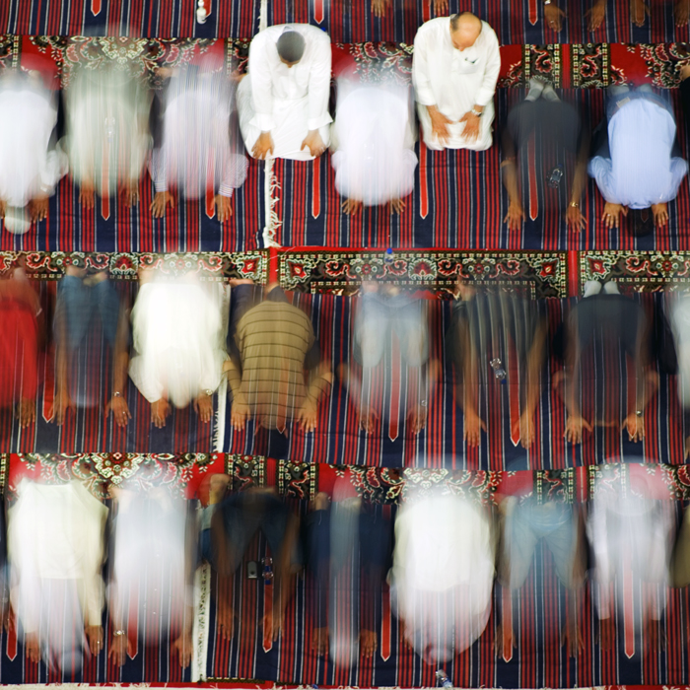
The ticket in the comparison represents
UNKNOWN
WORLD
EVERYBODY
HEREAFTER
the prescribed prayers.

Slide 22
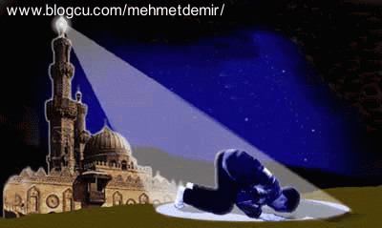
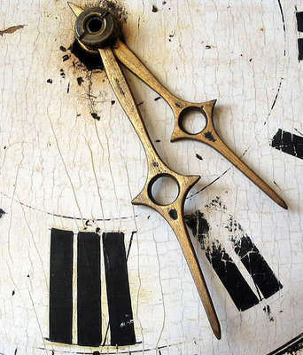
That is to say, a single hour in a day is sufficient for the five prayers together with taking ablutions. (i.e. preparing for salat by washing the hands, face, feet etc.)

Slide 23
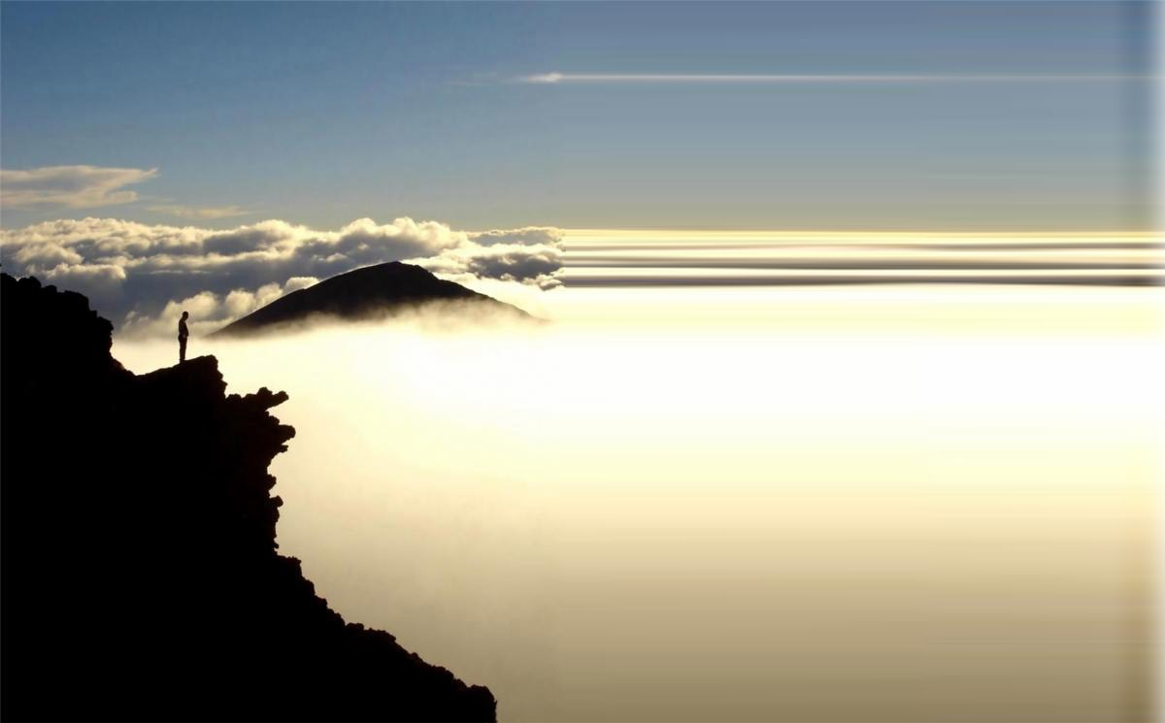
If a person spends 23 hours on this fleeting worldly life, and fails to spend one hour on the long life of the Hereafter (i.e. for the prescribed prayers); how unreasonably he behaves.

Slide 24
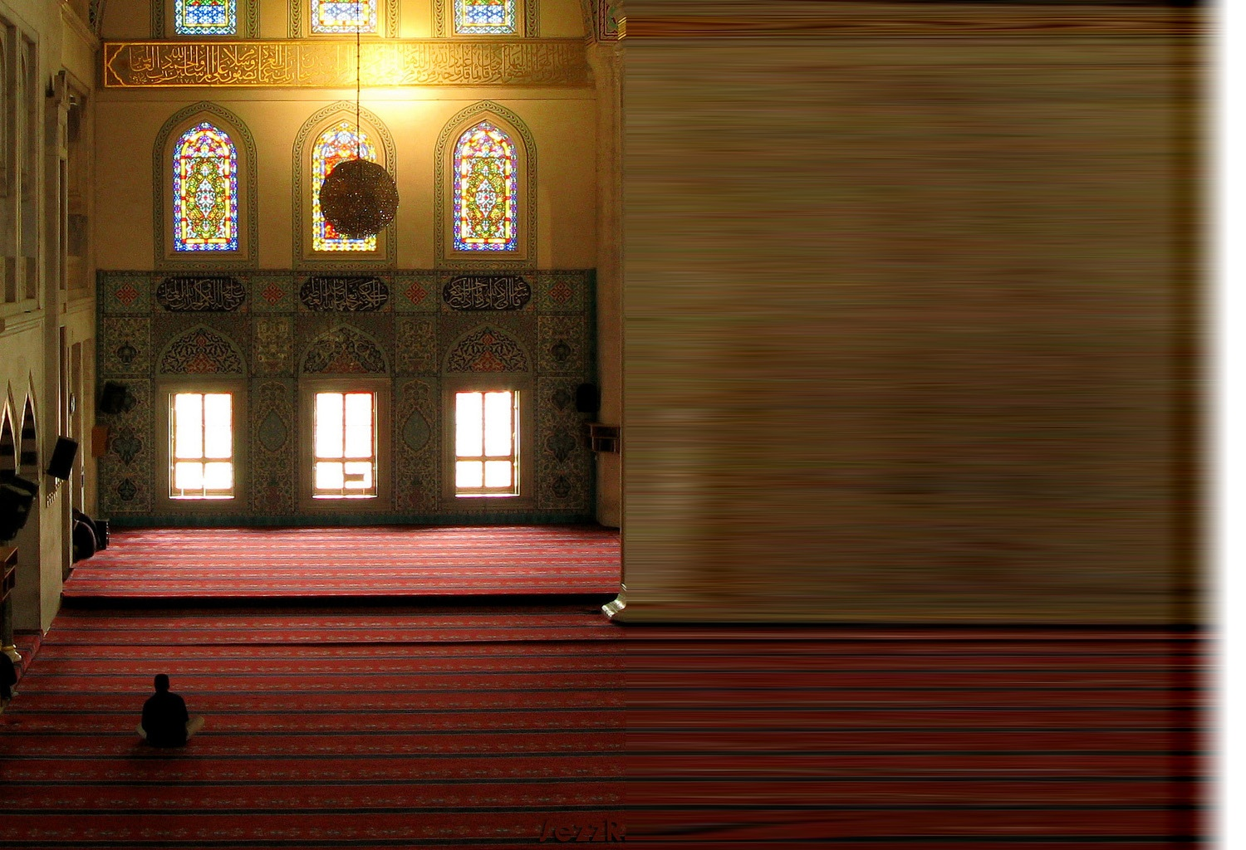
Moreover, the spirit, the heart, and the mind find great pleasure in prayer. And it is not trying for the body
Furthermore, the right intention transforms all the other non evil acts of someone who performs the prescribed prayers into worship.
Thus He can change the whole capital of his life into property of the Hereafter in this way. He can make his transient life permanent in one respect…

Slide 25
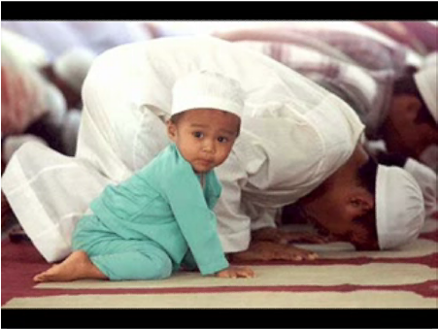
KADDER
This presentation was compiled from Words Book of Risale-i Nur Collection.

