Slide 1
Ramadan Mubarak

Slide 2
Fasting
Over 1 billion Muslims all over the globe
from Dawn to Sunset (5.40 am till 8.05 pm)
Eating, drinking and sexual relationship
for 30 days
Zakat - % 2.5 of the yearly income and the extra wealth of the moment
Ramadan Feast
Fitir - thanksgiving charity

Slide 3
Why?
“O you believe! Prescribed for you is the Fast, as it was prescribed for those before you, so that you may deserve God’s protection (against the temptations of your carnal soul) and attain piety.” (2/183)
Following the footprints of Prophet Muhammad (pbuh)

Slide 4
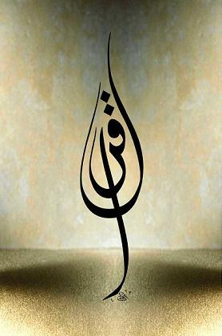
Why in Ramadan?
“The month of Ramadan (is the month) in which the Qur’an was sent down as guidance for people and as clear truths of the guidance and Criterion (between truth and falsehood). Therefore whoever of you is present this month must fast it,

Slide 5
Why in Ramadan?
and whoever is so ill that he cannot fast or on a journey (must fast the same) number of other days. God will ease for you and He does not will hardship for you, so that you can complete the number of the days required and exalt God for He has guided you and so it may be that you will give thanks “ (2/185)

Slide 6
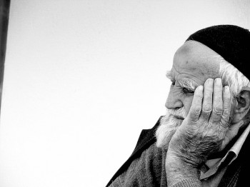
Thanking by fasting
Freedom of bodily desires
Contemplating
Realizing your own impotence
Realizing God’s bounties and His mercy
Gratitude

Slide 7
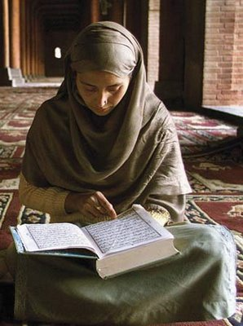
Qur’an.. guidance for humankind
“Read in and with the Name of your Lord, Who has created” (96/1)
Laylatu’l-Qadr
Individual and communal reading during the day (20 pages)

Slide 8
Ramadan & Understanding Qur’an
“O you believe! Prescribed for you is the Fast, as it was prescribed for those before you, so that you may deserve God’s protection (against the temptations of your carnal soul) and attain piety.” (2/183)
“Alif. Lam. Mim. This is the (most honored, matchless) Book; there is no doubt about it. A perfect guidance for the God-revering, pious, who keep their duty to God.” (2/1-2)

Slide 9
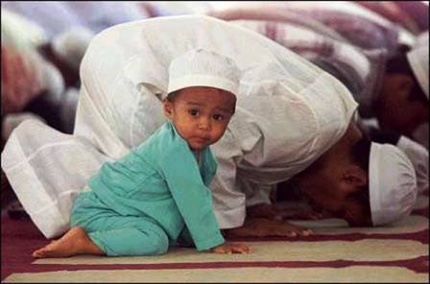
Tarawih Prayer
Rest
20 circles and 1 page in each circle
Last about 2 hours
Voluntary
Individually or in congregation

Slide 10
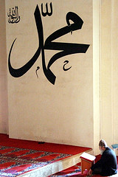
Muhammad (pbuh)
Allahumme salli ala seyyidina Muhammedin an-Nabiyyi al-Ummiyyi ve ala âlihi ve sahbihi ve sellim

Slide 11
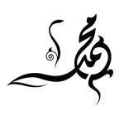
Whoever fasts in Ramadan by believing in its virtue and expecting its reward from God his all previous sins are forgiven.
Prophet Muhammad

