Slide 1
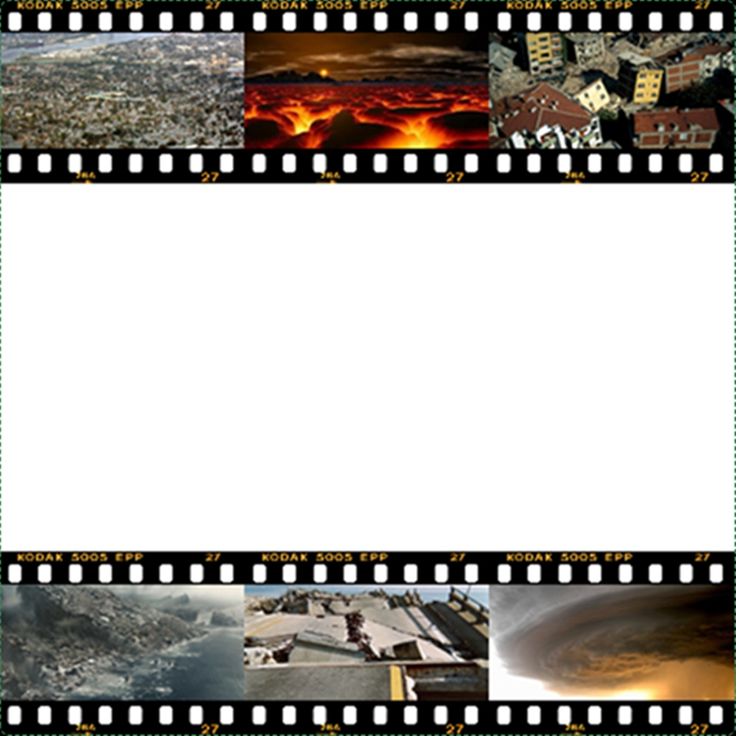
Natural Disasters
This presentation was based on addendum of the fourteen word; part of the Risale-i Nur Collection written by the late scholar
Bediuzzaman Said Nursi

Slide 2
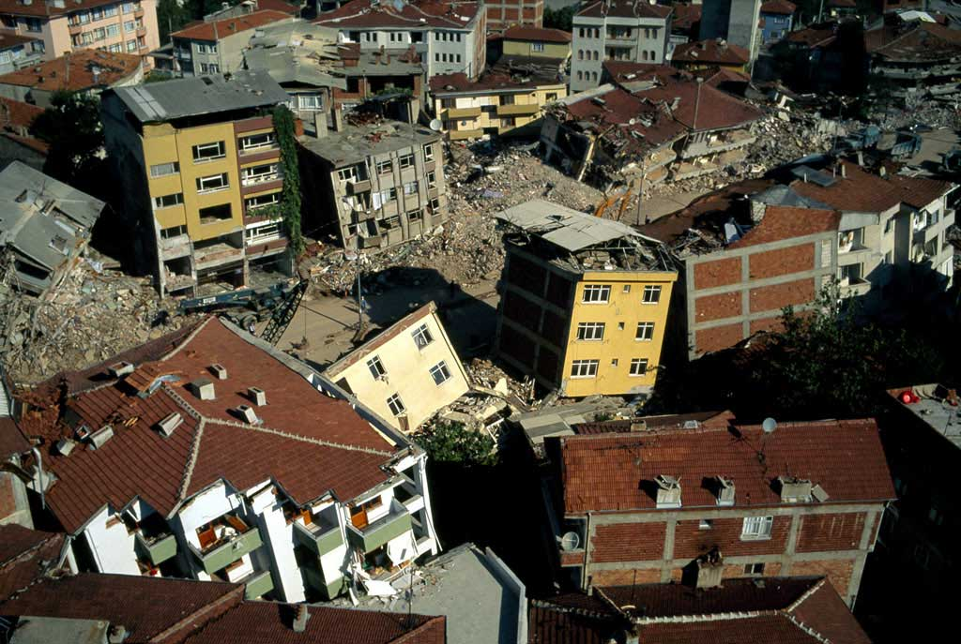
First Question: Earthquakes may strike at any time and cause considerable loss of life and property. So people experience anxiety as a result of earthquakes. What is the reason for such disasters?

Slide 3
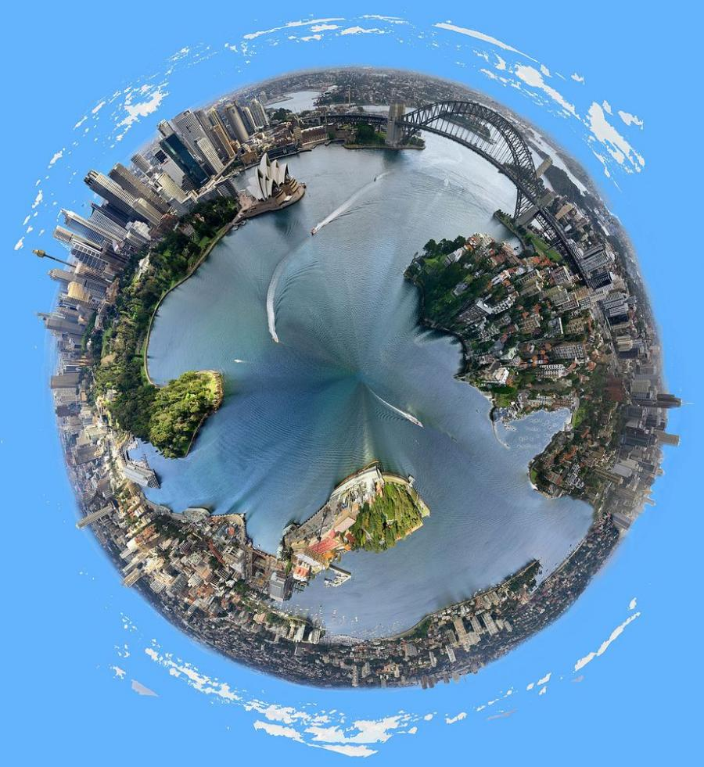
The Answer: Firstly; natural disasters should be viewed from the perspective that
God is
All-loving,
All-Knowing,
All-Powerful,
All-Wise,
And
The Most Compassionate.
Also, the world is a testing ground and the eternal bliss is in the hereafter.

Slide 4
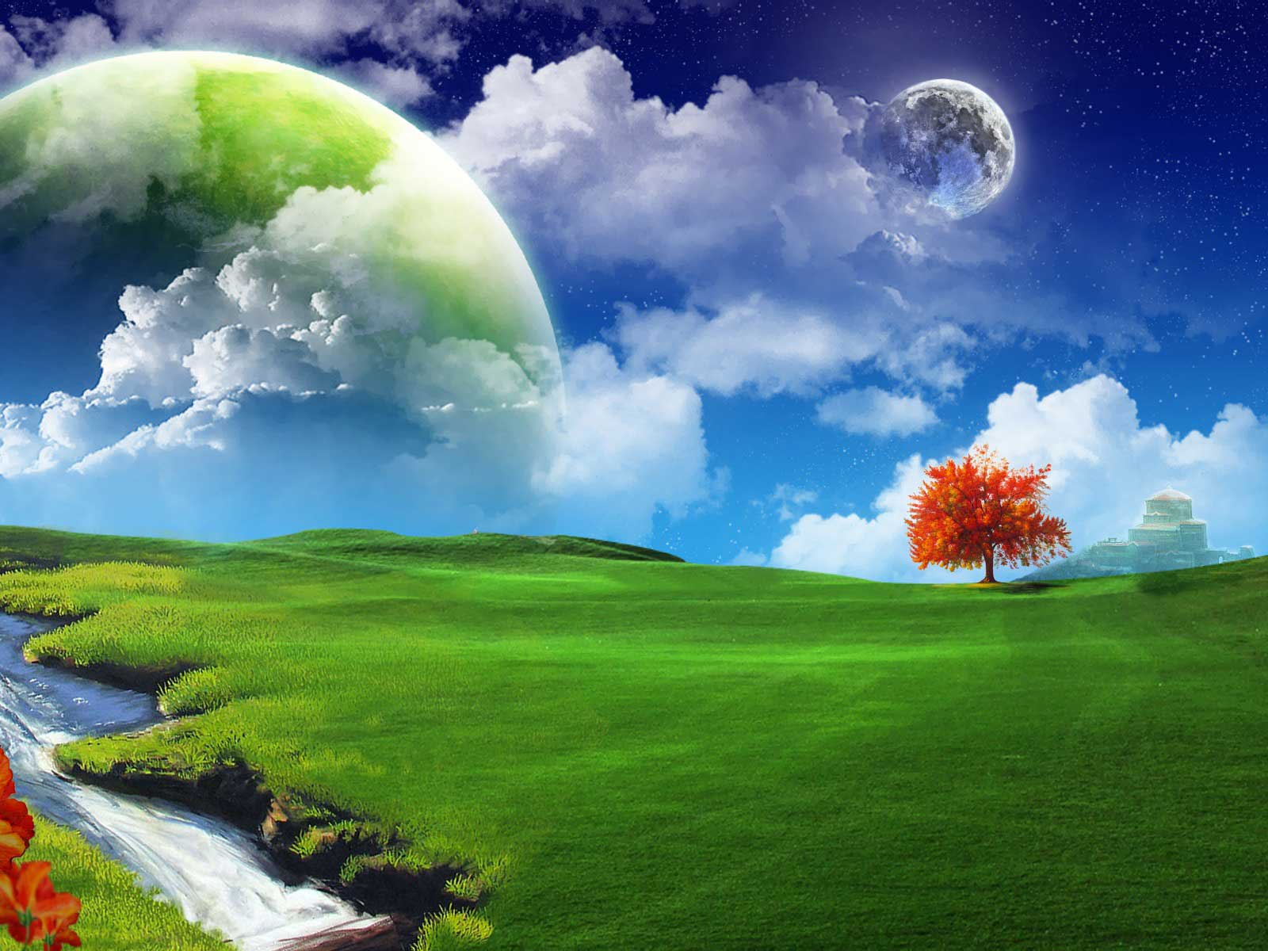
Therefore, nothing can happen without the knowledge of God and there is divine wisdom in whatever happens.

Slide 5
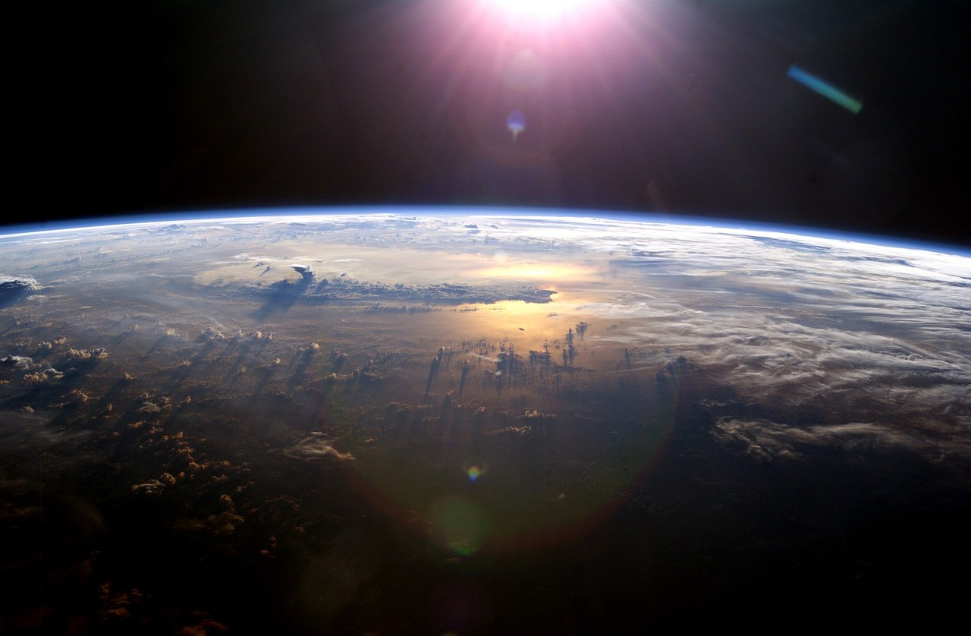
With this understanding, the believers should trust God, submit to the will of God, and never doubt the love of God even during the times of calamities.

Slide 6
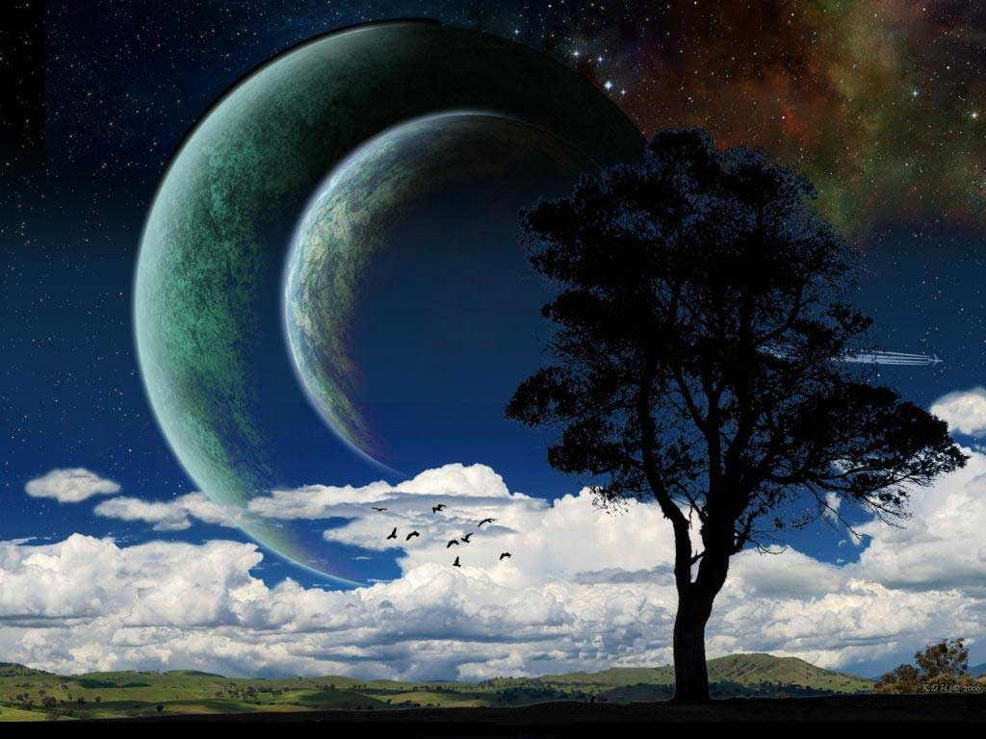
There are many instances of wisdom and mercy behind such disasters.

Slide 7
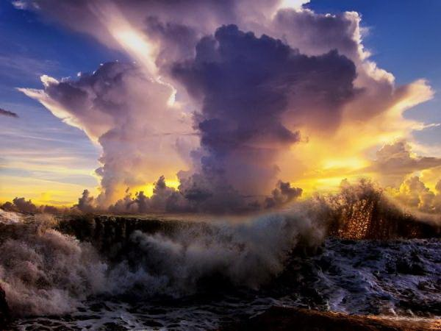
“The reins of all things that are hostile to you, from microbes to epidemics, storms, famine and earthquakes, are in the hands of God. He does nothing in vain. There is a form of grace and favour contained in everything He does.”

Slide 8
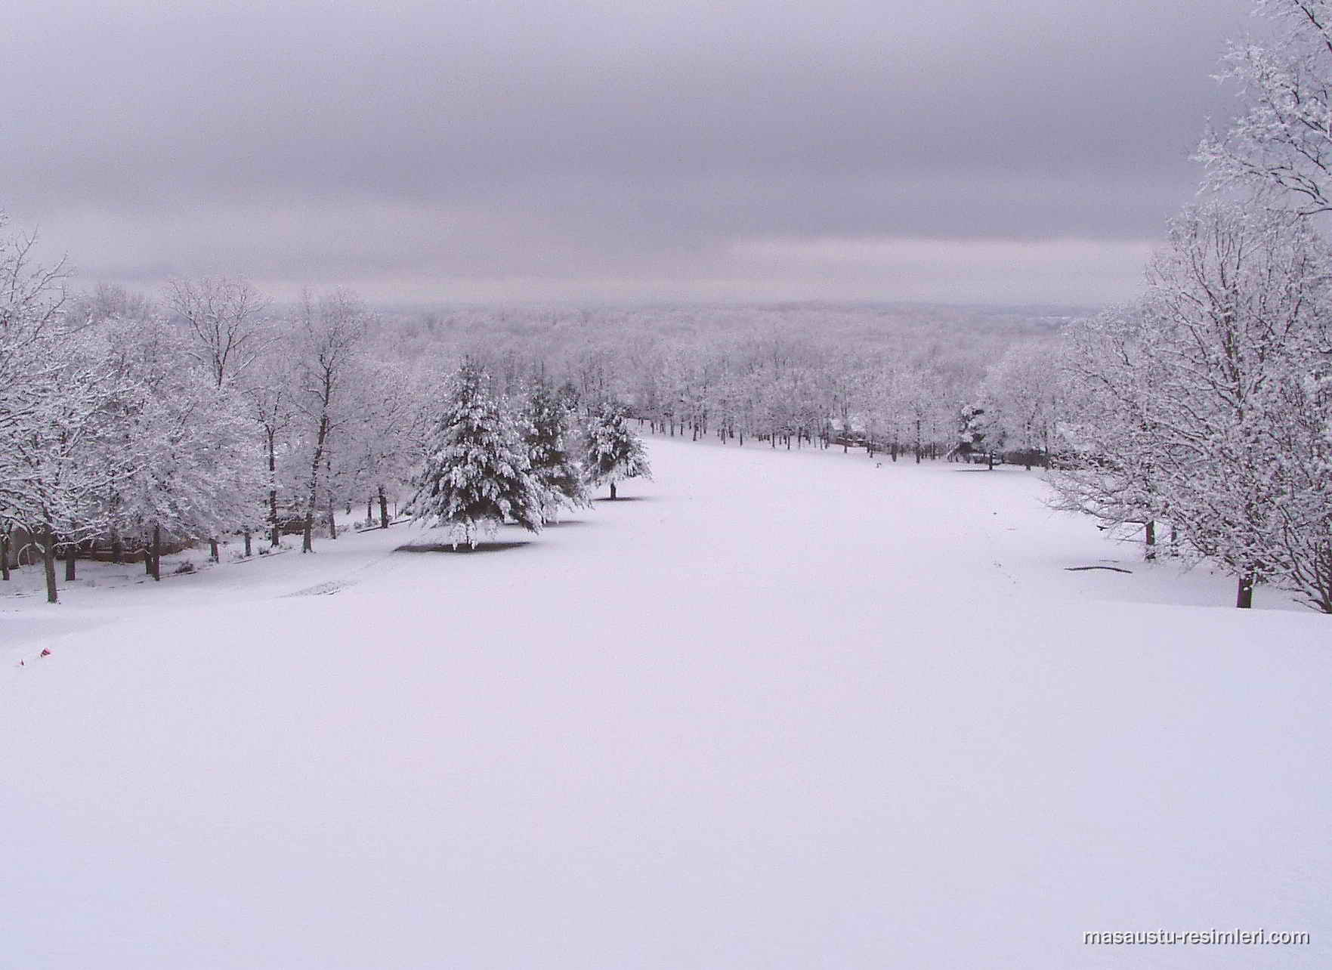
For example, some consider snow to be very cold and uninviting, but under that cold, unpleasing situation there are so many good, hidden results.

Slide 9
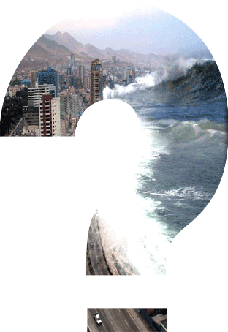
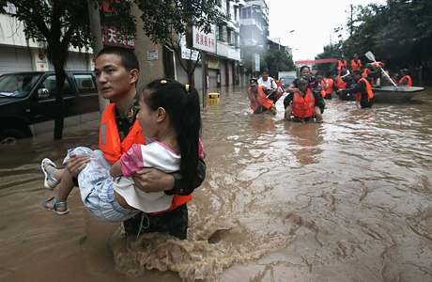
Second Question: : Such disasters are regarded to be punishment for sins. If so, why are the innocent also punished for the sins of a few? Not only evildoers, but everyone suffers in a natural disaster.

Slide 10
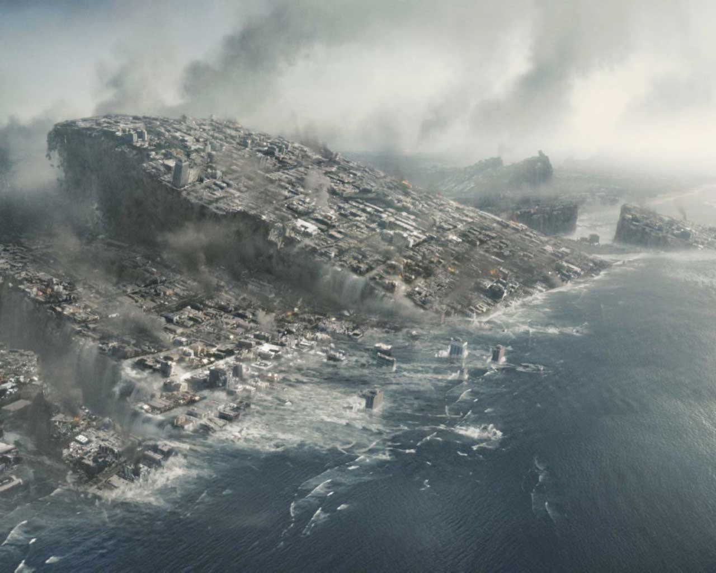
The Answer: Allah says: And fear tumult or oppression, which affects not in particular [only] those of you who do wrong. (Qur’an 8:25)

Slide 11
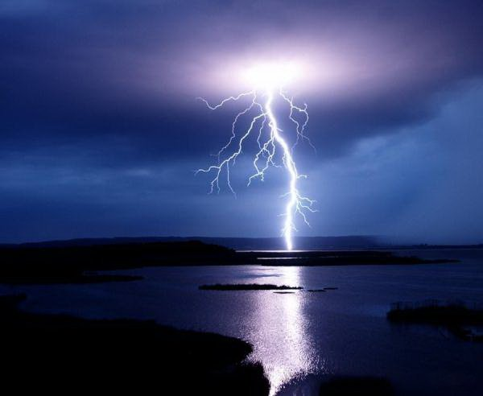
That is, beware of calamity or disaster which, when it occurs is not restricted to wrongdoers, but strikes the innocent as well.

Slide 12
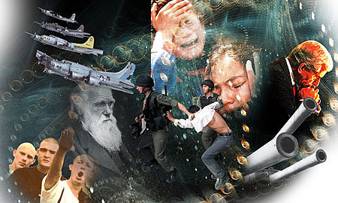
The general disaster results from the wrongdoing of the majority; on the other hand most people participate in the actions of wrongdoers by supporting them either actively or morally or another way.

Slide 13
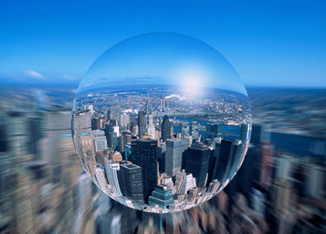
The meaning of the above verse is as follows: this world is a field of trial and examination, and a place of striving where man is responsible for his actions.

Slide 14
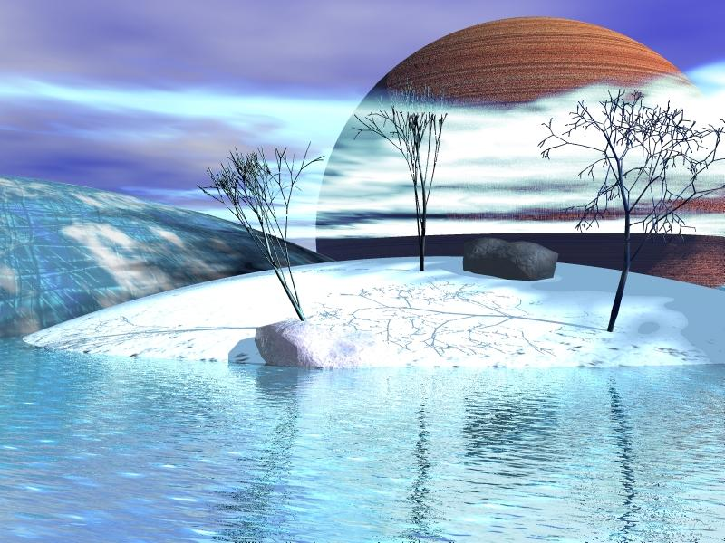
If in the case of disaster the innocent were saved while the guilty were punished, then to avoid worldly destruction evildoers would want to believe in and obey God. In this way the door of spiritual and moral progress through striving would be closed and the mystery of responsibility spoiled.

Slide 15
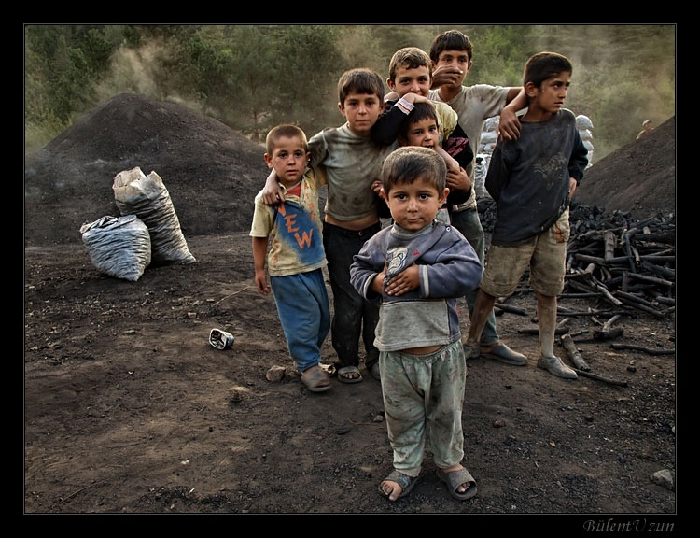
Third question: Since the oppressed and oppressor are all afflicted by disasters, what is God’s mercy and justice for the oppressed?

Slide 16
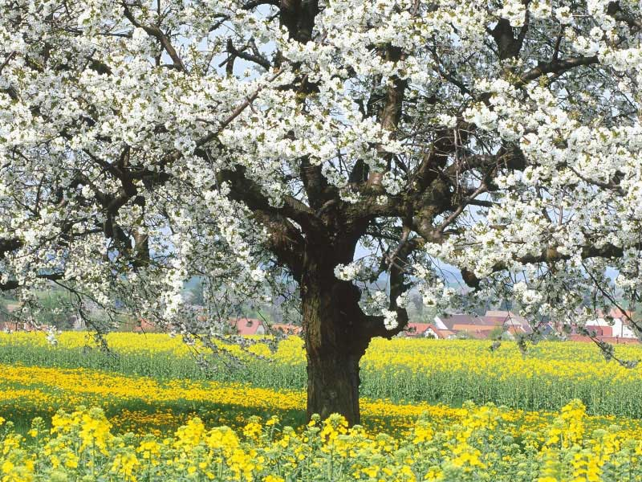
The Answer: For them there is a manifestation of mercy within the wrath and anger in the disaster. For, the property and livelihood of the oppressed become like alms and gain permanence, difficulty and torment is a form of martyrdom for them, and patiently endured suffering becomes equivalent to worship of God.

Slide 17
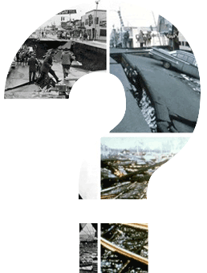
Fourth Question: Why does God not give a particular punishment for particular sins, and not prevent an earthquake or similar natural disaster from happening before such widespread destruction occurs? How is this in keeping with His mercy?

Slide 18
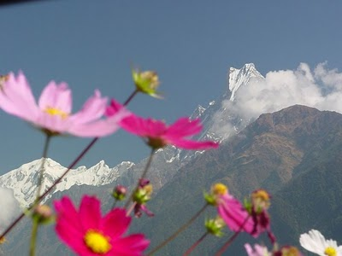
The Answer: God gives numerous duties to each element and each duty has numerous different results. If one result of an element’s duties is ugly or evil, the other good results also make this result good.

Slide 19
If the element is prevented from carrying out its duties, so that the single ugly result (i.e. a disaster) will not occur,
then many good results will also be abandoned, since not doing a good thing is considered evil.
Energy
Water
Clean Air
Life
Flood
Photosynthesis
Rain

Slide 20
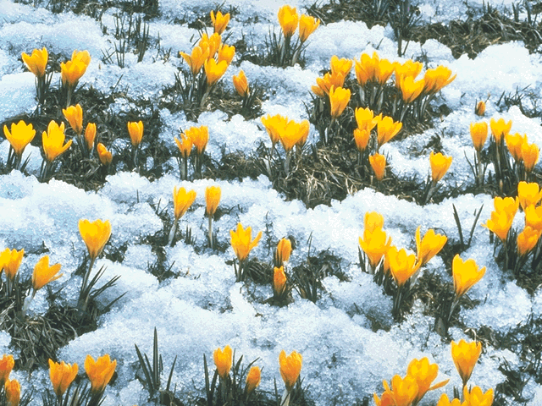
For example, “in autumn, appealing small animals and beautiful flowers are harshly destroyed and separated so as to preserve them from the blows and torments of winter and to prepare conditions for their reemergence as the new and beautiful creatures of next spring”.

Slide 21
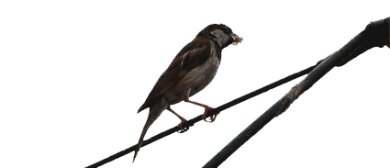
For example, hawk's attacking sparrows is apparently incompatible with mercy, but through this attacking, the sparrow’s abilities develop.

Slide 22
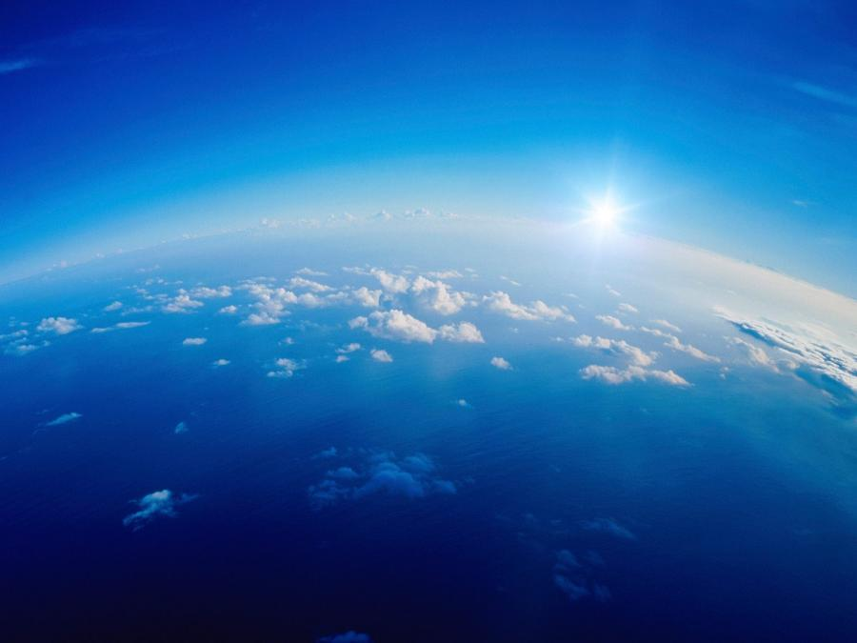
A disaster like an earthquake, while it causes serious destruction, also produces positive results in keeping with Divine providence, such as testing people’s faith, rewarding faithful believers to the status of martyrs, and serving as a beneficial warning to oppressors.

Slide 23
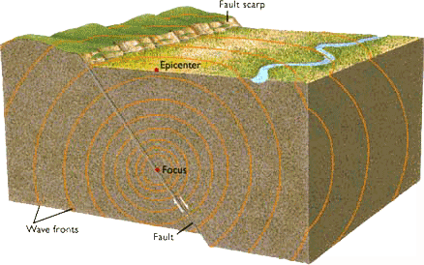
Fifth Question: Some people hold that earthquakes are solely the result of faults in the rock strata (i.e. layers of rock) inside the earth or tectonic plates sliding against each other. For them, the universe consists of matter, and disasters are entirely due to an unfortunate combination of material factors.

Slide 24
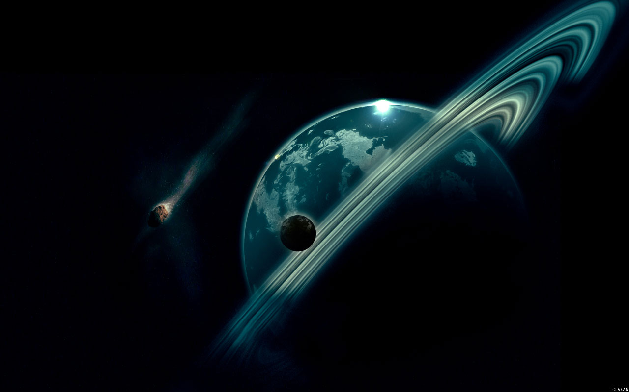
The Answer: The order of universe and wonderful complexity of creation shows that not even the tiniest element of the cosmos can be outside the control of the Creator.

Slide 25
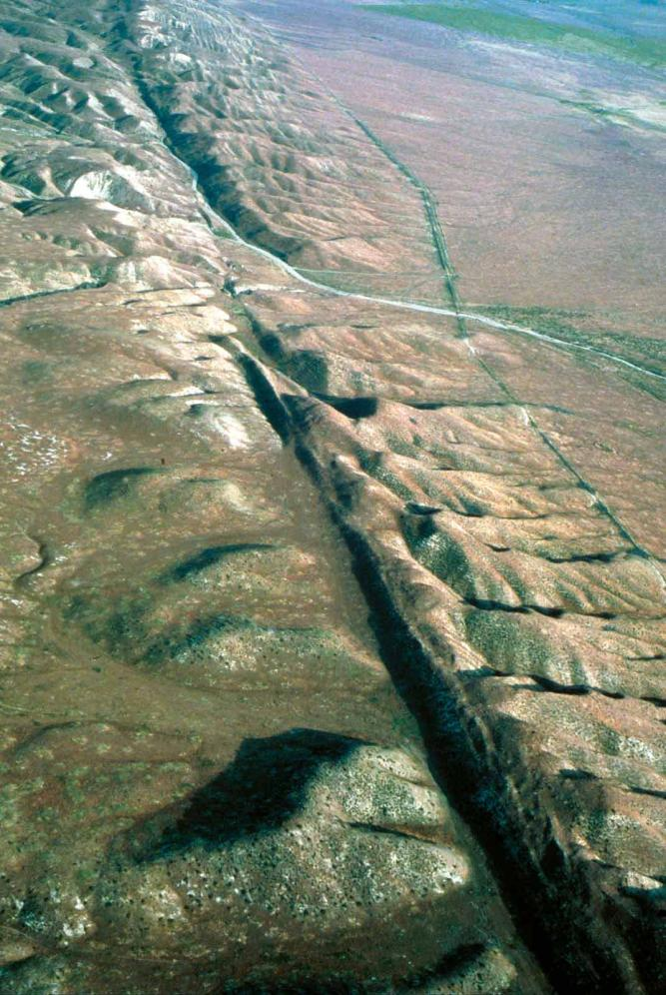
When He wills an earthquake, He commands sometime the movement of the strata and causes it. Even if it results from this movement or a fault in the strata, it is still at His command and cannot occur in any other way.

Slide 26
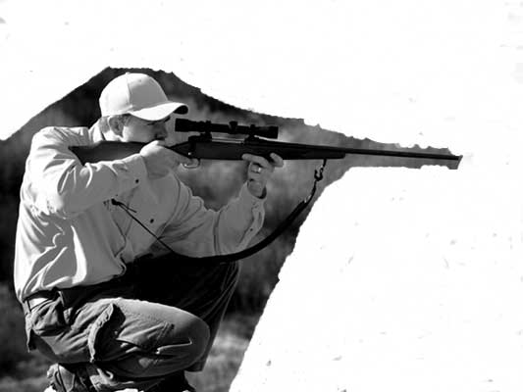
For example, one man shot another with a rifle. If the man who fired the shot is entirely neglected, and only the gun is taken into consideration, the rights of the victim would be completely violated, and it would be extreme foolishness.

Slide 27
Because reason tells us that beyond the material instrument there had to be a person who employed that instrument.

Slide 28
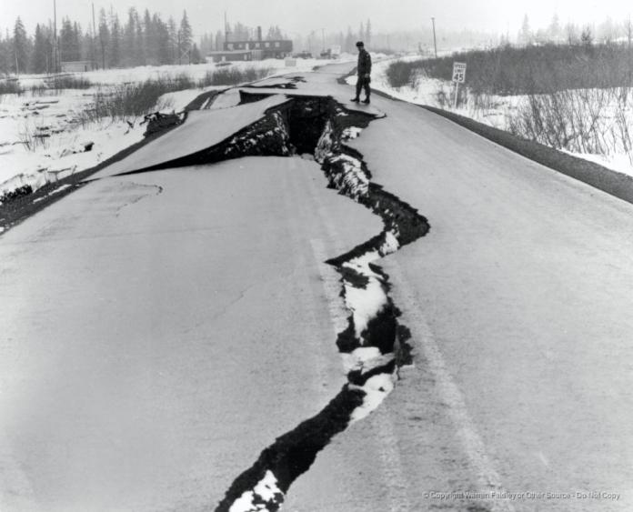
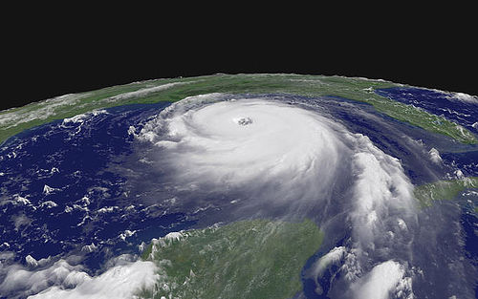
Similarly, to say that the earth is the ultimate cause of earthquakes
and other natural events, is to disregard the true actor, who is God.

Slide 29
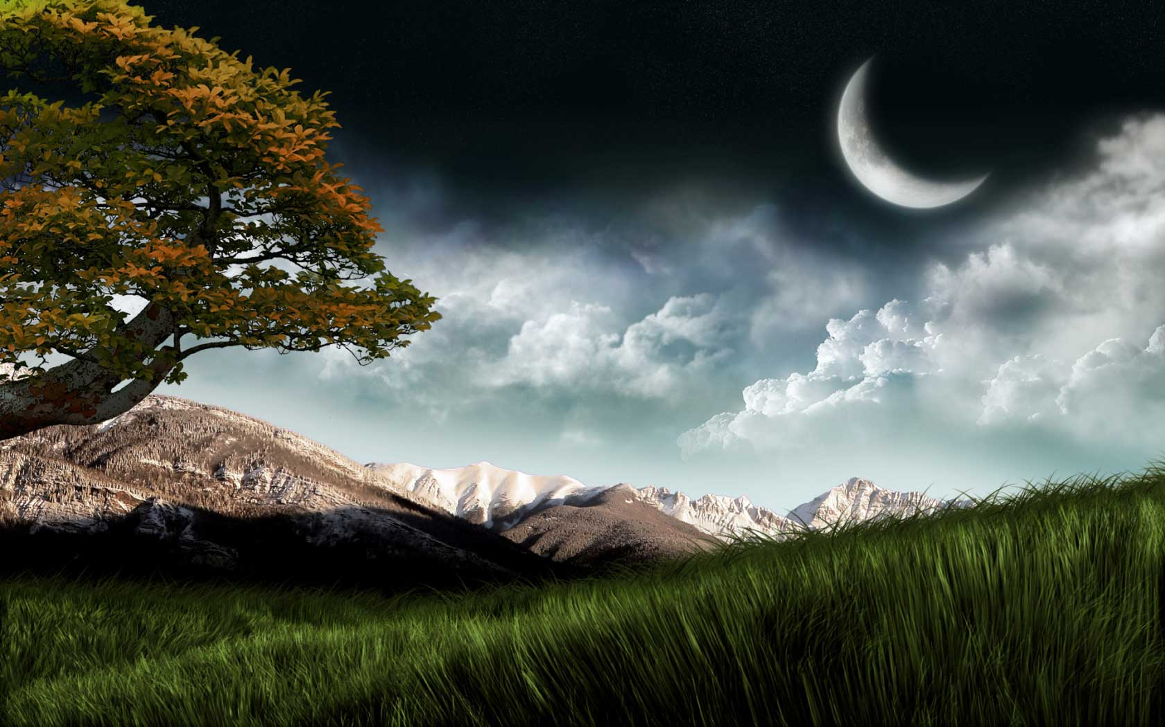
Anyway, those who do not believe in God are forced to refer all natural events to the status of chance occurrences, ignoring the One who set forth and directs the forces of nature.

Slide 30
All the chapters of the Risale-i Nur collection are about the truths of belief.

