Slide 1
PATIENCE

Slide 2
Outline
Meaning of Patience
What is its importance in Islam ?
Prophet Muhammed’s words
Qur’anic verses about it

Slide 3
Meaning of Patience
Patience, literary means enduring, bearing and resisting pain; suffering and difficulty; and dealing with problems calmly.
Another approach to patience is;
When a believer unburdens himself or herself to God while trying to overcome a misfortune or hardship, a responsibility that is very hard to fulfill, or sins that might be committed, this must not be considered a complaint against God. Rather, it is a believer's way of asking Him for help and seeking refuge in Him.
Preserving one's manners in the face of misfortune; being steadfast when confronted with events, and showing no sign of being deterred…

Slide 4
Importance of Patience
Patience is regarded as half of one's religious life (the other half is thankfulness).
Patience is an essential and most important dimension of servanthood to God, and is crowned with resignation, the highest spiritual rank in the sight of God, to whatever God has destined.
One of the most important actions of the heart and mentioned in the Qur'an.
Patience is an essential characteristic of those believers who are the most advanced in belief, spirituality, nearness to God, and who guide others to the truth.

Slide 5
Categories of Patience
Enduring difficulties associated with being a true servant of God or steadfastness in performing regular acts of worship
Resisting temptations of the carnal self and Satan to commit sins
Enduring heavenly or earthly calamities, which includes resignation to Divine decrees
Being steadfast in following the right path and not allowing worldly attractions to cause deviation
Showing no haste in realizing hopes or plans that require a certain length of time to achieve.
It is only for the sake of God (being convinced that only God enables one to show patience)
Enduring patiently whatever comes from God
Knowing that He acts from His Wisdom
Being resigned to whatever happens in the way of God
Showing patience by not disclosing the mysteries of one's achieved spiritual station and to preserve one's nearness to God
Resolving to fulfill one's mission of communicating God's Message to people despite one's deepest desire to die and meet with God.

Slide 6
The virtue of Patience
The most advanced people in terms of belief an worshiping experience the most misfortune ones, they are perfect embodiments of patience, which is the price they pay for the rank in paradise bestowed on them.
Travelers on the path to God should know how to burn and boil with love or to be consumed with affliction, but never complain to others of such love and affliction. Even if crushed by difficulty or responsibility as heavy as mountains, they should not complain to others.

Slide 7
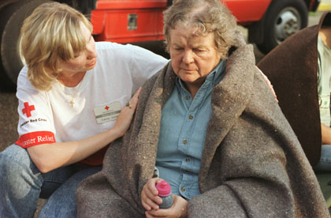
Types of Patience
There are several types of patience:
Patience for regular worshiping, daily prayers and obedience. This type carries more rewards.
Avoiding the prohibitions and sins.
Patience that required when hardship occurs which is mandatory.

Slide 8
Rumi’s approach to Patience
Rumi summarizes such a degree of patience as follows:
In order to be sustenance for man, a source of strength for his knees, a "light" for his eyes, and a substance for the maintenance of his life; a grain of wheat must be buried in the bosom of the earth, germinate under it, and grow to emerge into the air. It must come into the air after a fierce struggle with the earth, and then be sown and threshed, and ground in a mill. After that, it must be baked in an oven, and, finally, chewed by teeth, sent into the stomach, and digested.

Slide 9
Patience’s role to find one’s essence
To attain true humanity, each individual must be "sieved" or "distilled" many times to discover his or her true essence. Otherwise, the ability to develop one's potential to its fullest, to be truly human, is not possible:
How remarkable a believer's affair is, for it is always to his advantage. If something good happens to him he thanks God, which is to his advantage; if something bad happens to him he endures it, which is also to his advantage.

Slide 10
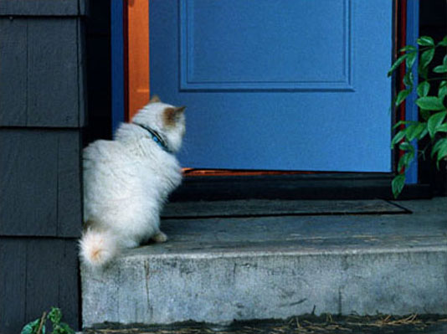
Few Verses of Holy Qur’an
Seek help in patience and prayer (2:45)
God praises the patient, declares that He loves them, or mentions the ranks He has bestowed on them as; The patient, steadfast, the truthful and loyal (3:16);
God loves the patient (3:145);
Surely God is with the patient (2:153).
Endure, vie with each other in endurance, and continue your relation with God (3:199)

Slide 11
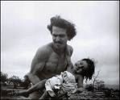
Few Sayings of Prophet Muhamed
The real patience is at the first stroke of a calamity.
If God Almighty has destined a servant of His to a rank or position which he cannot reach through his religious actions, He causes him to suffer from his own self and family, and equips him with patience to endure all his sufferings. He elevates him through patience to the rank to which he has destined him.
Also, it is considered that :
good patience when the disaster strikes, and a better patience while avoiding the prohibitions.

