Slide 1
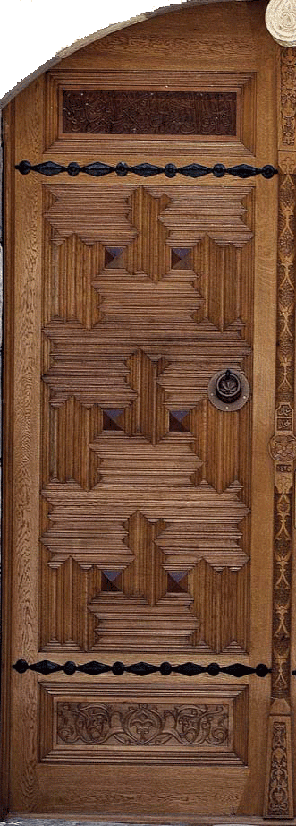
DEATH: ANNIHILATION
OR
THE DOOR TO ETERNAL LIFE?
This presentation was based on the Tenth Word; part of the Risale-i Nur Collection written by the late scholar
Bediuzzaman Said Nursi

Slide 2
Belief in the Hereafter has become one of the most debatable matters among the people who seek the reality of the world and it is one of the most important matters of faith.

Slide 3
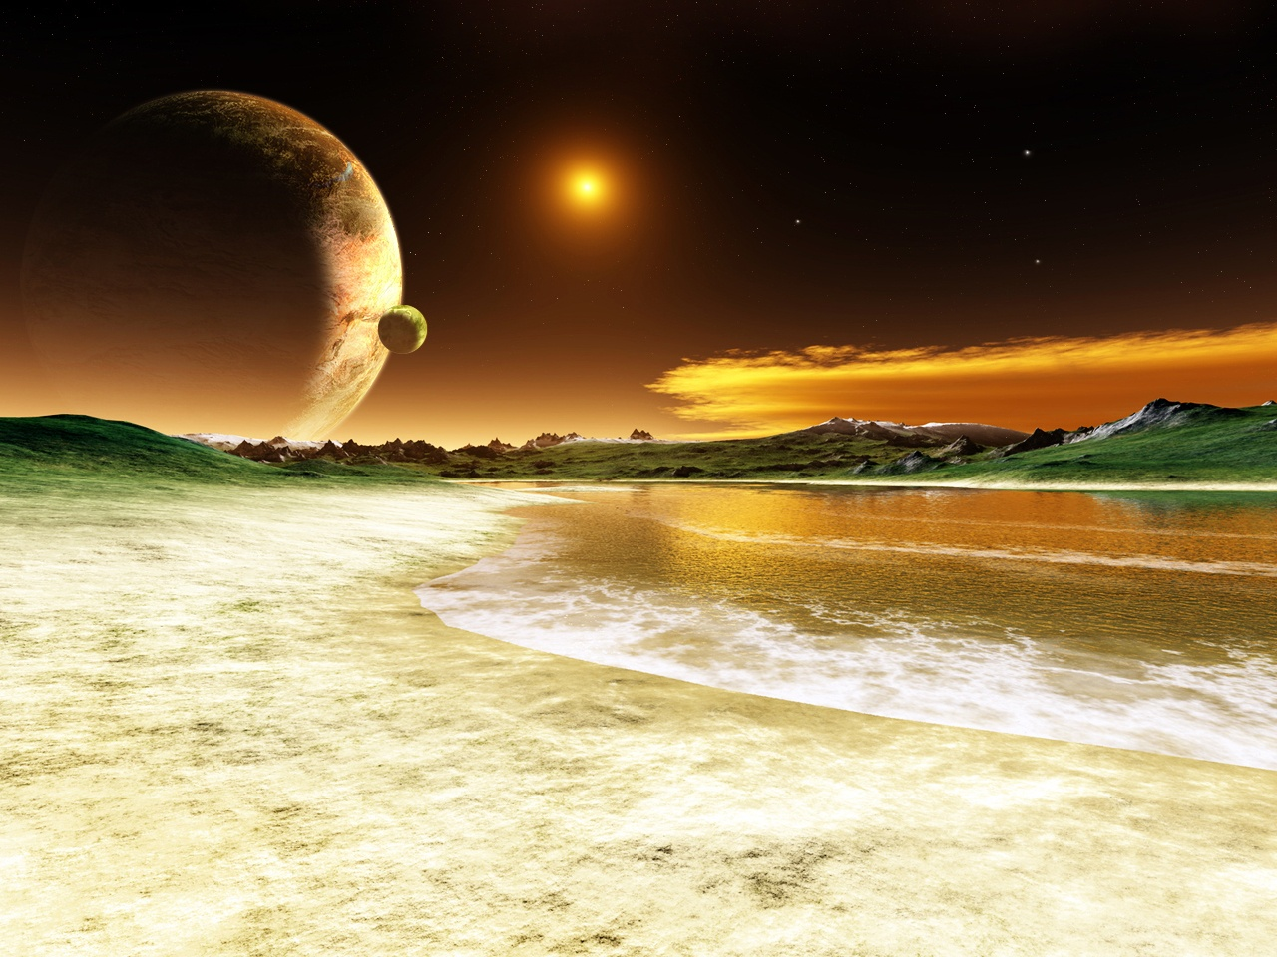
One who has faith in the Hereafter knows that God has power over all things and that His words and promises are evident, certain, and true.

Slide 4
The Earth
First Creation
A Drop of Sperm
Revolutions and Changes
Benefits and Order
Nutriment
Life of Society

Slide 5
The Earth: “Look, then, to the signs of God’s mercy - how He restores life to the earth after its death-verily He it is Who quickens the dead, for He is powerfull over all things.” (Qur’an: 30/50)

Slide 6
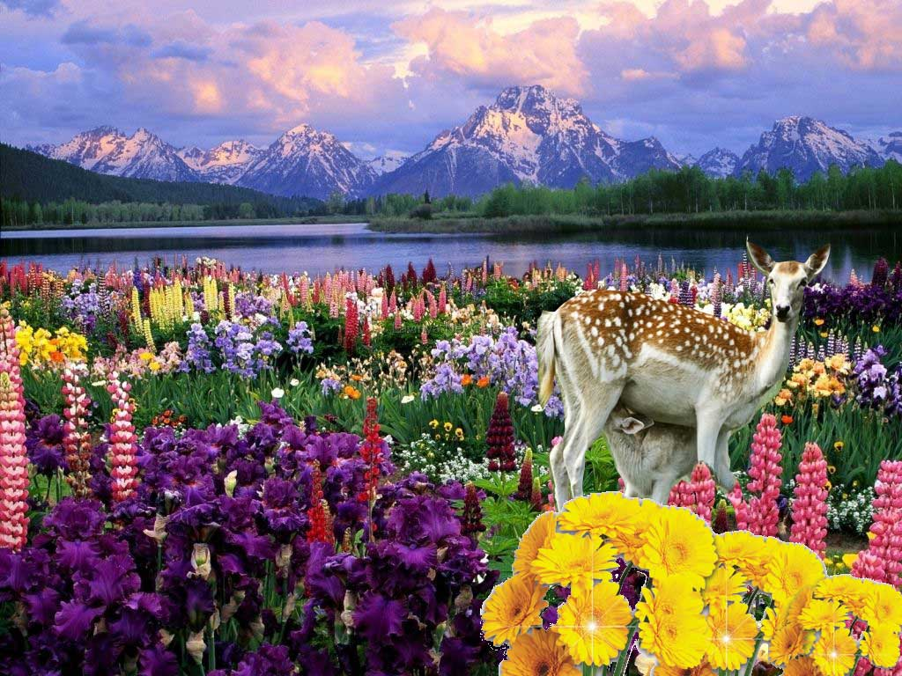
Bediüzzaman found spiritual enrichment in the miracle of springtime, with its “more than 400,000 species of plant and animal life” appearing almost miraculously every year after the end of a long, cold, grey winter.

Slide 7
He says that One Who raises to life and makes green in spring numberless skeleton-like trees which have been dead throughout winter, and in each and every tree demonstrates three examples in the resurrection of leaves, blossoms and fruit.

Slide 8
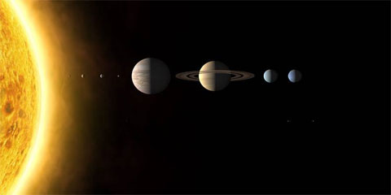
The power of such a Being cannot be challenged through
denial or by considering resurrection improbable.

Slide 9
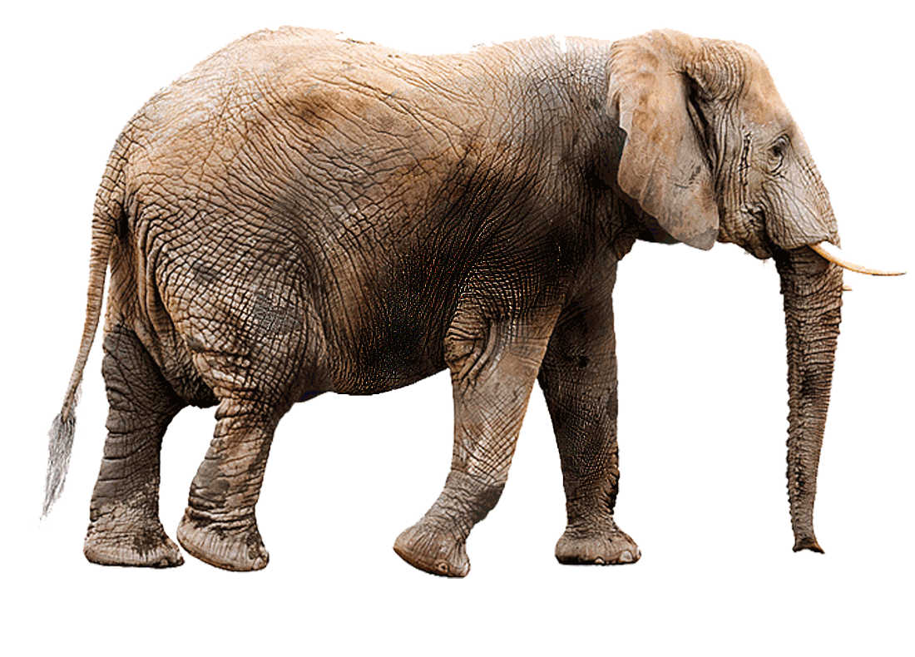
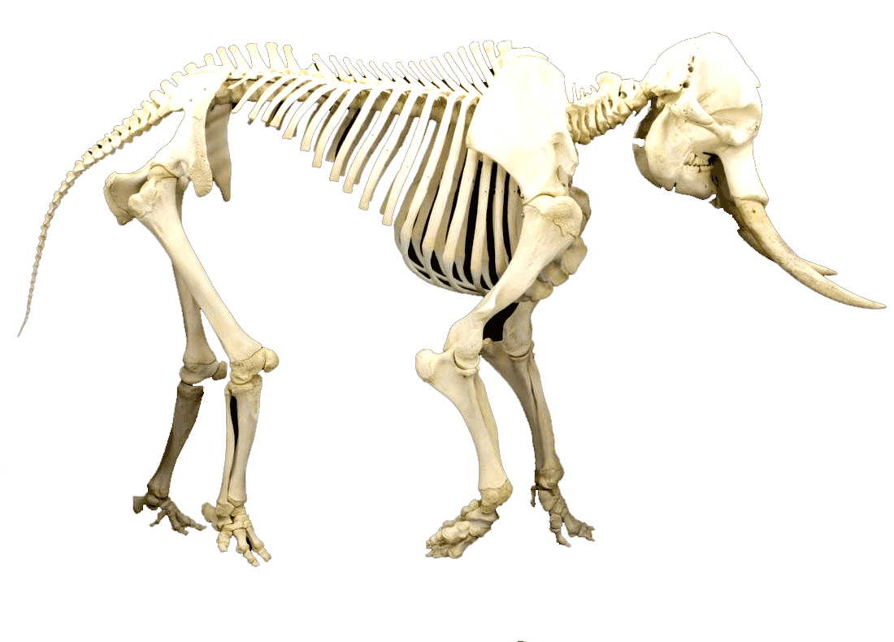
First Creation: Someone who forgets his own creation says "Who will give life to decaying bones?" (Qur’an: 36/78)

Slide 10
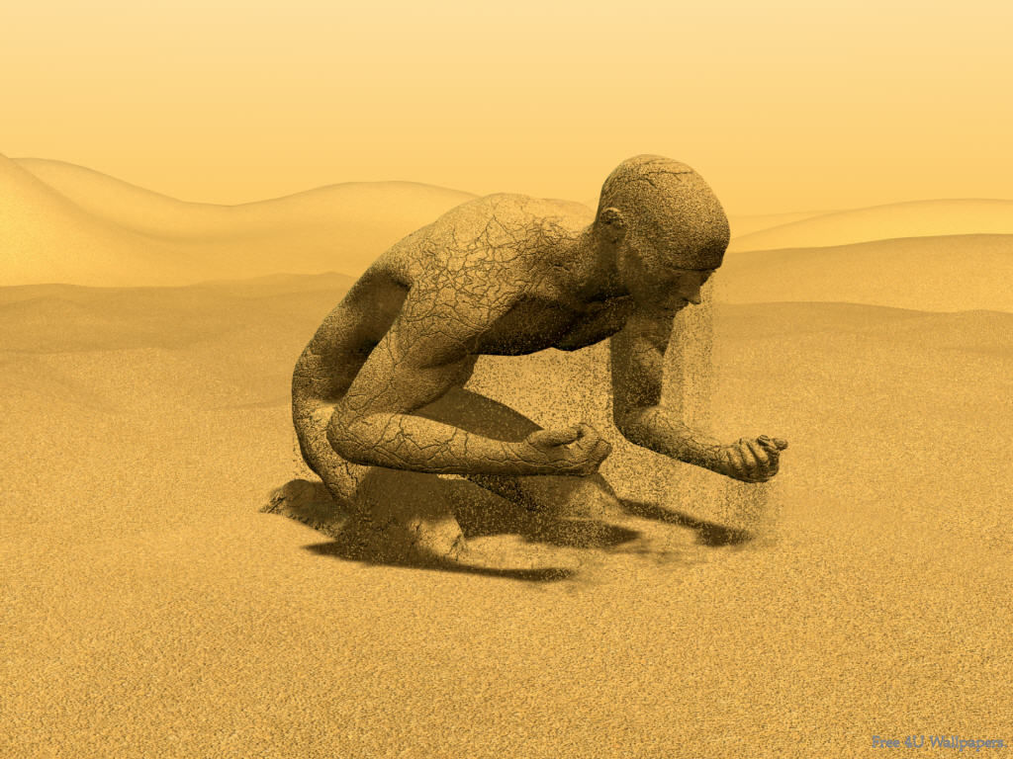
The answer of the question is explicit; Say
“He shall give them life who first gave them life, and He is All-Knowing concerning all creation.“ (Qur’an: 36/79)

Slide 11
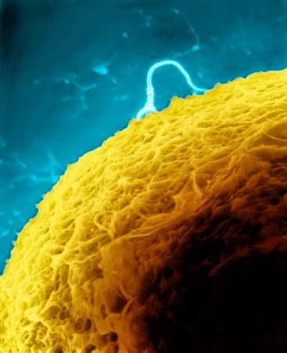
A Drop of Sperm: One example is furnished by the verse, “Has not man seen that We created him from a drop of sperm? And then he becomes an open disputer.”
(Qur’an: 16/4)

Slide 12
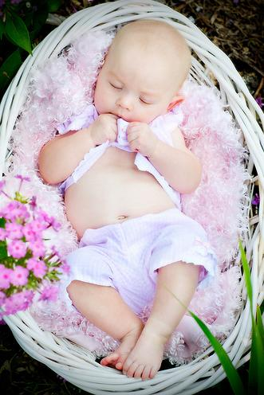
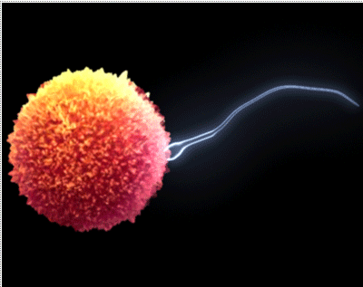
The Quran says;
“You see how you advanced from a drop of sperm to a flesh and to bone and finally to human form. How, then can you deny your second creation? It is just the same as the first, or even easier an accomplishment for God."
“He originates creation then brings it back again, and it is easier for Him.” (Qur’an: 30/27)

Slide 13
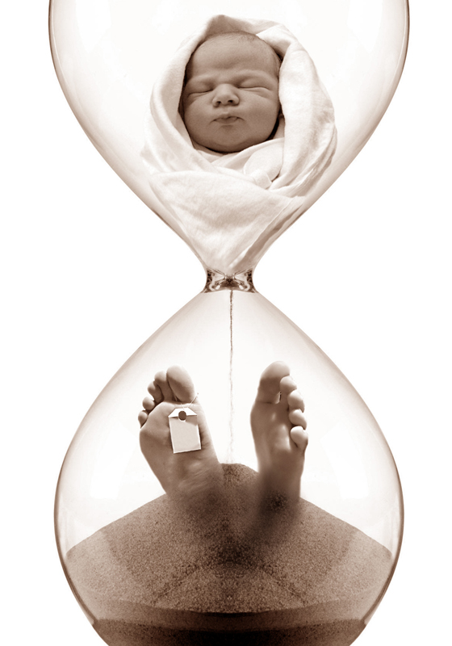
Baby
Youth
Man
Old Man

Slide 14
Spring
Summer
Autumn
Winter

Slide 15
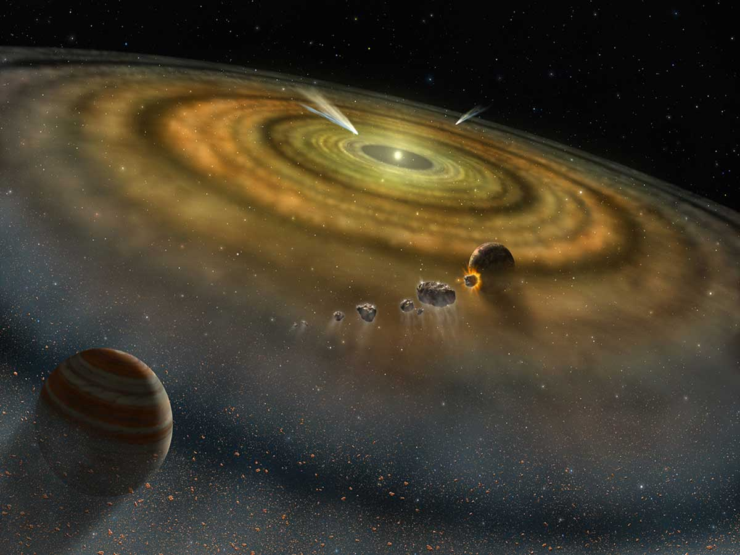
Revolutions and Changes: The tremendous revolutions and changes in the world, the arranging and destruction, the gathering together and dispersal, the constant flux and change, they are all the signs and indications of an awesome day which will witness destruction and reconstruction on a vast scale.

Slide 16
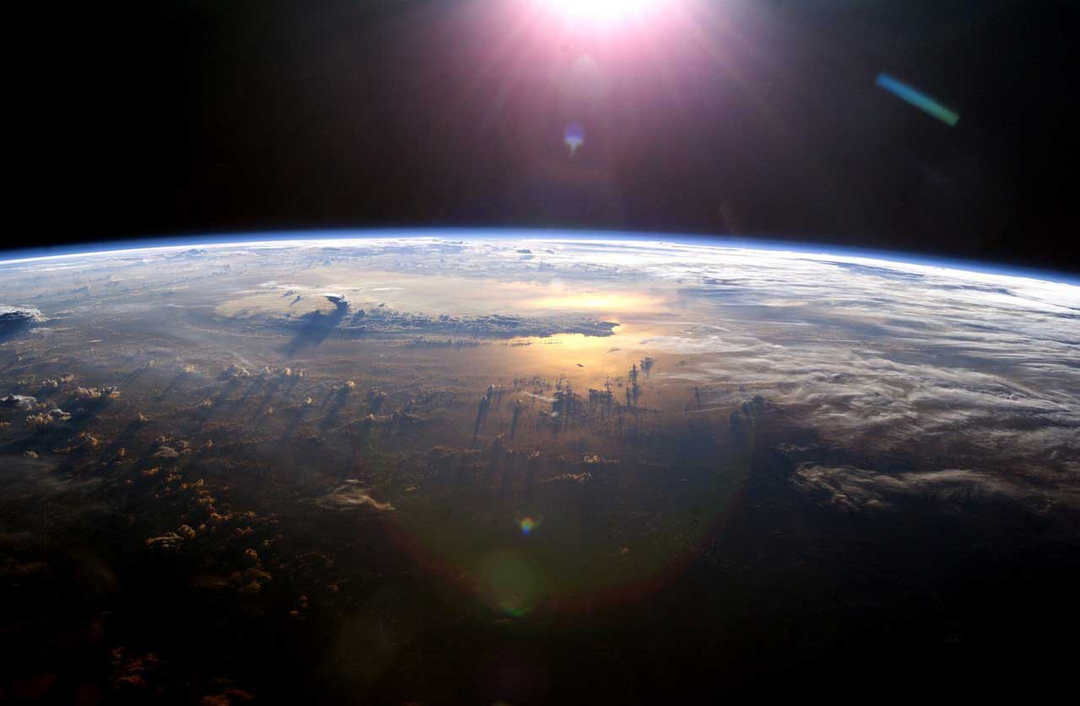
At the same time they all show that God is able to realize the hereafter and the eternal life of happiness.

Slide 17
Oxygen
Clean Air
Medicine-etc
Milk
Meat
Leather-etc
Benefits and Order: We see that each creature which comes into existence does so following not one, but many aims, benefits, and instances of wisdom.

Slide 18
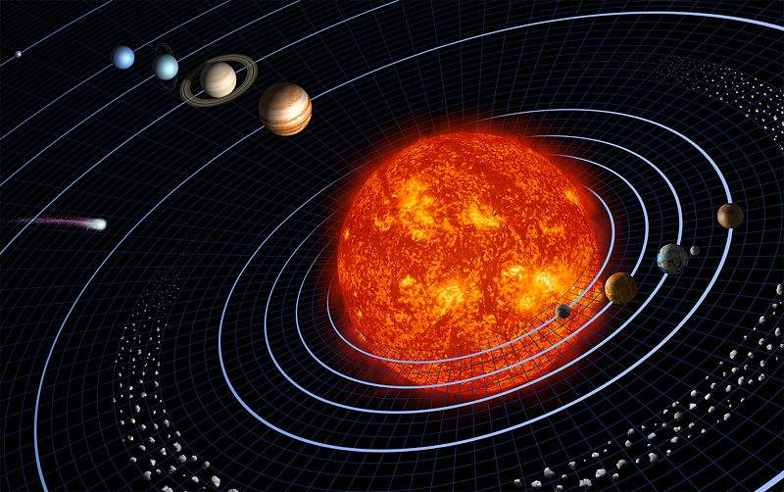
At the same time in the universe each creature proceeds within an order and there are laws which sustain that order. Functioning within a specified order from minute particles to the sun, the universe corroborates the necessity of eternal life.

Slide 19
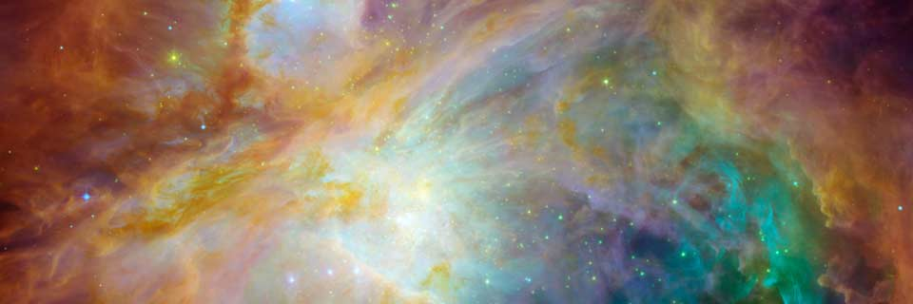
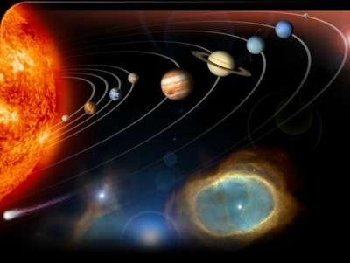
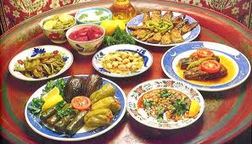
If the universe was not to result in everlasting happiness, its aims, benefits and perfect order would be deceptive, meaningless, and futile.

Slide 20
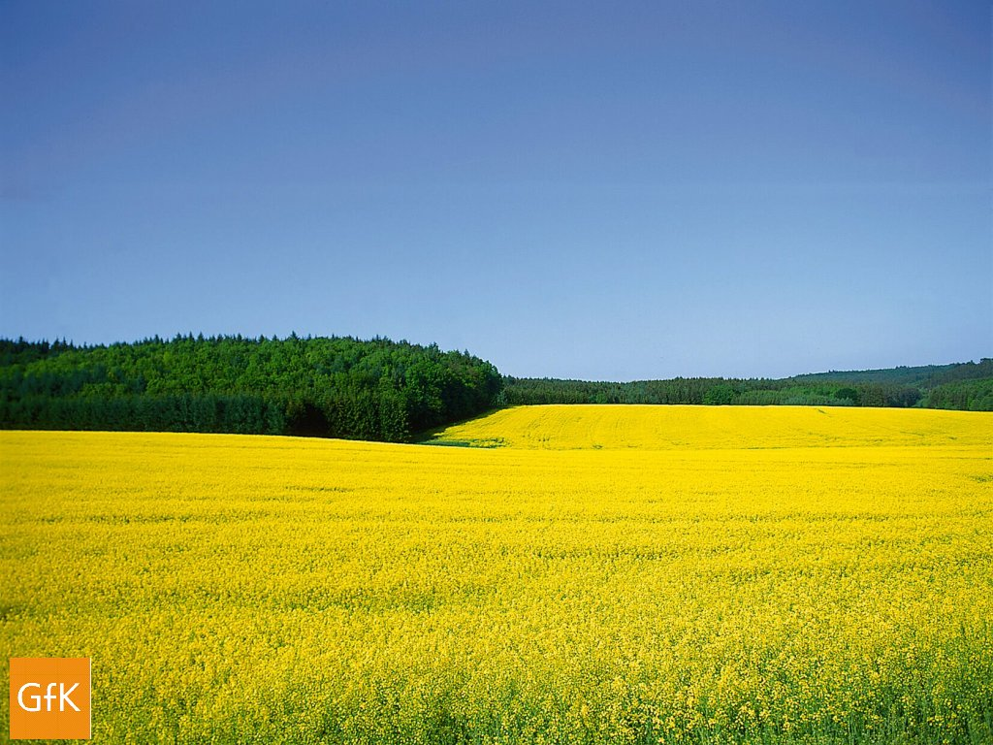
Nutriment: God makes the fields and gardens all work as a perfect factory.

Slide 21
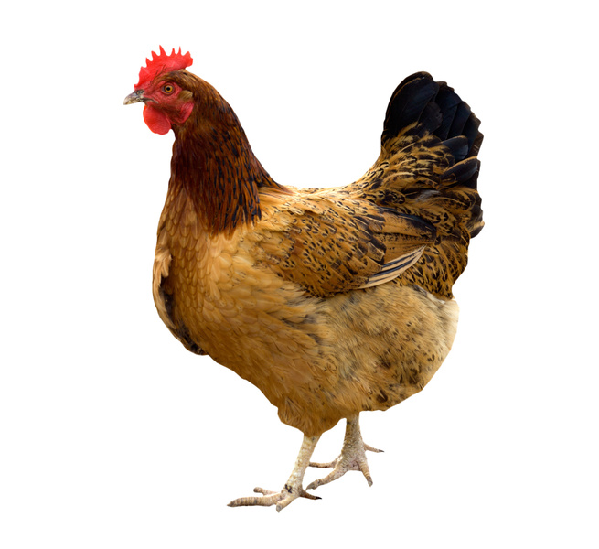
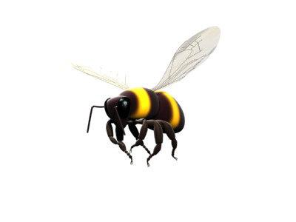
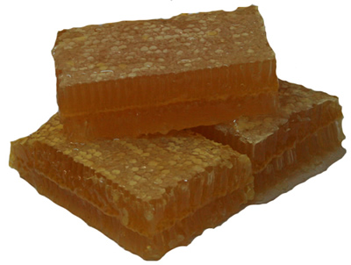
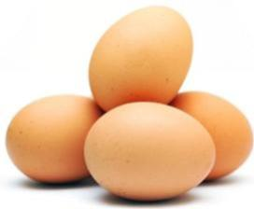
He makes the poisonous bee feed us with sweet honey
and each chicken works like an egg factory.

Slide 22
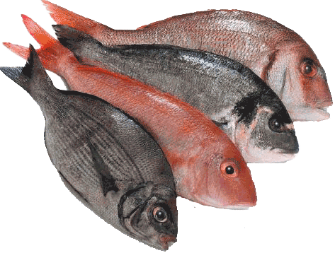
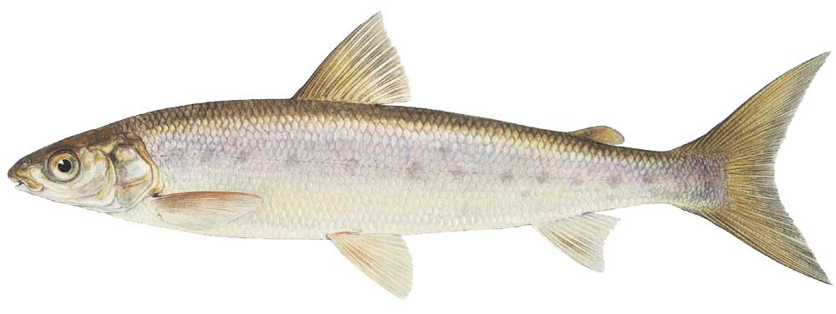
He creates salt-less fish for our sustenance from the salty seas.

Slide 23
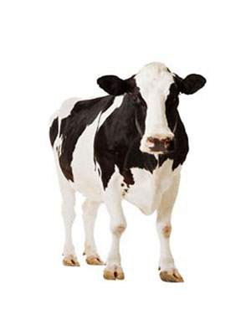
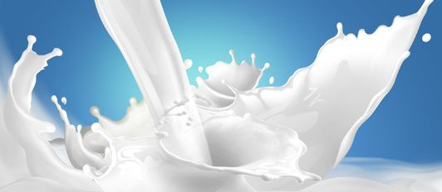
God has prepared for us one of the best sources
of nourishment,milk, produced amongst blood and dung within a cow.

Slide 24
Merciful God gives the good news of eternal happiness, it is eternal happiness that makes mercy into mercy and bounty into bounty, and prevents it being turned into an affliction.

Slide 25
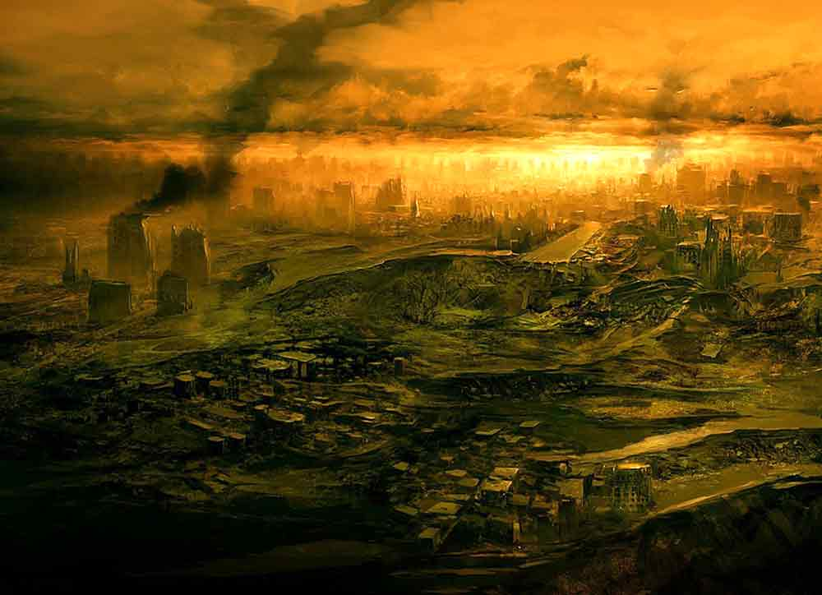
If there was no eternal life and happiness, all the mercies and bounties that would be transformed into torment.

Slide 26
The Risale-i Nur shows that belief in the hereafter is fundamental to the life of society
and to man’s personal life, and is the basis of his happiness, prosperity, and achievement.

Slide 27
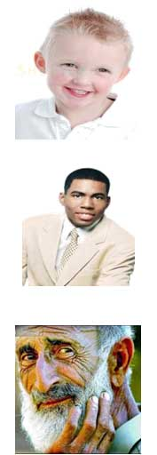
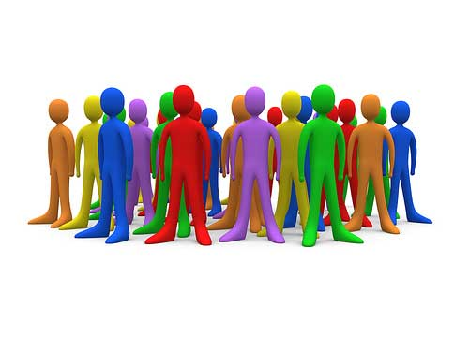
Life of Society: It is only belief in God that saves the elderly, youth, and children of a society from committing injustices towards each other, preserves them from mistakes, and bestows guidance on them. It is belief that strengthens the bonds between them.

Slide 28
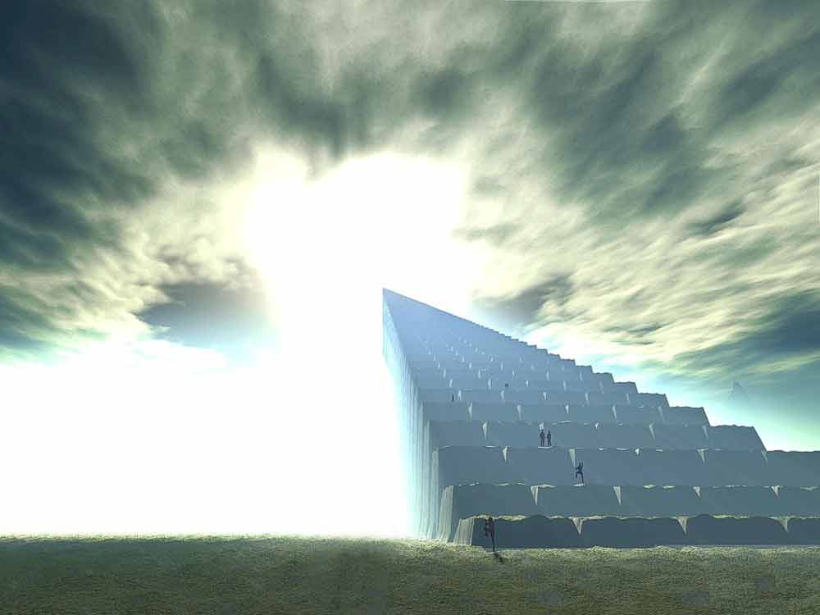
When people have a stronger belief in the hereafter, the more people will understand that this world is transitory and another life awaits them, then they will not have recourse to force, weapons, or oppression.

Slide 29
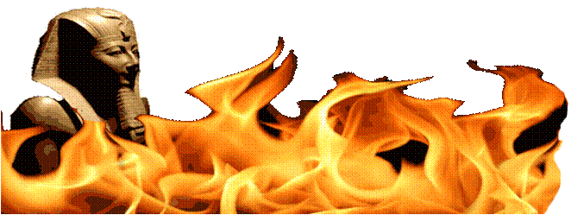
The Qur’an says to the oppressor: “There is severe torment; you will receive a blow!” (Qur’an: 14/42), and makes them bow to justice.

Slide 30
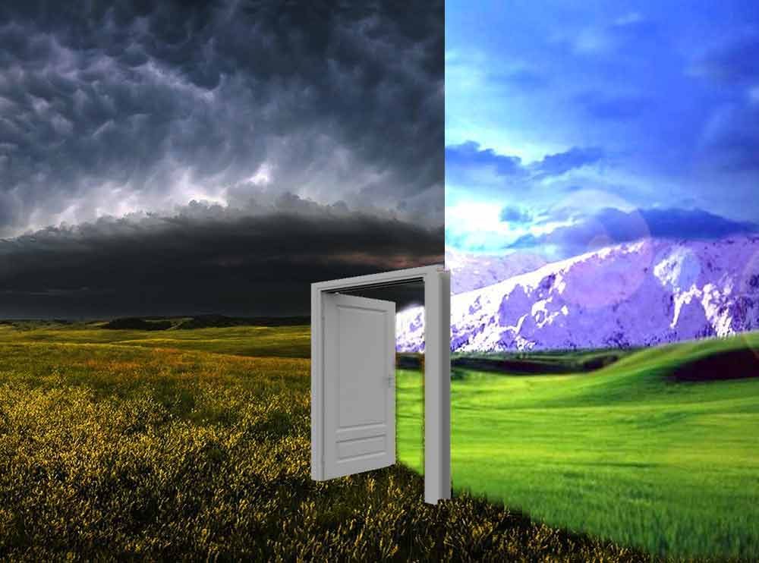
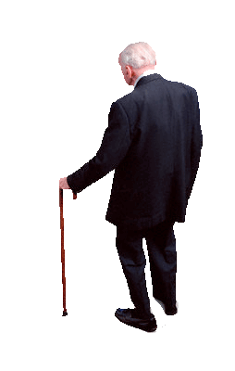
Qur’an also addresses the elderly: “Awaiting you is everlasting happiness in the hereafter far greater than all the happiness you have lost here, and immortal youth; try to win them!” (Qur’an: 56/17) It turns their tears into laughter.

Slide 31
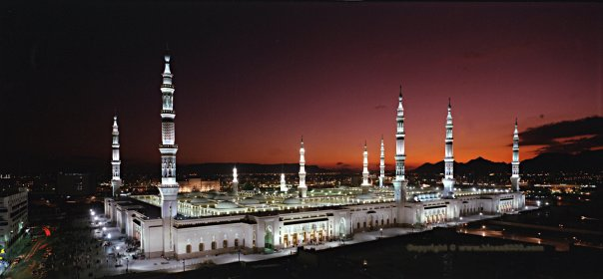
KADDER
This presentation was compiled from Words Book of Risale-i Nur Collection.

