Slide 1
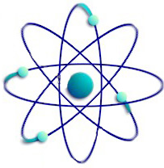
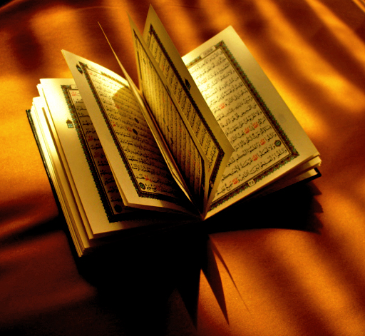
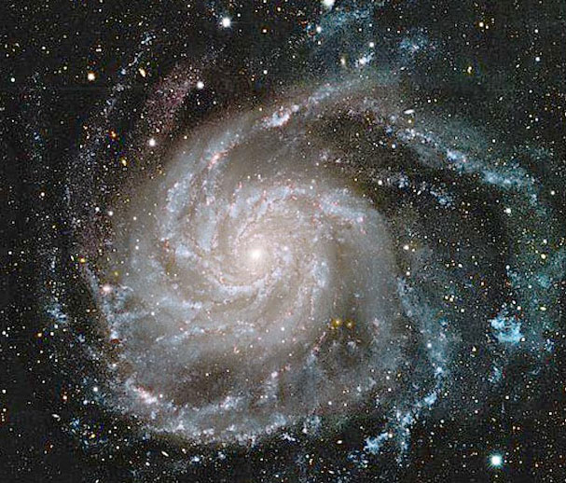
The Qur’an and Science
Contradictory or Complementary?

Slide 2
Outline
What is the Qur’an?
The Qur’an and Modern Science
Scientific Miracles of the Qur’an
Astronomy
Biology
Embryology
Geology
Physics

Slide 3
What is the Qur’an?
The last revelation of God.
The principal source of every Muslim's faith and practice.
Its basic themes are the relationship between God and His creatures and between people one another.
The Qur'an provides guidelines for a just society, proper human conduct, and equitable economic principles.
The Qur’an is the only book that has been maintained in its original language; Arabic.

Slide 4
The Qur’an and Modern Science
Religion & Science are associates in Islam.
It is impossible to explain how a text produced at the time of the Quran (over 1435 years ago) could have contained ideas that have only been discovered in modern times except if we accept the fact that it is the words of the Creator.
Many Muslims scholars were considered among the greatest scientists of their time, as well as many branches of science were either considered to be an Islamic innovation like Algebra & Chemistry or indebted to Muslim Scientists like Medicine and Architecture.

Slide 5
Scientific Miracles of the Qur’an
Many scientific discoveries were used for better understanding of Quran, which were magnetic attraction for today’s scientists.
Some Fields of the Scientific Miracles of the Quran
Astronomy
Biology
Embryology
Geology
Physics

Slide 6
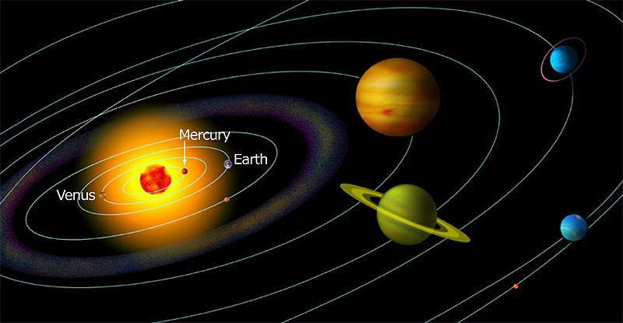
"It is He Who created the night and the day, and the sun and the moon. They swim along, each in an orbit. “
(The Qur'an, 21:33)
ASTRONOMY

Slide 7
"Yes, We are able to fashion in perfect order the very tips of his fingers."
(The Qur'an, 75:3-4)
BIOLOGY

Slide 8
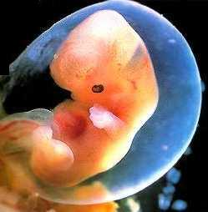
"... He creates you stage by stage in your mothers' wombs in a threefold darkness. That is God, your Lord. Sovereignty is His. There is no god but Him. So what has made you deviate?“
(The Qur'an, 39:6)
EMBRYOLOGY
"Recite: In the name of your Lord Who created man from a CLING. Recite: And your Lord is the Most Generous."
(The Qur'an, 96:1-3)
"The life in the uterus has three stages: pre-embryonic; first two and a half weeks, embryonic; until the end of the eighth week, and fetal; from the eighth week to labor."(Williams P., Basic Human Embryology, 3. edition, 1984, s. 64.)

Slide 9
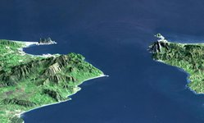
"He has let loose the two seas, converging together, with a barrier between them they do not break through."
(Qur’an 55:19-20)
GEOLOGY
Salinity
Density
Temperature
Currents
Because of the physical force called “surface tension“, the waters of neighboring seas do not mix. Caused by the difference in the density of their waters, surface tension prevents them from mingling with one another, just as if a thin wall were between them . (Davis , Richard A . , Jr. 1972 , Principles of Oceanography, Don Mills, Ontario)

Slide 10
“We placed firmly embedded mountains on the Earth, so it would not move under them…”
(The Qur’an, 21:31)
GEOLOGY
With extensions that mountains extend out towards under the ground, they clench different plates of the earth like a peg.
The Earth’s crust consists of plates that are in constant motion. This clenching property of mountains prevents shocks to a great extent by fixing the earth’s crust, which has a very movable structure.

Slide 11
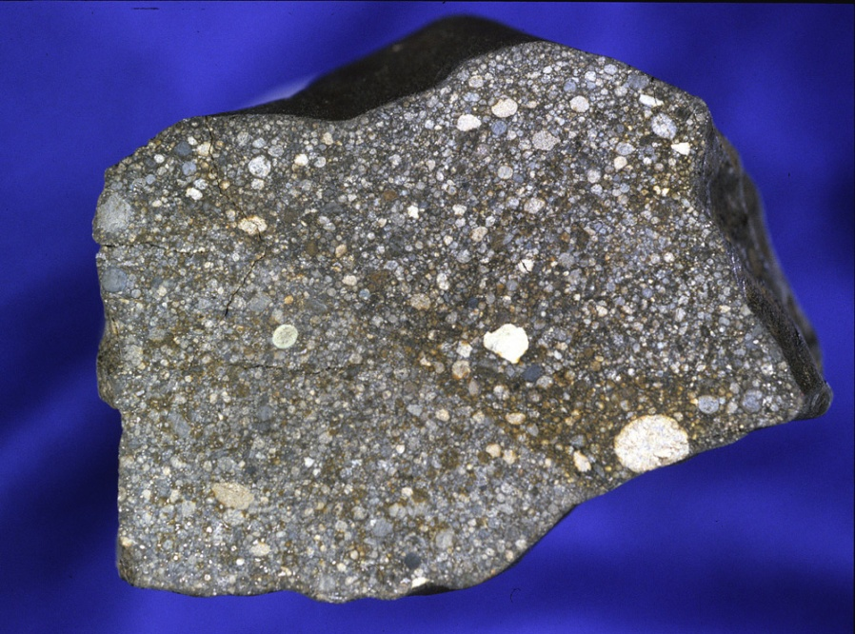
“…And We sent down iron in which there lies great force and which has many uses for mankind…”
(Qur’an, 57:25)
PHYSICS
The word “sent down”, particularly used for iron in the verse, could be thought of having a metaphorical meaning to explain that iron has been given to benefit people.
But when we take into consideration the literal meaning of the word, which is, “being physically sent down from the sky”, we realize that this verse implies a very significant scientific miracle. This is because modern research has proven that the iron found in our world comes from the giant stars in outer space.

Slide 12
Sources
http://www.muslimway.org
http://www.fountainmagazine.com
http://www.mfgulen.com

Slide 13
