Slide 1
IN THE NAME OF GOD
The Worth of Bismillah
This presentation was based on the First Word; part of the Risale-i Nur Collection written by the late scholar
__________ ___ ____

Slide 2
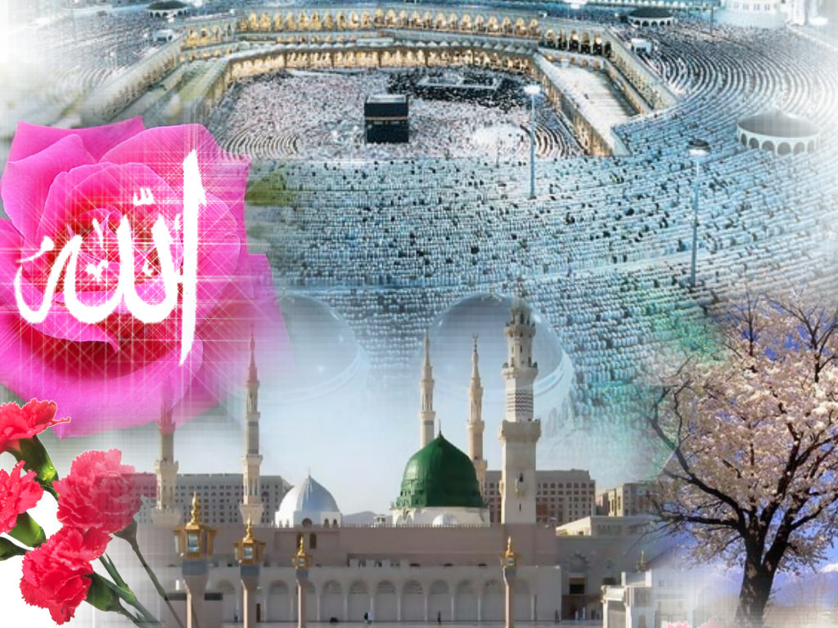
Bismillah, In the Name of God, is the start of all things good. We too shall start with it.
This blessed phrase is
•a mark of Islam,
•an inexhaustible strength
•an unending source of bounty
•constantly recited by all beings through their tongues of disposition (i.e. behavior).

Slide 3
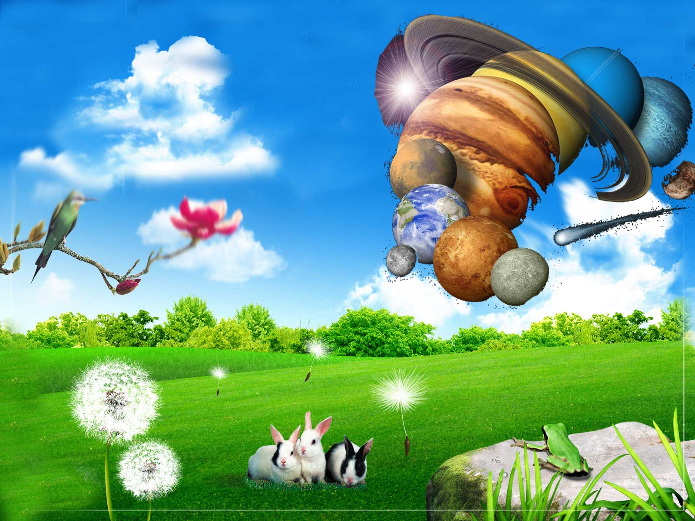
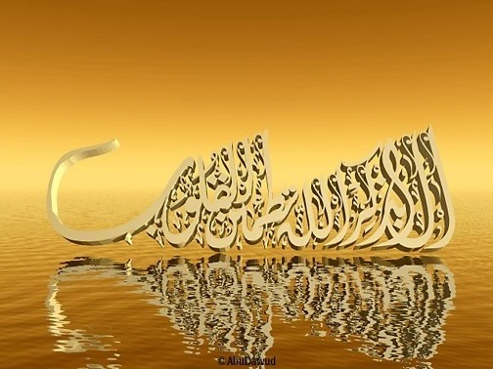
All beings say, "Bismillah" through the tongue of disposition. Is that so?

Slide 4
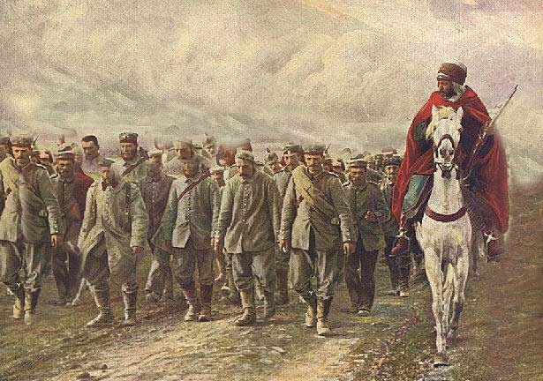
Indeed, it is so. If you were to see that a single person had come and had driven all the inhabitants of a town to a place by force and compelled them to work,
you would be sure that he was a soldier, acting in the name of the government and relying on the power of a king.

Slide 5
In the same way, all things act in the name of Almighty God, it means that all things perform wondrous duties far exceeding their own strength and knowledge, for

Slide 6
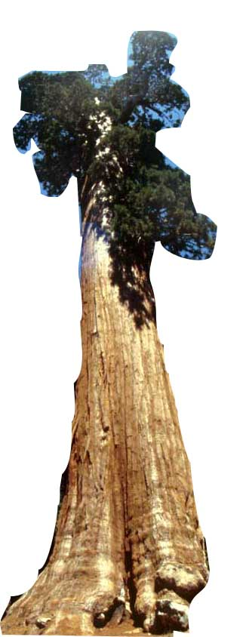
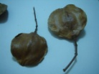
1) Small seeds and grains bear huge trees on their heads; they raise loads like mountains.
A small seed becomes like a machine for the production of a pine-tree the size of a mountain and contains the index of the whole tree. That is a seed, the source of a tree, is a program of it and containing the systems of the tree’s creation.

Slide 7
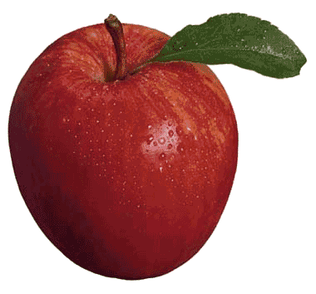
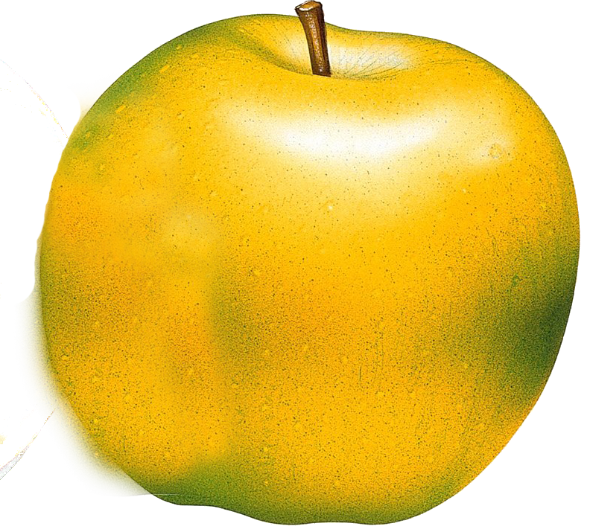
2) All trees say: "Bismillah," fill their hands from the treasury of Mercy, and offer them to us. If all scientists in the world were gathered together and the biggest budget were put at their disposal, they could not make a single apple. How can a piece of wood one meter high and ten centimeters in diameter work like a factory and produce apples from soil? All fruits have various aromas and tastes!

Slide 8
3) All gardens say: "Bismillah," and become cooking pots from the kitchens of Divine Power in which are cooked numerous varieties of different foods.

Slide 9
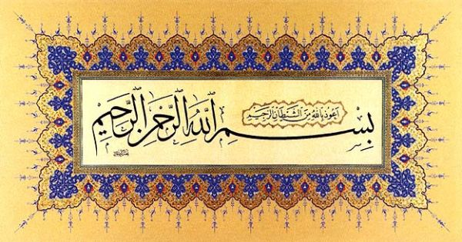
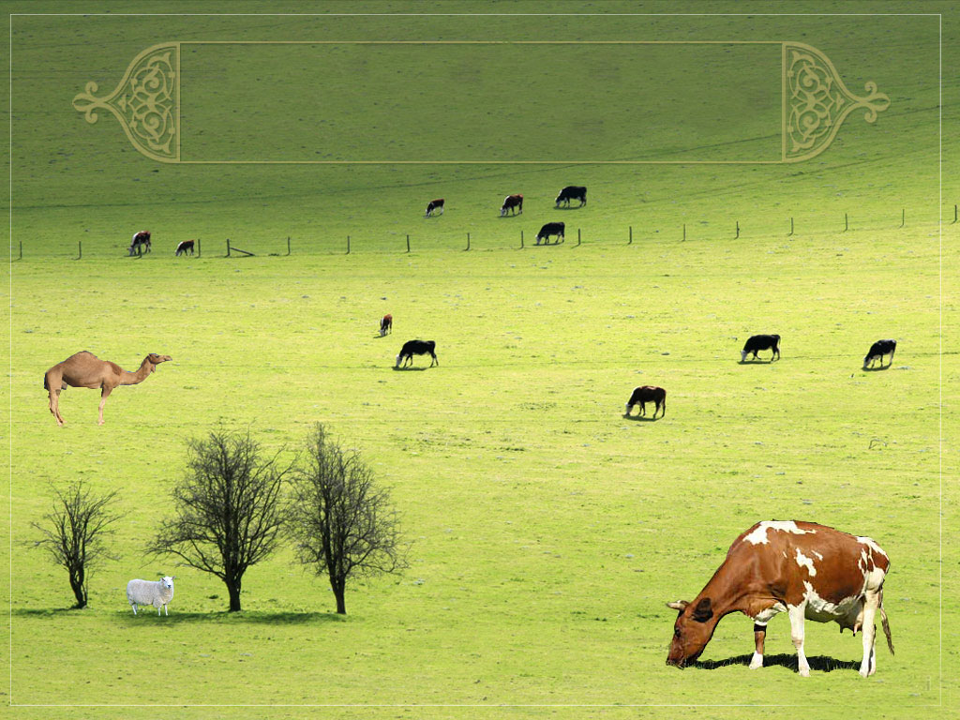
4) All blessed animals like cows, camels, sheep, and goats, say: "Bismillah," and become fountains of milk from the abundance of Mercy, offering us a most delicate and pure food like the water of life in the name of the Provider.

Slide 10
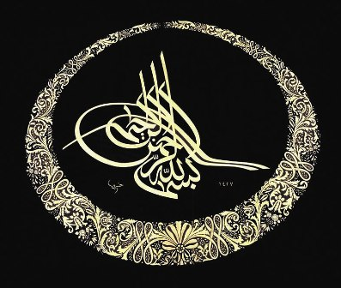
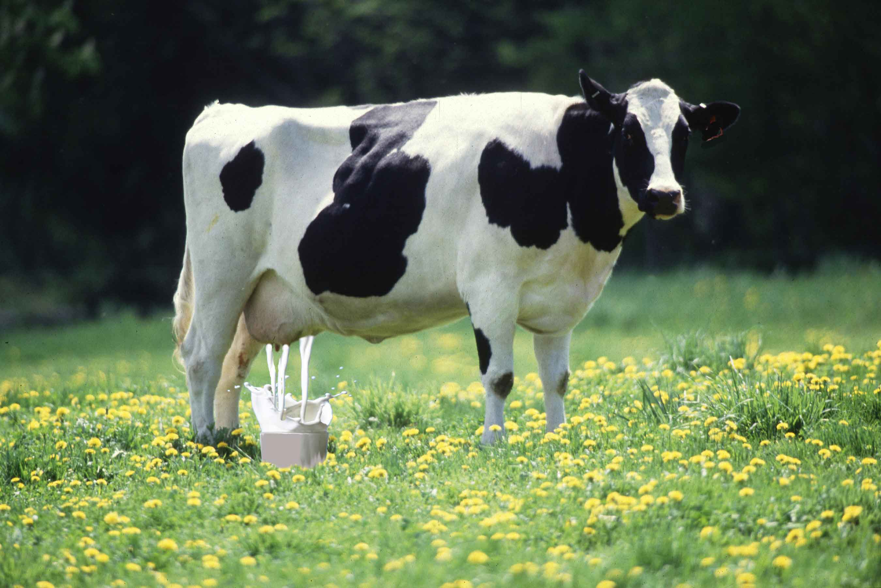
How can an unconscious cow work like a milk factory and produce milk from grass and water? On the other hand, God has prepared for us one of the best sources of nourishment-milk-from among blood and dung inside the cow. That is, all blessed animals act in His Name and work like milk factories.

Slide 11
5) Roots and rootlets, soft as silk, of all plants, trees, and grasses, say Bismillah", and pierce and pass through hard rock and soil. That is, roots and rootlets mention the name of God and everything becomes subjected to them.
Indeed, the roots spread through hard rock and soil as easily as the branches spread through the air and produce fruits.

Slide 12
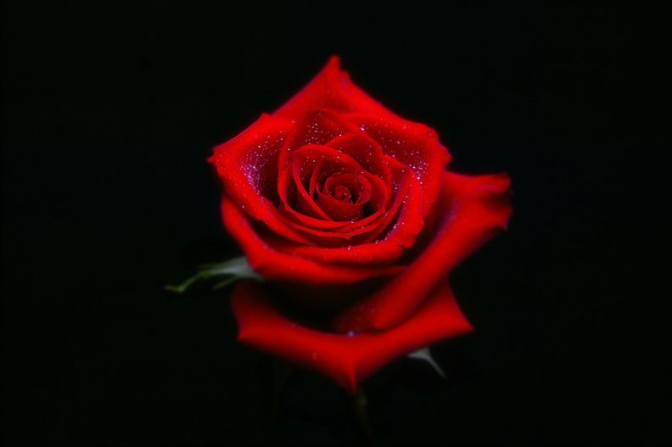
6) Delicate green leaves hold their moisture for months despite extreme heat. These realities refute the assertion of Naturalistic atheist .

Slide 13
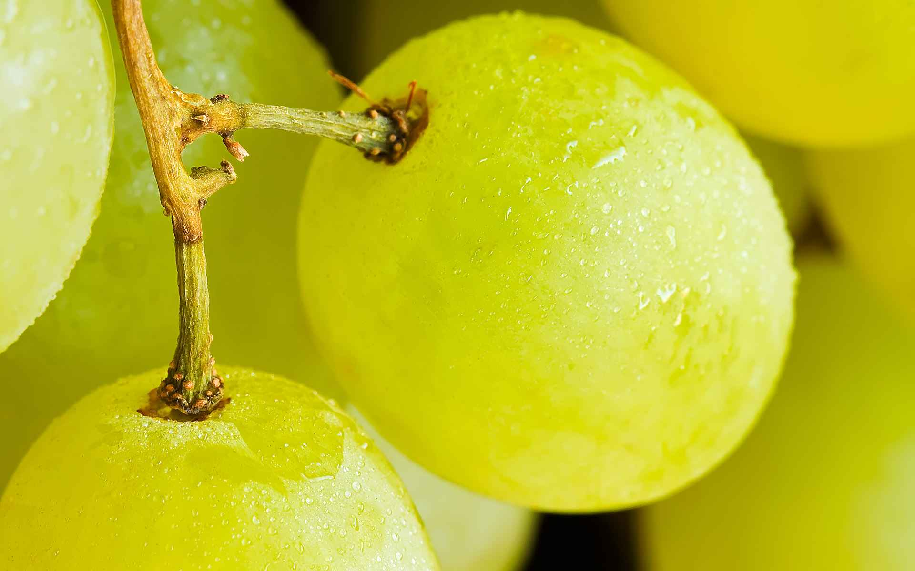
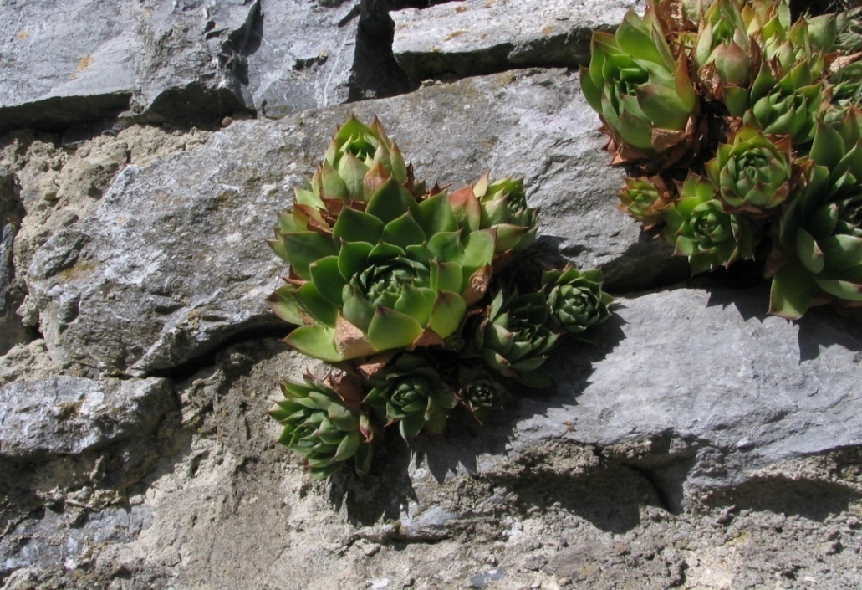
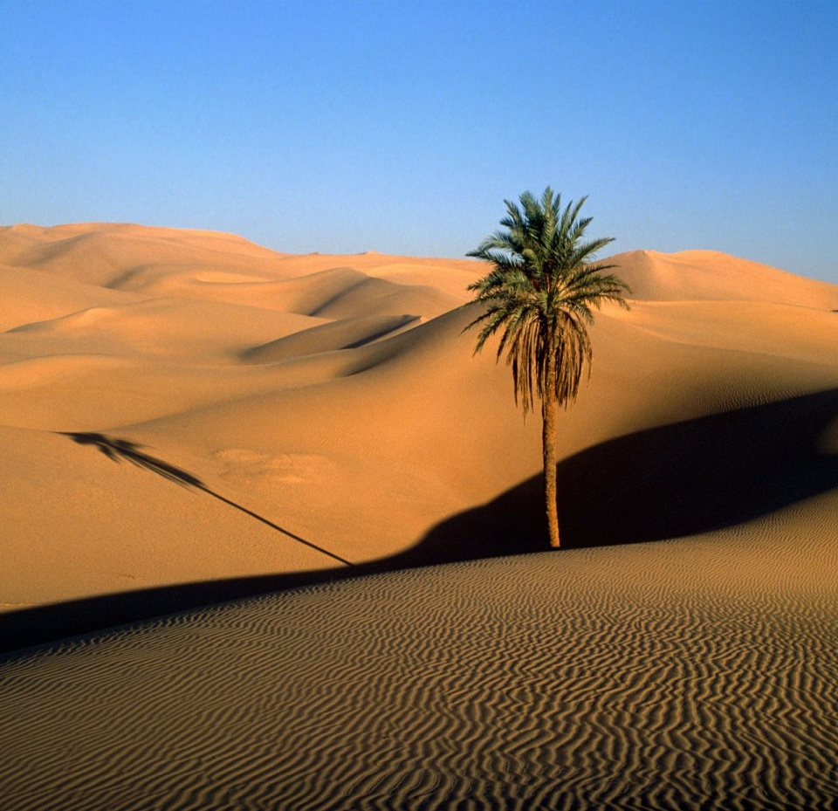
Even heat and hardness, in which you most trust, are under a command.
For instance, like the Staff of Moses, each of soft rootlets obey the command of “And We said, O Moses, strike the rock with your staff” (Quran 2:60) and split the rock
Each of the delicate, thin leaves, like the members of Abraham (upon whom be peace), recite the verse “O fire be coolness and peace” (Quran 21:69) against the extreme heat.

Slide 14
Since all things say "Bismillah", and, bearing God's bounties, give them to us,
We too should say in the name of Allah "Bismillah".
We should give in the name of Allah
We should take in the name of Allah

Slide 15
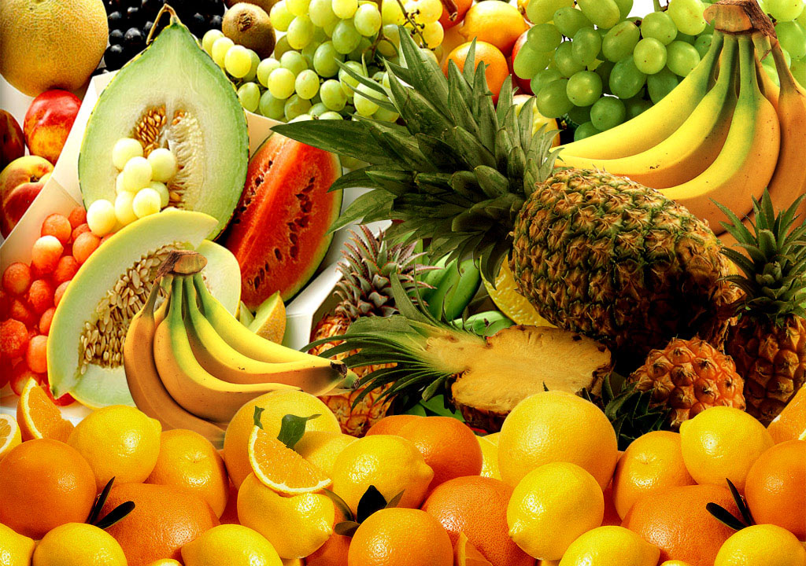
Question: We give a price to people, who are like tray-bearers. So what price does God want, who is the true owner?

Slide 16
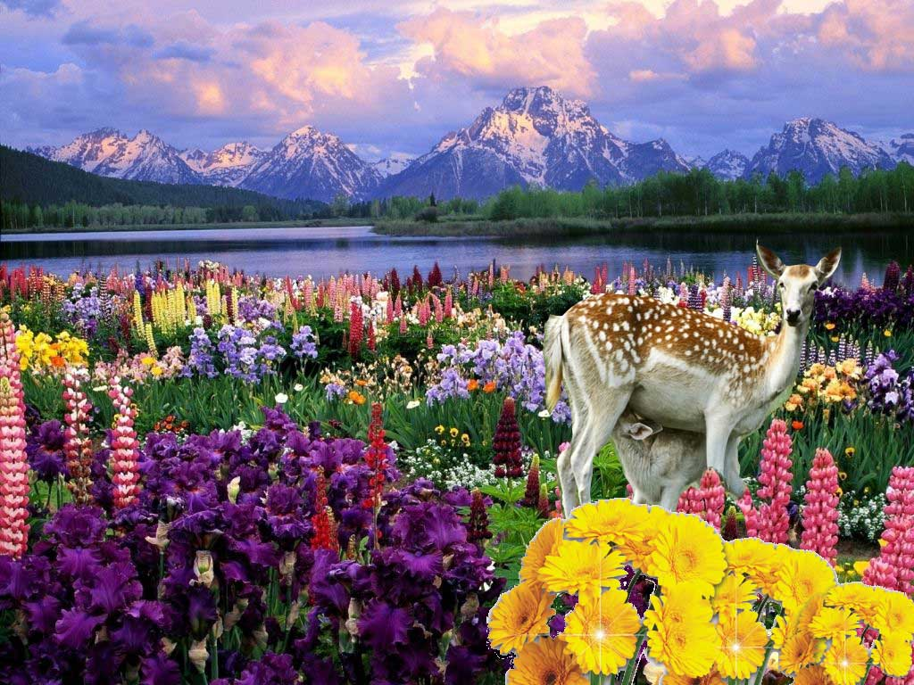
The Answer: Yes, the price God wants, in return for those valuable bounties and goods, is three things: remembrance, thanks and reflection.

Slide 17
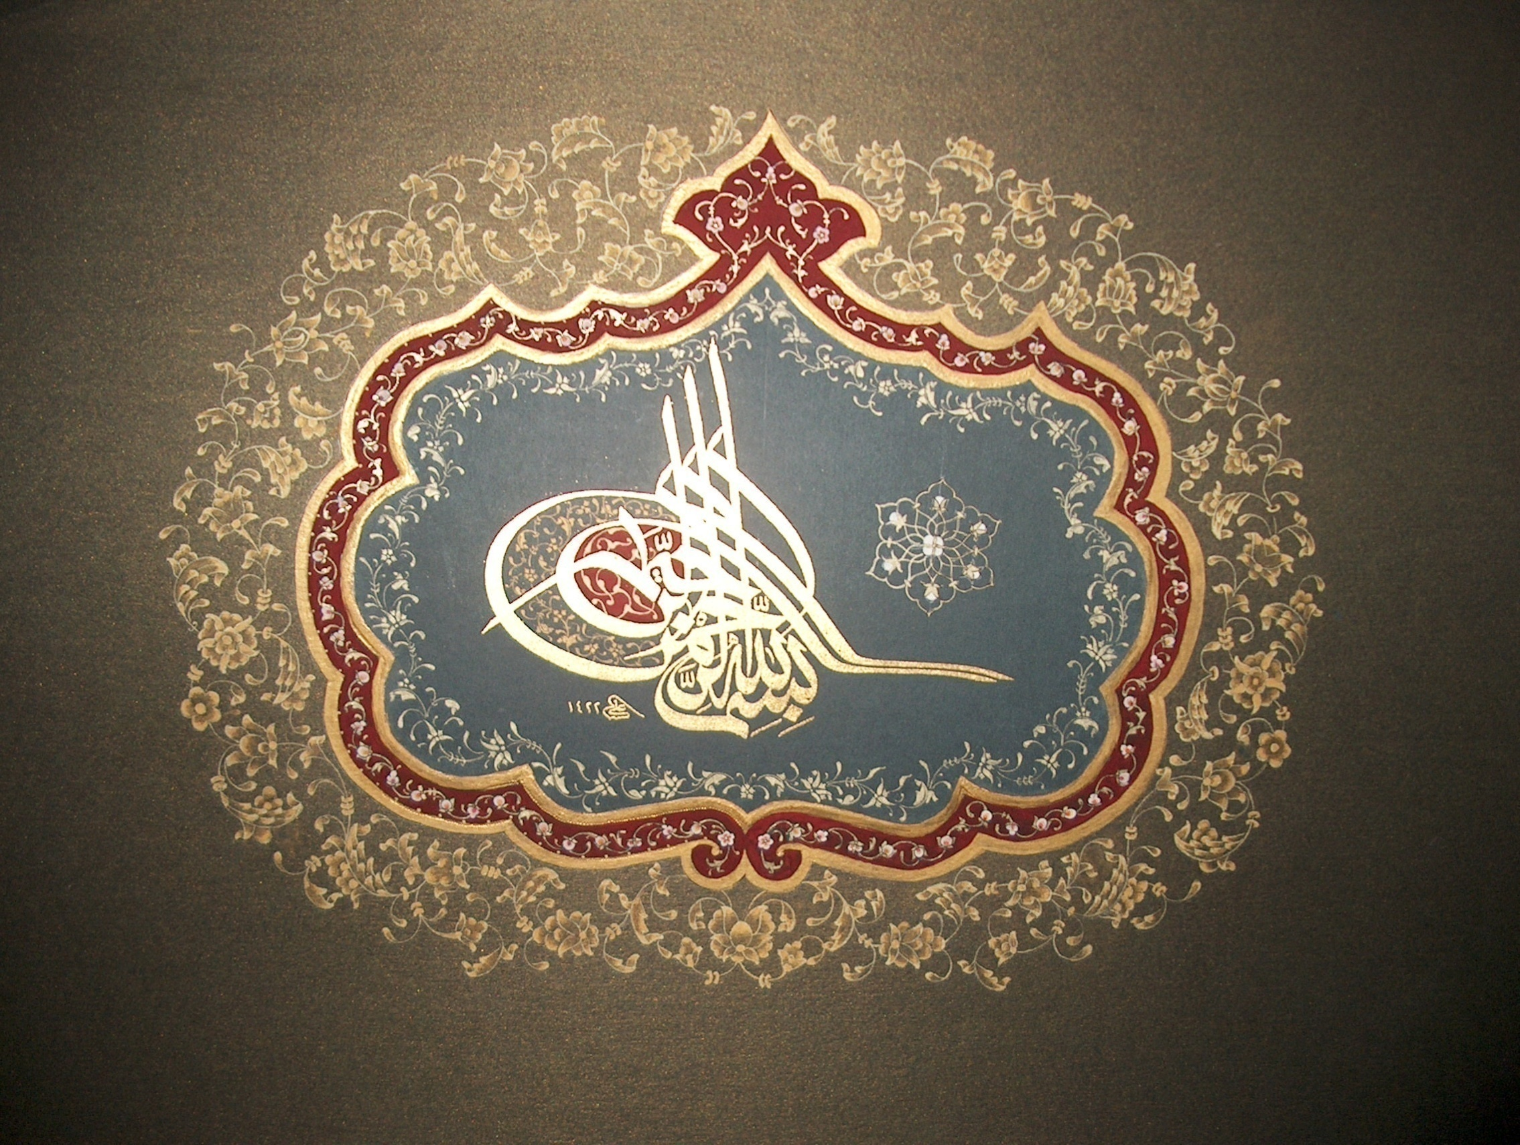
Saying,“ Bismillah" (In the Name of God) at the start is remembrance, and,
Saying,“Al-hamdu lillah” (All praise be to God) at the end is thanks.
And perceiving and thinking of those bounties, which are valuable wonders of art, being miracles of God and gifts of His mercy, is reflection.

Slide 18
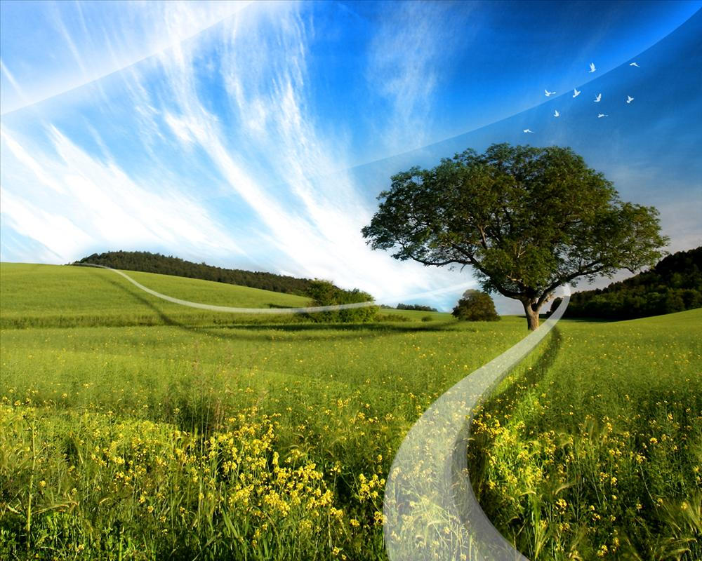
However foolish it is to kiss the hand of a man who conveys to you the valuable gift of a king and not to recognize the gift's owner, to praise and love a man (i.e. the apparent source of bounties; like tree, sun, soil, water…etc.) and forget the True Bestower of Bounties is a thousand times more foolish.

Slide 19
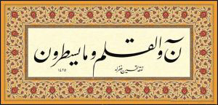
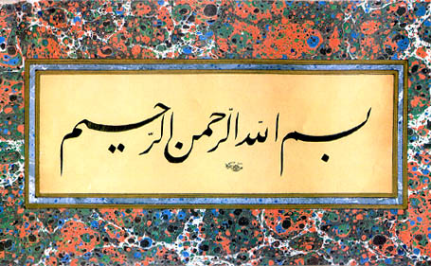
O my soul! If you do not wish to be foolish in that way,
give in God's name,
take in God's name,
begin in God's name,
and act in God's name.

