Slide 1
Cultivating Positive Qualities and Positive Thinking, Patience, Coping Skills, and Emotional Resilience
Notes:
Welcome, everyone, to today's presentation on the transformative power of combining the wisdom of Imam Ghazali with the practical techniques of Cognitive Behavioral Therapy (CBT) to address thought patterns and enhance well-being. For those who may not be familiar, allow me to provide a brief overview of both Ghazali and CBT before delving into our exploration.
Imam Ghazali, also known as Abu Hamid al-Ghazali, was a towering figure in Islamic scholarship during the 11th century. His profound insights into theology, philosophy, and mysticism have left an indelible mark on Islamic thought. Ghazali's teachings emphasized the importance of self-reflection, spiritual growth, and the purification of the soul. Central to his philosophy was the recognition of the power of thought in shaping our perception of reality and our relationship with the divine.
On the other hand, Cognitive Behavioral Therapy (CBT) is a modern therapeutic approach grounded in psychology. Developed in the 20th century, CBT focuses on identifying and challenging negative thought patterns and behaviors that contribute to emotional distress and dysfunction. By teaching individuals to recognize and modify these patterns, CBT empowers them to improve their mental health and overall quality of life.
In today's presentation, we will explore cultivating resilience through positive thinking and coping skills through the teachings of Zayd Al-Balkhi. After a brief recap of what we have studied so far, I will introduce you to Balkhi and his teachings in mental health. He is believed amongst many to have been the first cognitive behavioral therapist. I also have a PDF of his writings which I will be sharing the shared Google drive that you should all have access to. If for some reason you do not, you can reach out to Shule who will make sure you gain access.

Slide 2
The Little boy with the dead sparrow
Notes:
Anas bin Malik r.a said: “The Messenger of Allah s.a.w used to come to visit us. I had a younger brother who was called Abu ’Umair by nickname (kunyah). He had a sparrow which he played with, but it died. So one day the Prophet s.a.w came to see him and saw him grieving. He asked: ‘What is the matter with him?’ The people replied: ‘His sparrow has died.’ He (the Prophet s.a.w) then said: ’Oh Abu ‘Umair! What has happened to the little sparrow?’”

Slide 3
Tazkiyah al-nafs “The purification of the self"
Tazkiyah in Arabic = purification of something from impurities, and its growth, development, and perfection
“By the soul/self, and the proportion and order given to it; and its enlightenment as to its wrong and its right; truly he succeeds that purifies it [zakkaha], and he fails that corrupts it!” (Quran, 91:7-10)
Notes:
The purification of self (Tazkiyat al-Nafs) is an extremely important approach to perfecting the human condition and actualizing the state of being God’s vicegerent (khalifa) on earth.
The term tazkiyah in the Arabic language means purification of something from impurities, and its growth, development and perfection. Imam al-Ghazali developed the practice or art of tazkiyat al-nafs based on the Quranic verse (91:7-10):
“By the soul/self, and the proportion and order given to it; and its enlightenment as to its wrong and its right; truly he succeeds that purifies it [zakkaha], and he fails that corrupts it!”
In this sense, tazkiyat al-nafs can be defined as the purification of the self from all evil inclinations and its beautification with good values and virtues.
In our modern day and age rife with moral confusion and temptation, it is extremely important we are equipped with a method or process that we can use to re-gain mastery over our self and purify it from negative influences. This will then allow us nurture our own individual growth and development as better Muslims. Ghazali is a very helpful guide on this quest because he uses very clear terms and concepts geared towards individual growth and development. For Ghazali, a human being is both, body and soul, matter and spirit. It is the unique balance between the two that makes humans what they are, the highest creation.

Slide 4
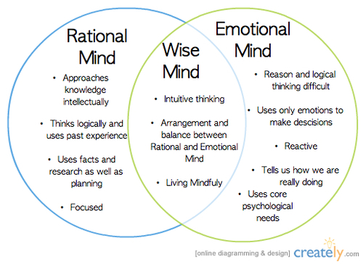
What is CBT?
Notes:
Cognitive Behavioral Therapy (CBT) is a widely used therapeutic approach that focuses on the connections between thoughts, feelings, and behaviors. It's based on the idea that our thoughts and perceptions influence how we feel emotionally and how we behave.
In CBT, therapists work collaboratively with clients to identify and challenge negative or distorted thought patterns and beliefs that may be causing emotional distress or dysfunctional behavior. By helping individuals recognize these patterns and develop more balanced and realistic ways of thinking, CBT aims to alleviate symptoms of various mental health conditions such as depression, anxiety disorders, PTSD, and more.
CBT also involves teaching practical skills and techniques to help individuals cope with difficult emotions, manage stress, and solve problems effectively. These techniques may include relaxation exercises, mindfulness practices, behavioral experiments, and cognitive restructuring, among others.
Overall, CBT is a structured, goal-oriented therapy that empowers individuals to become more aware of their thoughts and behaviors and learn practical strategies to improve their mental health and well-being.

Slide 5
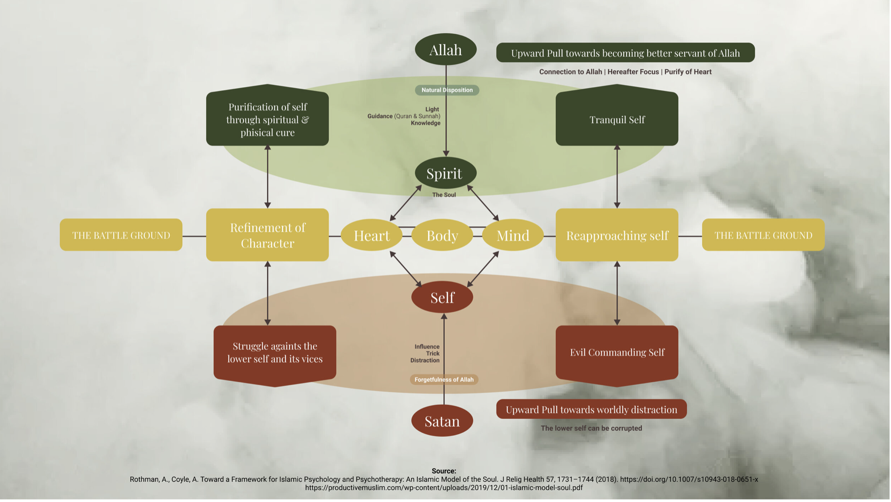
Notes:
Purification of self is the struggle against the inciting self to actualize the tranquil self. This requires that we turn inward, starting with understanding our inner life.

Slide 6
Notes:
Look at the diagram on the screen. This is from the teachings of Imam Ghazali on the important of positive intentions and how to cultivate them.
Intention is something that we do when we are just about to perform an action. It means that an intention happens at the moment that an action is about to be performed. But an intention is the result of a long internal process that begins with what the scholars call a prompting (khatir).
What is a prompting?
A prompting is a faint idea, passing thought, or suggestion that pops into our head quickly and pops out as quickly as it came. It happens extremely fast. We have these ‘faint ideas’ all the time. A prompting is an urge to do something right or wrong and is characterized by the speed by which it comes to us and leaves us.

Slide 7
Notes:
Look at the diagram above again. The scholars teach us that if we think about the prompting or entertain it a little in our mind it transforms into a will (irada) or desire to do it. If we still think about it, it becomes stronger and transforms into a determination (‘azm) and then an objective (qasd) or goal. At this point we have thought about it long enough that it becomes a purposeful thing we intend to do. This process is very fast, faster than the blink of an eye sometimes. Hence the importance of cultivating the growth and crystallization of a good intention.

Slide 8
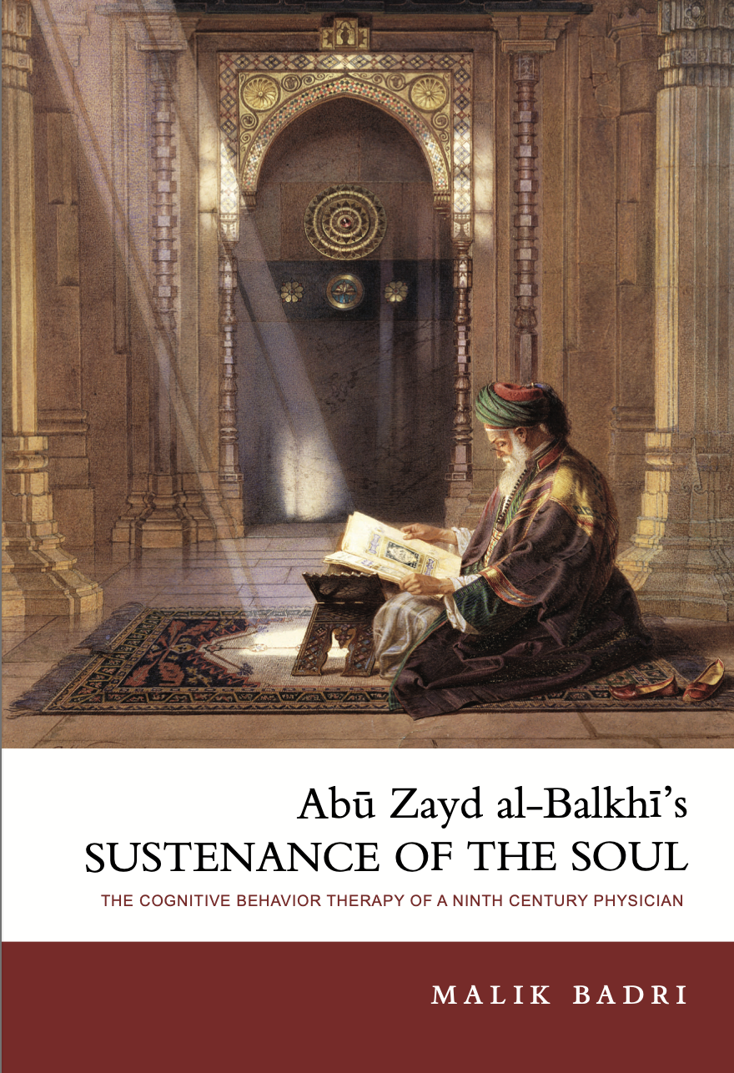
Zayd al-Balkhi Sustenance for Bodies and Souls
850-934 CE
“The right approach is to supplement ministrations to the body with those directed to the soul; this is essential.”
Notes:
Abu Zayd Ahmad ibn Sahl al-BalkhÏ (236–322/ 850–934), the author of the book here presented, was one of the greatest scholars of his time. In the fields of philosophy, mathematics, history, geography, medicine, belles lettres, grammar, and others, he composed about sixty works, most of them non-exis- tent.1 From the few which have survived, however, we gather that Abu Zayd was a natural philosopher possessed of a vast fund of knowledge, a capacity for original thinking, and a concise literary style.
As he himself put it, “The right approach is to supplement minis- trations to the body with those directed to the soul; this is essential.” The benefit is intensified by reason of the interrelation between the two. Man’s constitution is from both his soul and body; there is no con- ceiving that he may endure, except by their union, giving rise to human actions. The two participate in events, both joyful and sorrowful, and in accidental pain.

Slide 9
The Intersection of Ghazali and Al-Balkhi
1. Approach to Emotional Well-Being
2. Understanding Fear & Anxiety
3. Preventative vs. Curative Approach
4. Integration of Rationality & Spirituality
Notes:
Both Ghazali and al-Balkhi offer valuable insights into human psychology and emotional well-being, albeit in different historical and cultural contexts. Here's a comparison of their thoughts on certain aspects:
1. **Approach to Emotional Well-being:**
- Ghazali: Ghazali emphasizes the importance of spiritual purification and moral character development as essential components of emotional well-being. He advocates for self-reflection, mindfulness, and the cultivation of virtues such as patience, gratitude, and humility to attain inner peace and contentment.
- Al-Balkhi: Al-Balkhi focuses on the psychological aspects of emotional well-being, offering practical techniques and therapeutic strategies to address emotional disturbances. He emphasizes cognitive restructuring, rational thinking, and behavior modification to alleviate symptoms of distress and promote psychological resilience.
2. **Understanding Fear and Anxiety:**
- Ghazali: Ghazali addresses fear and anxiety from a spiritual perspective, highlighting the role of trust in Allah (tawakkul) and reliance on divine providence in overcoming these emotions. He encourages individuals to strengthen their faith and surrender their worries to Allah, trusting in His wisdom and mercy.
- Al-Balkhi: Al-Balkhi approaches fear and anxiety from a cognitive-behavioral standpoint, emphasizing the role of irrational thinking patterns and maladaptive behaviors in perpetuating these emotions. He advocates for cognitive restructuring, exposure therapy, and relaxation techniques to challenge and overcome irrational fears and anxieties.
3. **Preventive vs. Curative Approach:**
- Ghazali: Ghazali's teachings often focus on preventive measures to maintain emotional well-being, such as spiritual practices, moral conduct, and mindfulness. He emphasizes the importance of cultivating virtuous habits and attitudes to prevent the onset of emotional disturbances.
- Al-Balkhi: Al-Balkhi adopts both preventive and curative approaches to emotional well-being. While he emphasizes the importance of cultivating healthy thought patterns and coping strategies as preventive measures, he also provides therapeutic techniques to address existing emotional disturbances and alleviate symptoms of distress.
4. **Integration of Rationality and Spirituality:**
- Ghazali: Ghazali integrates rational inquiry with spiritual insight, advocating for a balanced approach to understanding the self and the world. He encourages critical thinking and self-examination while also emphasizing the importance of spiritual guidance and divine revelation in seeking truth and attaining inner peace.
- Al-Balkhi: Al-Balkhi's approach is primarily grounded in rationality and empirical observation, focusing on practical techniques and evidence-based strategies to address psychological issues. While he acknowledges the role of spirituality and faith in emotional well-being, his emphasis is primarily on psychological principles and therapeutic interventions.
Overall, while Ghazali and al-Balkhi approach the topic of emotional well-being from different perspectives, both offer valuable insights and practical guidance for navigating the complexities of human psychology and spirituality. Their teachings complement each other, providing a holistic framework for promoting inner peace, resilience, and personal growth.

Slide 10
Four classifications of neuroses
Fear and Panic “al-khawf wa al-faza”
Anger and Aggression “al-ghadab”
Sadness and Depression “al-huzn wa al-jaza”
Obsessions “al-waswasah”
Furthermore, he wrote in great detail of how rational and spiritual cognitive therapy could be used to treat each one of his classified disorders.
Notes:
the Sustenance of the Soul, Abu Zayd al-BalkhÏ presented physicians of the ninth century with medical and psychotherapeutic information that was far ahead of his time and only discovered or developed more than eleven centuries after his death. He was probably the first physician to clearly differentiate between mental and psychological disorders; between psychoses and neuroses. He was also the first to classify emotional disorders in a strikingly modern way and to categorize them in one general classification.

Slide 11
Eight chapters of sustenance of the soul
2. Sustenance of Psychological Health
3. Ways of Regaining Psychological Health When One Loses it
4. Enumerating the Psychological Symptoms and Specifying their Distinguishing Attributes
5. How to Counteract Anger and Get Rid of It
1. Sustaining Health of the Nafs (Soul)
6, Tranquilizing Fear
7. Methods of Dealing With Sadness & Depression
8. Mental Maneuvers that Fend off the Recurring Whispers of the Heart and the Obsessive Inner Speech of the Soul

Slide 12
Al-BalkhI as a Modern Counseling Psychologist
His humane approach stresses that emotional disorder is simply a learned habit that need not divide people into normal persons and patients.
Notes:
Al-Balkhi's work stands out for its broad scope, which extends beyond just individuals with diagnosed mental health conditions. He addresses emotional challenges not only in those considered "patients" but also in everyday people who experience emotional ups and downs. Al-Balkhi views emotional struggles not as fixed conditions but as habits that can develop over time. This perspective emphasizes that emotional difficulties are not exclusive to a certain group but rather a common aspect of human experience. This approach contrasts with traditional psychotherapy, which often focuses solely on treating diagnosed illnesses, neglecting the psychological well-being of those who may simply be feeling unhappy.

Slide 13
Al-Balkhi’s advice for Cultivating Positive Qualities, Positive Thinking, Patience, Coping Skills, and Emotional Resilience
1. External Factors: what a person sees or hears in their environment (fearful things, humiliating words, etc.)
2. Internal Factors: Thinking that leads to anger, sadness or fear
Notes:
Balkhi said that faulty thinking leads to emotional habits of anxiety, anger, and sadness and is the main reason behind disorders of the soul.
He often uses physical concepts of the body to bring a better understanding. For example, he says that the body can lose its health from external or internal factors. External factors such as heat or cold. And internal factors such as what he calls the imbalance of humors.
To illustrate, al-Balkhi provides vivid examples of fear and anxiety in everyday life. He discusses scenarios where individuals experience anxiety about future uncertainties, such as losing a job or facing health issues, as well as fear or panic related to specific phobias, like thunder or death. After presenting these examples, he demonstrates that many of the things people fear are not as harmful as they may seem when approached with rational and logical thinking. He uses a compelling analogy to drive this point home: Imagine a fearful Bedouin encountering thick fog for the first time in a cold, humid country. Initially, he perceives the fog as a solid, impenetrable barrier. However, upon entering it, he realizes that it's just humid air, no different from what he was breathing moments ago. Through cognitive rational therapy, al-Balkhi suggests that individuals undergoing treatment would similarly come to realize that many of their fears and worries are irrational, much like the harmless nature of fog.
When discussing cognitive therapy, al-Balkhi takes a proactive approach that goes beyond the focus on treatment found in modern cognitive therapy. He introduces a thought-provoking analogy comparing the body to the mind. Just as a physically healthy individual keeps medicine on hand for unforeseen emergencies, al-Balkhi suggests that maintaining a reserve of healthy thoughts and emotions in the mind is essential for managing unexpected emotional challenges. These positive thoughts and cognitions, he suggests, should be cultivated and stored during moments of calm and relaxation. Through this analogy, al-Balkhi emphasizes a form of psychotherapy that aligns with what we now term "rational cognitive therapy."

Slide 14
Al-Balkhi’s advice for Cultivating Positive Qualities, Positive Thinking, Patience, Coping Skills, and Emotional Resilience
“Given the significant impact of psychological symptoms on our overall well-being, it's essential for each of us to prioritize the care of our souls and take proactive measures to protect them from disturbances and anxieties. Neglecting our mental health can lead to a life filled with unhappiness and turmoil, similar to how bodily symptoms cause pain and illness, resulting in a state of suffering. Therefore, it's crucial to address psychological distress with the same level of attention and care as we would physical ailments, to ensure a balanced and fulfilling life.”
Notes:
In Balkhi’s book he says: We begin by recognizing that as human beings, we are composed of both a physical body and a soul, and it's inevitable that we will encounter challenges affecting both aspects of our being. On the physical side, we may experience symptoms like fever, headaches, and various pains that disrupt our bodily well-being. On the psychological side, we encounter symptoms such as anger, sorrow, fear, and panic, which can significantly impact our mental health.
Interestingly, psychological symptoms tend to occur more frequently than bodily symptoms. While some individuals may rarely experience physical ailments throughout their lives, almost everyone grapples with psychological distress at some point. However, the intensity of these emotional responses varies from person to person, influenced by factors such as temperament and constitution.
For instance, some individuals may have a quick temper, while others exhibit more patience and resilience. Similarly, reactions to fear can range from overwhelming panic to composed courage, depending on one's predisposition and ability to cope with distressing situations. These differences are not only evident between individuals but also across different demographic groups, such as women, children, and those with inherently strong or weak dispositions.
Given the significant impact of psychological symptoms on our overall well-being, it's essential for each of us to prioritize the care of our souls and take proactive measures to protect them from disturbances and anxieties. Neglecting our mental health can lead to a life filled with unhappiness and turmoil, similar to how bodily symptoms cause pain and illness, resulting in a state of suffering. Therefore, it's crucial to address psychological distress with the same level of attention and care as we would physical ailments, to ensure a balanced and fulfilling life.

Slide 15
Emotional resilience & Positive coping skills
Stress can be internal or external. Therefore, the treatments can be internal or external, as well.
Advice 1: On good days, practice gratitude, on bad days, practice self-convincing.
Notes:
Self-convincing = self talk.
The inherent nature of this dunya is a world of tribulation, a world of difficulties. For this reason, we don’t put expectations upon it that are unrealistic. Because some of the stress we carry with us comes from unrealistic expectations. Whether it is from the people in our lives or the world itself and how it functions.
Allah asks us a rhetorical question about this in the Qur’an, when He asks us if we think we won’t be tested just because we say we believe. We will be tested. Don’t expect it to be other than that. We believe in the akhira which is the place of no trials and tribulations and full tranquility only comes there. So we actually have a very pragmatic view of the world and it can help us keep our expectations in check. But we also shouldn’t look at the world as bleak and terrible. We should follow the prophetic middle way. In suratul Baqarah, Allah explains that we will certainly be tested with fear, hunger, loss of wealth, etc.
Balkhi is reminding us to be pragmatic when things are going well – pause – remind yourself that this world is not meant to be the easiest place and hold on to those happy thoughts. Keep them in a treasure box when you need to pull them out to remind yourself that even in your darkest moments, you know things are also good sometimes.
This is al-Balkhi’s technique for protecting yourself from stress and to teach us how to be more resilient and that when the time comes and we need to draw upon our inner strength, we know how to do that.

Slide 16
External help
When we need help externally, that it is not a shameful thing to do.
“So ask the People of Knowledge if you do not know.” (16:43)
Notes:
Allah tells us to ask people of knowledge at all times when we do not know.

Slide 17
Stress reduction techniques
1. Center Yourself
2. Reciprocal Inhibition
3. Tenets of Social Interactions
4. Know Your Degree of Forbearance
5. Protect Yourself
Notes:
Center Yourself – This means to become relaxed and tranquil and remind ourselves that the stressors are only to be expected, they are temporary, and when it feels like everything is too easy, it is too good to be true ☺
Reciprocal inhibitions – This is actually a technique we use all the time in practice today. This is where you take something that is a difficult stimulus or emotion and you repeatedly connect it with a relaxing response until you create a bond between these two things. The painful, stressful stimuli and the relaxing stimuli and you continue to pair them together until you finally have something called systemic desensitization. You desentize yourself from that stress. And we have an example of this in our own religious traditions. What do we usually say when someone passes away or when something is taken from us?
Tenets of social interactions – we should know that dealing with other people can be stressful and that this is a part of life. Family, spouses, friends, parents, co-workers, etc. Train yourself not to overreact to minor incidences or experiences. We all have seen people go from 0-100 over something that is relatively small. Just like when it gets really hot or really cold. If you get really cold, you can put on a jacket. And you can take it off when it gets really hot. We know what to do with our bodies when we feel hot or cold, al-Balkhi says, so why don’t we know how to handle our emotions? This requires thinking and planning ahead of time.
Then he says every person must be aware of the degree of forbearance that their soul can bear or not bear. Because everything we’ve said so far stands, but how it applies to each person will be different. How much we are able to handle or bear is different. We all have different degrees of forbearance. Our level of endurance is really important, and sometimes working with a professional can help you regulate that when you don’t know how, because we are trained in recognizing and customizing it to your needs. But it starts with knowing yourself, knowing your triggers and then making plans accordingly.
This brings us to the next of his advices, which is to protect ourselves from the things that cause us stress. This doesn’t mean we shut ourselves in and avoid all stressful situations, but we all know what types of gatherigns, conversations, and sometimes people can bring us stress. Then it is best to set a limit to those kinds of gatherings. I’m not saying isolate. But go, perhaps avoid meaningless conversations, and then get out. But this takes discipline. We call this boundary setting in modern day speech. It boils down to knowing what type of problems we are ready to face and what kind we need to avoid at all costs – and when we need outside support.

Slide 18
Stories of trials and tribulations from the qur’an
1. Prophet Yunus (Jonah) – 3 Layers of Darkness
2. Prophet Suleiman – Trials of Wealth
3. Prophet Yaqub (Jacob) – Embracing Resilience
4. The Mother of Moses – Trusting the Process
5. Asiya – A Home in Jannah (Heaven)
6. Hajar – A Well of Blessings
7. Prophet Yusuf (Joseph) - Betrayal and Complex Trials
8. Prophet Adam - Temptation
9. Prophet Muhammad - Persecution, Loss, Ta'if, and Ascension
10. Maryam (Mary) - Unshakeable Tawakkul (Full Trust in God)
11. Aisha - Trials of Slander
12. Prophet Ibrahim - The Power of Dua (Supplication)
Notes:
Both Ghazali's teachings and modern day psychology recognize the importance of recognizing and controlling thought patterns. CBT aims to identify and challenge negative thought patterns to promote healthier thinking, similar to Ghazali's emphasis on purifying the mind from negative thoughts. While Ghazali's teachings are rooted in Islamic spirituality and ethics, and CBT is a secular therapeutic approach, they share common principles and techniques for promoting mental well-being and personal development. Both emphasize the role of individual agency, self-awareness, and intentional behavior change in overcoming challenges and achieving inner peace.
Controlling thought patterns involves a combination of self-awareness, cognitive restructuring, and mindfulness techniques. Here's a detailed exploration of how to control thought patterns:
1. **Self-Awareness:**
- Start by observing your thoughts without judgment. Notice the types of thoughts that arise, their frequency, and their impact on your emotions and behavior.
- Keep a thought journal to track recurring patterns and identify triggers that lead to negative or unproductive thoughts.
2. **Cognitive Restructuring:**
- Challenge negative or irrational thoughts by examining evidence for and against them. Ask yourself if there is another way to interpret the situation.
- Replace negative thoughts with more balanced and realistic alternatives. For example, instead of thinking "I'm a failure," reframe it as "I may have made a mistake, but I can learn from it and improve."
3. **Mindfulness Techniques:**
- Practice mindfulness meditation to cultivate present-moment awareness and observe thoughts without getting caught up in them.
- Use mindfulness techniques such as deep breathing or body scanning to anchor yourself in the present and interrupt negative thought patterns.
4. **Positive Self-Talk:**
- Replace self-critical or self-defeating thoughts with positive affirmations and statements of self-compassion.
- Encourage yourself with words of encouragement and remind yourself of past successes and strengths.
5. **Seek Support:**
- Talk to a trusted friend, family member, or therapist about your thoughts and feelings. Sometimes, sharing your concerns with others can provide perspective and support.
- Consider seeking professional help if negative thought patterns persist and significantly impact your daily functioning.
6. **Lifestyle Factors:**
- Pay attention to lifestyle factors such as sleep, nutrition, exercise, and stress management, as these can influence your thought patterns and overall mental well-being.
- Engage in activities that promote relaxation and joy, such as hobbies, spending time in nature, or connecting with loved ones.
By incorporating these strategies into your daily life, you can gradually gain greater control over your thought patterns and cultivate a more positive and resilient mindset. Remember that changing thought patterns takes time and effort, so be patient and compassionate with yourself throughout the process.

Slide 19
The tricks of shaytan when it comes to Resilience
1. Magnifying mistakes
2. Fueling negative self-talk
3. Discouraging repentance
4. Promoting despair
Notes:
As we stated in the previous slides, Shaytan, or Satan, may exploit feelings of guilt, shame, and self-condemnation to manipulate and deceive individuals, leading them further away from God and towards despair and hopelessness. Here's how Shaytan may use self-forgiveness against people:
1. **Magnifying Mistakes:** Shaytan may magnify and exaggerate the significance of a person's mistakes, making them feel overwhelmed by guilt and shame. By amplifying feelings of unworthiness, Shaytan seeks to create a barrier between individuals and their ability to seek forgiveness and redemption from God.
2. **Fueling Negative Self-Talk:** Shaytan may encourage negative self-talk and self-criticism, reinforcing beliefs of inadequacy and unworthiness. By fostering a negative self-image, Shaytan seeks to undermine individuals' confidence and resilience, making them more susceptible to despair and despair.
3. **Discouraging Repentance:** Shaytan may discourage individuals from seeking forgiveness and repentance by convincing them that their sins are too grave to be forgiven or that they are unworthy of God's mercy. By instilling doubt and despair, Shaytan seeks to prevent individuals from experiencing the transformative power of repentance and redemption.
4. **Promoting Despair:** Shaytan may exploit feelings of guilt and shame to promote despair and hopelessness, convincing individuals that they are irredeemably sinful and beyond God's forgiveness. By fostering a sense of despair, Shaytan seeks to lead individuals away from God's mercy and towards spiritual stagnation and despair.
To counter Shaytan's tactics, it's essential for individuals to recognize and challenge negative thoughts and beliefs, seek forgiveness and redemption through sincere repentance, and cultivate a deep trust in God's mercy and compassion. By embracing self-forgiveness and turning to God with sincerity and humility, individuals can overcome Shaytan's influence and experience true spiritual healing and growth.

Slide 20
Combat the influence
Seek Refuge in Allah
Develop Self-Awareness
Challenge Negative Thoughts
Strengthen Faith & Connection to Allah
Seek Forgiveness & Repentance
Stay Connected to Positive Influences
Practice Self-Compassion
Stay Grounded in Reality
Notes:
To counter Shaytan's tactics, it's essential for individuals to recognize and challenge negative thoughts and beliefs, seek forgiveness and redemption through sincere repentance, and cultivate a deep trust in God's mercy and compassion. By embracing self-forgiveness and turning to God with sincerity and humility, individuals can overcome Shaytan's influence and experience true spiritual healing and growth.
Combatting Shaytan's influence within ourselves requires vigilance, self-awareness, and a strong connection to God. Here are some strategies to counter Shaytan's tactics:
1. **Seek Refuge in God (A'udhu billahi min ash-shaytan ir-rajim):**
- Begin every endeavor and action by seeking refuge in God from Shaytan's whisperings and evil influences. This simple yet powerful invocation serves as a reminder of God's protection and guidance.
2. **Develop Self-Awareness:**
- Cultivate mindfulness and self-awareness to recognize Shaytan's tactics and the negative thought patterns he instigates. Pay attention to your inner dialogue and emotions, and be vigilant against thoughts of guilt, shame, and despair.
3. **Challenge Negative Thoughts:**
- Actively challenge negative thoughts and beliefs that arise, questioning their validity and reframing them in a more positive and constructive light. Replace self-critical thoughts with words of self-compassion and self-encouragement.
4. **Strengthen Faith and Connection to God:**
- Deepen your faith and connection to God through regular prayer, recitation of Quranic verses, and remembrance (dhikr) of God's names and attributes. Strengthening your spiritual connection serves as a protective barrier against Shaytan's influence.
5. **Seek Forgiveness and Repentance:**
- Regularly seek forgiveness and repentance from God for any sins or mistakes, recognizing your human fallibility and the need for divine mercy. Turn to God with sincerity and humility, knowing that His mercy is vast and all-encompassing.
6. **Stay Connected to Positive Influences:**
- Surround yourself with positive influences, such as supportive friends, mentors, and religious leaders, who encourage growth, resilience, and spiritual well-being. Seek out uplifting and inspiring content that nourishes your soul and strengthens your faith.
7. **Practice Self-Compassion:**
- Cultivate self-compassion by treating yourself with kindness, understanding, and forgiveness. Recognize that making mistakes is a natural part of the human experience and that you are worthy of love and forgiveness, despite your imperfections.
8. **Stay Grounded in Reality:**
- Maintain a realistic perspective on your strengths, weaknesses, and limitations. Avoid comparing yourself to others or holding yourself to unrealistic standards, as this can leave you vulnerable to Shaytan's attacks on your self-esteem and self-worth.
By implementing these strategies and remaining steadfast in your faith and connection to God, you can effectively combat Shaytan's influence within yourself and experience greater peace, resilience, and spiritual growth.

Slide 21
Dhikr for resilience and cultivating positive qualities
Gratitude - Alhamdulilah: Alhamdulillah Reciting this dhikr, which means "All praise is due to Allah," fosters gratitude and positive thinking by acknowledging and appreciating Allah's blessings and favors.
Patience - Inna ma'al usri yusra: This phrase, which means "Verily, with hardship comes ease,” reminds believers of the temporary nature of difficulties and encourages patience and perseverance in challenging times.
Tawakkul (Reliance on Allah) - Hasbunallahu wa ni'mal wakeel: Reciting this supplication, which means "Allah is sufficient for us, and He is the best disposer of affairs," instills trust in Allah's divine wisdom and strengthens one's coping skills by surrendering to His will.
Emotional Resilience - La tahzan, Innallah ma'ana This phrase, meaning "Do not grieve, indeed Allah is with us," offers solace and reassurance in times of distress, nurturing emotional resilience by affirming Allah's presence and support.
Cultivating Inner Strength - La hawla wa la quwwata illa billah: Reciting this phrase, meaning "There is no power nor strength except with Allah," reminds believers of their dependence on Allah's strength and resilience, empowering them to face challenges with confidence and faith.
Notes:
And more!

