Slide 1
Faith & Mindfulness

Slide 2
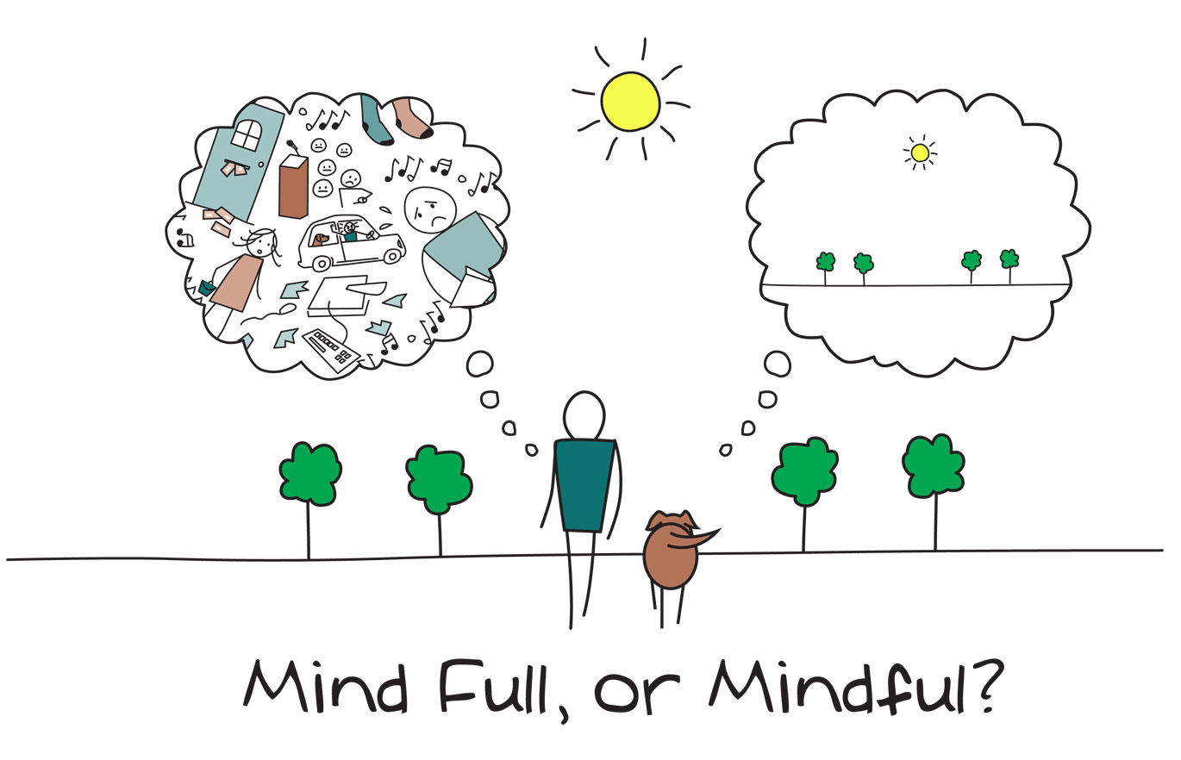
Notes:
Mindfulness became popular in the US in the 1960s, but has been a part of both our islamic tradition and ancient traditions for centuries.
mindfulness in the Western context is about cultivating a state of active, open attention on the present. It involves observing one's thoughts and feelings without judgment, which helps to create a sense of calm and focus. This practice is often seen as a way to enhance psychological well-being and improve quality of life through increased awareness and acceptance.
mindfulness in Islam is a holistic concept that encompasses spiritual awareness, ethical living, and continuous self-reflection. It integrates the mindfulness of one's inner state with the external adherence to Islamic teachings, aiming for a harmonious and conscious life that is always aware of Allah’s presence.

Slide 3
Muraqabah مراقبة
Vigilance, watchfulness
Involves constantly being aware of one’s thoughts, actions, and the presence of Allah
Taqwa, niyyah, dhikr, muhasabah, khushu, wasatiyyah
Notes:
Mindfulness in the Islamic perspective, often referred to as "muraqaba" (which can mean vigilance or watchfulness), involves being constantly aware of one's thoughts, actions, and the presence of God (Allah). It integrates mindfulness practices with spiritual consciousness and ethical living according to Islamic teachings. Here are key aspects of mindfulness from the Islamic perspective:
1. **Awareness of God (Taqwa):**
- Central to Islamic mindfulness is the concept of **taqwa**, which means having a consciousness of Allah in every aspect of life. It involves being aware that Allah is always watching and that one is accountable for their actions.
- This awareness helps Muslims to align their actions with Islamic principles, fostering a sense of spiritual vigilance and moral integrity.
2. **Intention (Niyyah):**
- In Islam, the intention behind actions is crucial. Mindfulness includes being conscious of one’s intentions (niyyah) in every action, ensuring they are for the sake of Allah.
- A hadith (saying of the Prophet Muhammad) emphasizes the importance of intention: "Actions are judged by intentions."
3. **Remembrance of Allah (Dhikr):**
- Dhikr, or the remembrance of Allah, is a practice that involves reciting phrases that glorify and praise Allah. This can be a form of meditation that keeps the believer mindful of God’s presence.
- Regular dhikr helps in maintaining a state of mindfulness and spiritual awareness throughout the day.
4. **Self-Reflection (Muhasabah):**
- Muhasabah involves self-examination and reflection on one's deeds and thoughts. Muslims are encouraged to regularly assess their actions and intentions to ensure they conform to Islamic teachings.
- This practice promotes self-awareness and continuous improvement in one's spiritual and moral conduct.
5. **Presence in Worship (Khushu):**
- Khushu refers to a state of humility and concentration in prayer (Salah). Muslims strive to perform their prayers with full attention and a sense of reverence, being mindful of each movement and recitation.
- Achieving khushu in prayer is seen as a way to deepen one’s connection with Allah and enhance overall mindfulness.
6. **Balance and Moderation (Wasatiyyah):**
- Islam advocates for a balanced approach to life, avoiding extremes. This concept of wasatiyyah can be seen as a form of mindful living, where one maintains equilibrium in their spiritual, physical, and emotional aspects of life.
- Practicing moderation helps in leading a mindful and disciplined lifestyle.
In summary, mindfulness in Islam is a holistic concept that encompasses spiritual awareness, ethical living, and continuous self-reflection. It integrates the mindfulness of one's inner state with the external adherence to Islamic teachings, aiming for a harmonious and conscious life that is always aware of Allah’s presence.

Slide 4
Origins of mindfulness
Buddhism
Notes:
Now, mindfulness actually started as a practice with Buddhism. Hamza Yusuf actually wrote an article called Buddha in Quran? That discusses the parallels between what we know about Khidr (as) and Buddha and there are a lot of them. Some scholars even suggest that they may have been the same person. Allahu alim.
Anyway the Buddha talked about mindfulness often and I was interested to see how they translated the word mindfulness from the Pali language, which was the original language he spoke. Another side note, Dr. Thomas Cleary, who was a translator or eastern texts, including islamic works, argues that in the earliest manuscript called the Dhammapadha, that the Buddha actually predicted the coming of the Prophet Muhammad, pbuh.
The word used is sati.

Slide 5
Sati = dhikr
Notes:
Sati in the pali language means “remembrance of the sacred scriptures” So, its dhikr. The question then becomes what are we doing dhikr of? In other words, what is our mind full of? Are we doing dhikrulnafs? Just thoughts full of ourselves?

Slide 6
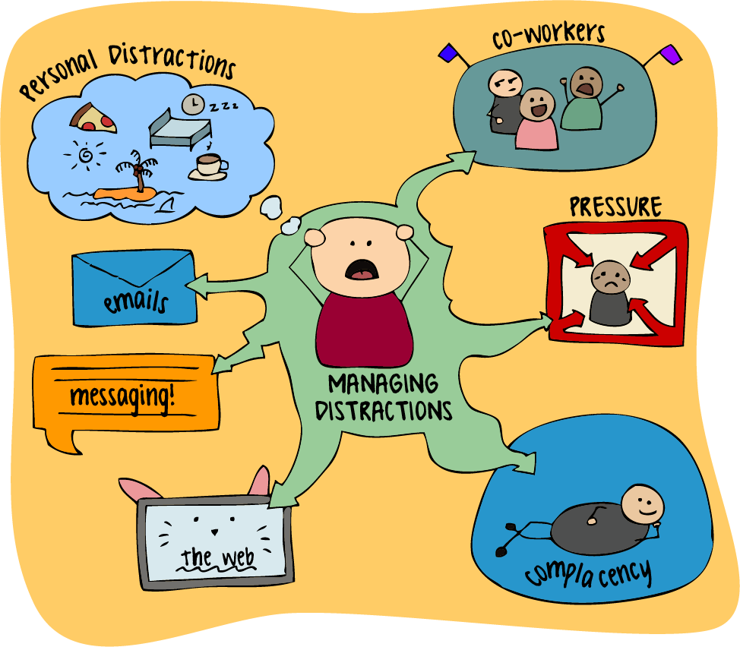
A world of distractions
This Photo by Unknown Author is licensed under CC BY
Notes:
We live in an age of immense distractions, I argue that we live in the most distracted age of human history. But what does distraction mean?
We are living in a time where people don’t even know what they are and have forgotten Allah. They think this is all meaningless and they are completely distracted. What are they distracted from and who is distracting them?
One of the problems of distraction is that if you’re looking for it, there are plenty there, and plenty of people that will help you find it. Think about advertisements for a moment.

Slide 7
Advertisements, distractions, and our state of mind
This Photo by Unknown Author is licensed under CC BY-SA-NC
This Photo by Unknown Author is licensed under CC BY
Notes:
Advert literally means to distract or draw your attention to something. Social media was designed to keep us on it. And they don’t call it surfing the web for no reason. What do you know about webs? Or better what do spiders do in their webs?
Now think about surfing. Has anyone here ever gone surfing before? When you surf, all you can do is try to stay afloat, but the wave takes you away. Same goes for surfing the web and wasting time on social media.
One of the definitions of distraction is that it creates mental distress and divides your attention. In the English language, the meaning of the root word of decide is to cut. Because when you decide to do something, you cut off everything else related to that choice. So we have to make decisions like where do we spend our time and who do we give our time to?

Slide 8
Where do we spend our time? who do we give our time to?
What you give your attention to, will determine your reality.
Notes:
The word in Arabic for distraction is ilha (coming from il ha un) which means to pull somebody into lahu or entertainment, which is the pleasureable occupation of the mind.
In other words, what you give your attention to, will determine your reality. For example, if we watch news that constantly talks about crime, we will think crime is much more relevant than it actually is, and we will walk around scared, like chicken little. So, if what we give our attention to determines our reality, then what is Allah asking of us?
He is asking us to give our attention to Him.

Slide 9
What is attention?
Courtesy
What a lover gives their beloved
Devotion
In Arabic – ihtimam إهتمام what you are concerned with and what preoccupies your mind.
Notes:
In English, attention has a lot of meanings, one of them is courtesy. “He was very attentive of me”
So your attention becomes your devotion. Prophet Muhammad PBUH said whoever makes his concerns about one thing, Allah will take care of all of his other concerns. What is that? Hum al-akhira.
Prophet Muhammad also said to die before you are dead. Meaning come to attention before you are brought to attention, or wake up now.

Slide 10
Yaqadha يقظة
In Arabic means "alertness," "wakefulness," or "vigilance." It refers to a state of being awake and aware, both physically and mentally. In a spiritual context, yaqadha can denote a heightened state of awareness and consciousness, particularly regarding one's actions, thoughts, and spiritual duties. It emphasizes being mindful and attentive to one's responsibilities and surroundings.
This Photo by Unknown Author is licensed under CC BY-NC-ND
Notes:
And this is what mindfulness is really about, dhikr. It is what is coming to another word for attention in Arabic which is yaqadha
I always find it very interesting that in post-modern writings we often see people avoiding the concept of death, yet in pre-modern writing it was often the focus. Why? Because they are choosing to occupy their minds with other things rather than what is really important. They used to write about death in as a fear tactic, but as a reminder that we are finite beings. Have you ever heard the old saying carpe diem? Seize the day…it actually never meant that. It was used in old writings as reminder that in one of the hours of one of the days you will be seized.
So the post-modern world might want to avoid talking about death, but the end of this dunya is just the beginning of the eternal world where there is no death. And the start of our real lives.
Prophet Muhammad was fully aware of death and there is not a page in the Qur’an that doesn’t have the scent of death permeating from it, but not in the morbid sense. This is not morbidity, it is actually to make us fully aware of the preciousness of the time we have been given.

Slide 11
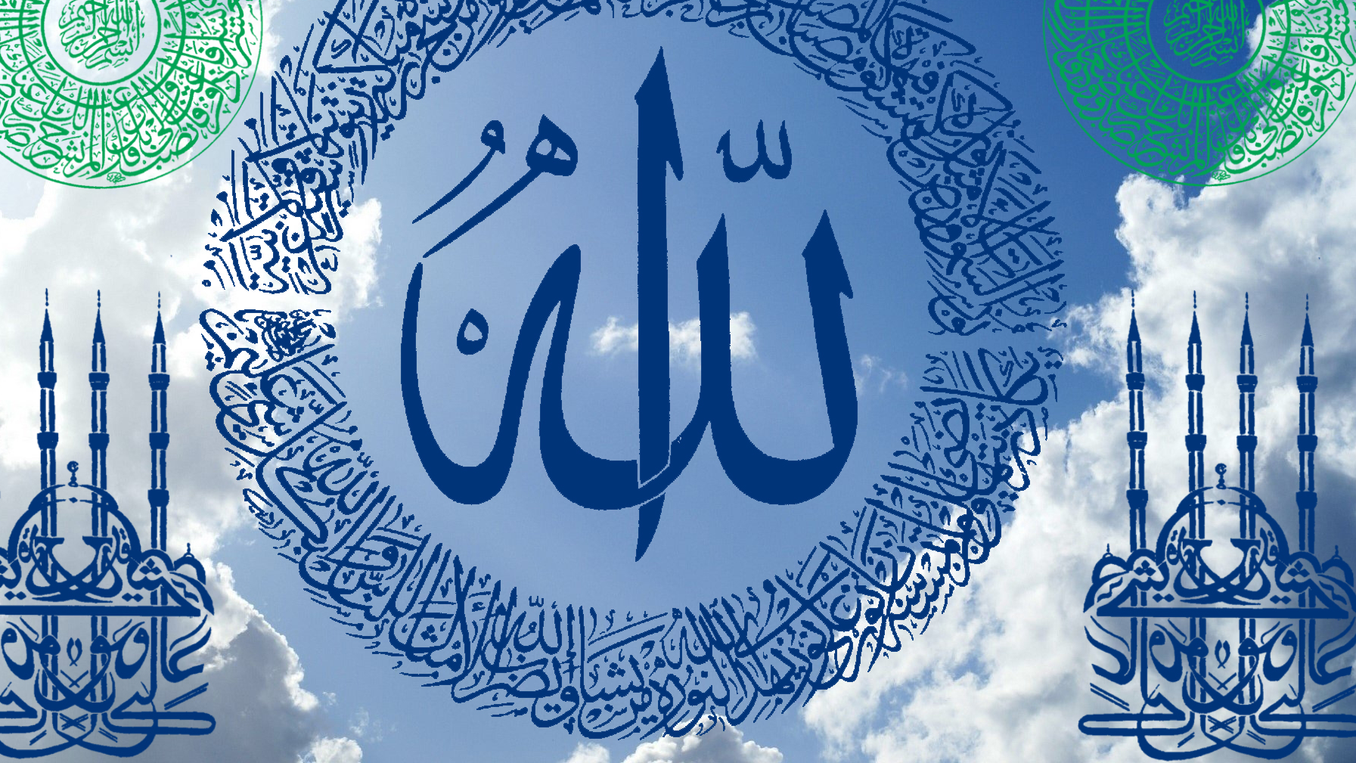
Life is a gift from allah
This Photo by Unknown Author is licensed under CC BY
Notes:
Life is a gift from Allah – so we must not waste it away with insignificant concern. Even the ancient greeks had similar teachings they said what you pay attention to will define you. The point here isn’t that we can’t spend time relaxing, but that sometimes we aren’t consciously choosing at all.

Slide 12
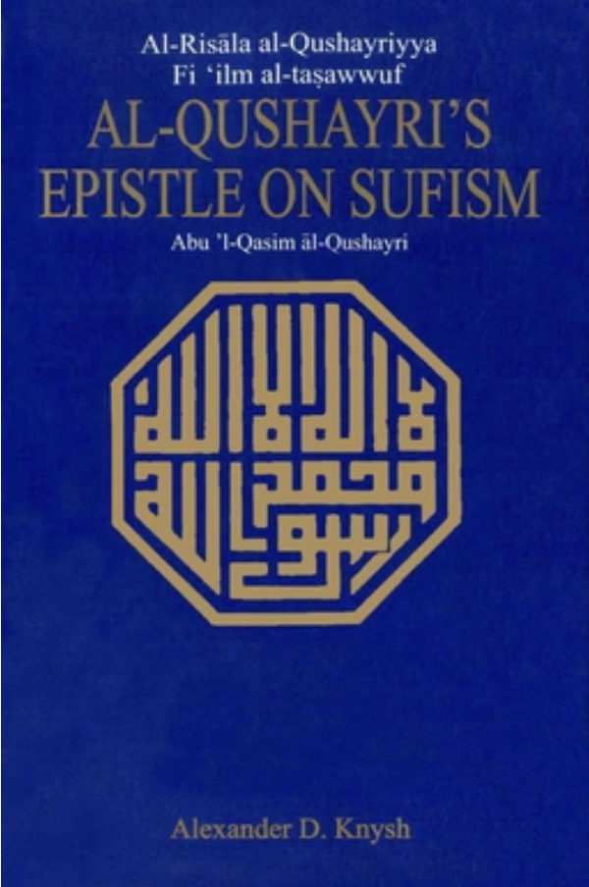
Imam al-qushayri
D. 1074
Foundational book on the concept of Tasawwuf
Notes:
See, we have the ability all the time to internalize good or bad things. And this brings me to another early scholar that I am happy to introduce you to this evening, which is Imam Al-Qushayri, who wrote a Risalah on Sufism.
This book had a profound impact on Imam Ghazali. It is a foundational book on the concept of tasawwuf. Tasawwuf is the spiritual life of islam, so it means to know yourself, gain knowledge, and form a relationship with Allah, and more. But it’s a sufi word and it is a very important aspect of our deen.
In this risalah, he has a chapter called al-waqt. (time) and he says, “time for the people who have had realization (meaning they interpreted the reality of our deen) have confirmed that it is true and if you practice it, you will get the results. Meaning the people who have tahqiq (who have verified things) view time and know time not as something tangible, but almost like an illusion.
What he means by this, is we don’t know if we are going to have the next minute. So I can make plans for tomorrow, and tomorrow will come for a lot of people, but it’s not going to come for everybody.

Slide 13
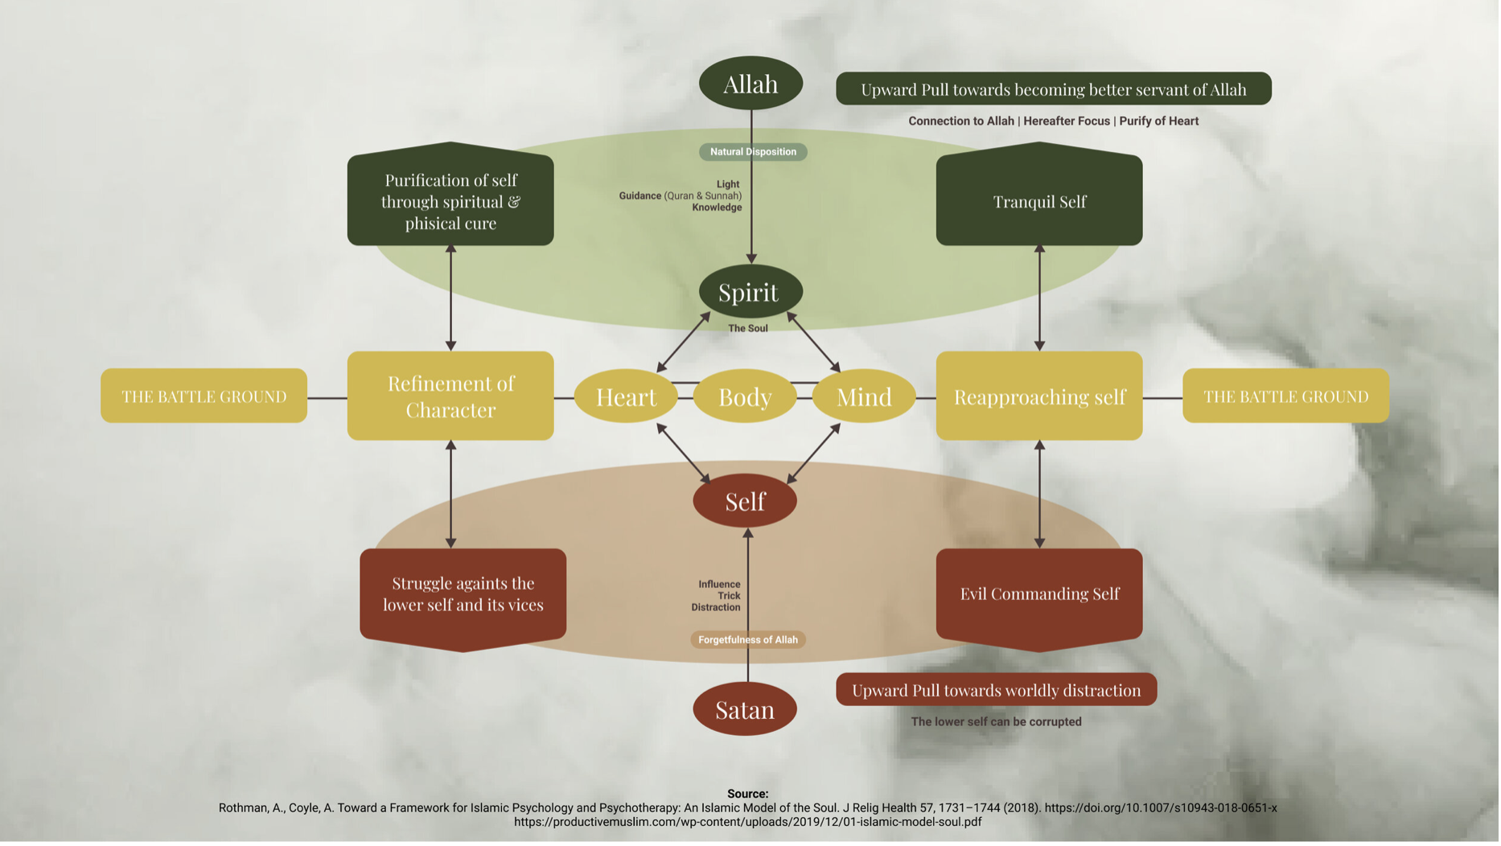
Notes:
We are not angels, but we are also not devils. We are somewhere in between. Where we will through our own weaknesses, may sin. We may commit sins because we are human, not because we are devils. And then we seek forgiveness of Allah. Look at Adem as – there was only one thing he and Hawa could have done wrong, but they did it. Then they showed us how to seek forgiveness, and they continued to progress. They were present in the moment.

Slide 14
Dua of Adem (as)
Notes:
This supplication reflects Adam's recognition of his mistake, his humility, and his plea for Allah's forgiveness and mercy.
"Rabbana zalamna anfusana wa illam taghfir lana watarhamna lanakoonanna mina alkhasireen.”
How did Adem & Hawa progress?

Slide 15
Time is what you are in
Notes:
The risalah then continues to say that time is what are you in, if you are in the dunya, then your time is the dunya, if you are in the afterlife then time is the afterlife, if you are in joy, then time is joy, and if you are in grief, then time is grief. Time is essentially what overwhelms the human being. It’s your experience, It is the now and only God is the eternal One.
Imam shafi once said he leanred two things from sufi’s and one of them is that if you don’t cut time, then time will cut you.
We don’t kill time – it kills us. So, then perhaps we can start framing our minds each day and rather than starting our days thinking about what we have to do that day, we can think.

Slide 16
What is allah going to do through me today?
Notes:
He then continues saying our egos are such an entity that if we don’t preoccupy it, it will focus on the harmful.
Then he concludes the chapter by saying that as each day passes it takes a part of him and leaves remorse in his heart for that time he wasted. This continues on for a while and ends by saying that the intelligent one is the one who is mindful of his time.

Slide 17
Prophet muhammad
Al-Mudhakkir – The one who reminds you back to your mindfulness
Notes:
When we look at Prophet Muhammad, everything about him was in the middle, completely void of extremes. And he gave us a path to become awakened. And this is through dhikr. In fact, one of the best ways to become someone who remembers Allah is to have a daily dhikr. Many scholars have created their own and published them into books. I would like to share a few with you – and I am guessing you may already use them.

Slide 18
Compiled dhikrs & ibadat
Tasbihat – Compiled by Said Nursi
Evening Adkhar (between maghrib and isha prayers) – Compiled by Said Nursi
Prayers of Prophet Muhammad – Compiled by Fethullah Gulen
Kulubu’d Daria – Compiled by Fethullah Gulen
Jawshan & Morning Adhkars
Wudu
Notes:
From here, I also recommend expanding this list when you are ready. Now, I do have a recommendation that I hope everyone takes heed to. Please do these with intention and do not rush through them. Sometimes I join prayers and we do the tasbihat afterwards, but we read through them so quickly, it is almost impossible for us to understand and feel them in our souls. Let’s not do them just to do them, but know their meanings and read them slowly.
Lastly, I wanted to take just a moment to discuss the power of wudu. It is an incredibly powerful tool that we can use not only as a preparation for salah, but as an ibadah anytime throughout the day, and if we say bismillah before beginning and the ending dua afterwards, it also becomes a form of dhikr.
Ash-hadu ‘an laa ‘ilaaha ‘illallaahu wahdahu laa shareeka lahu wa ‘ash-hadu ‘anna Muhammadan ‘abduhu wa Rasooluhu.

