Slide 1
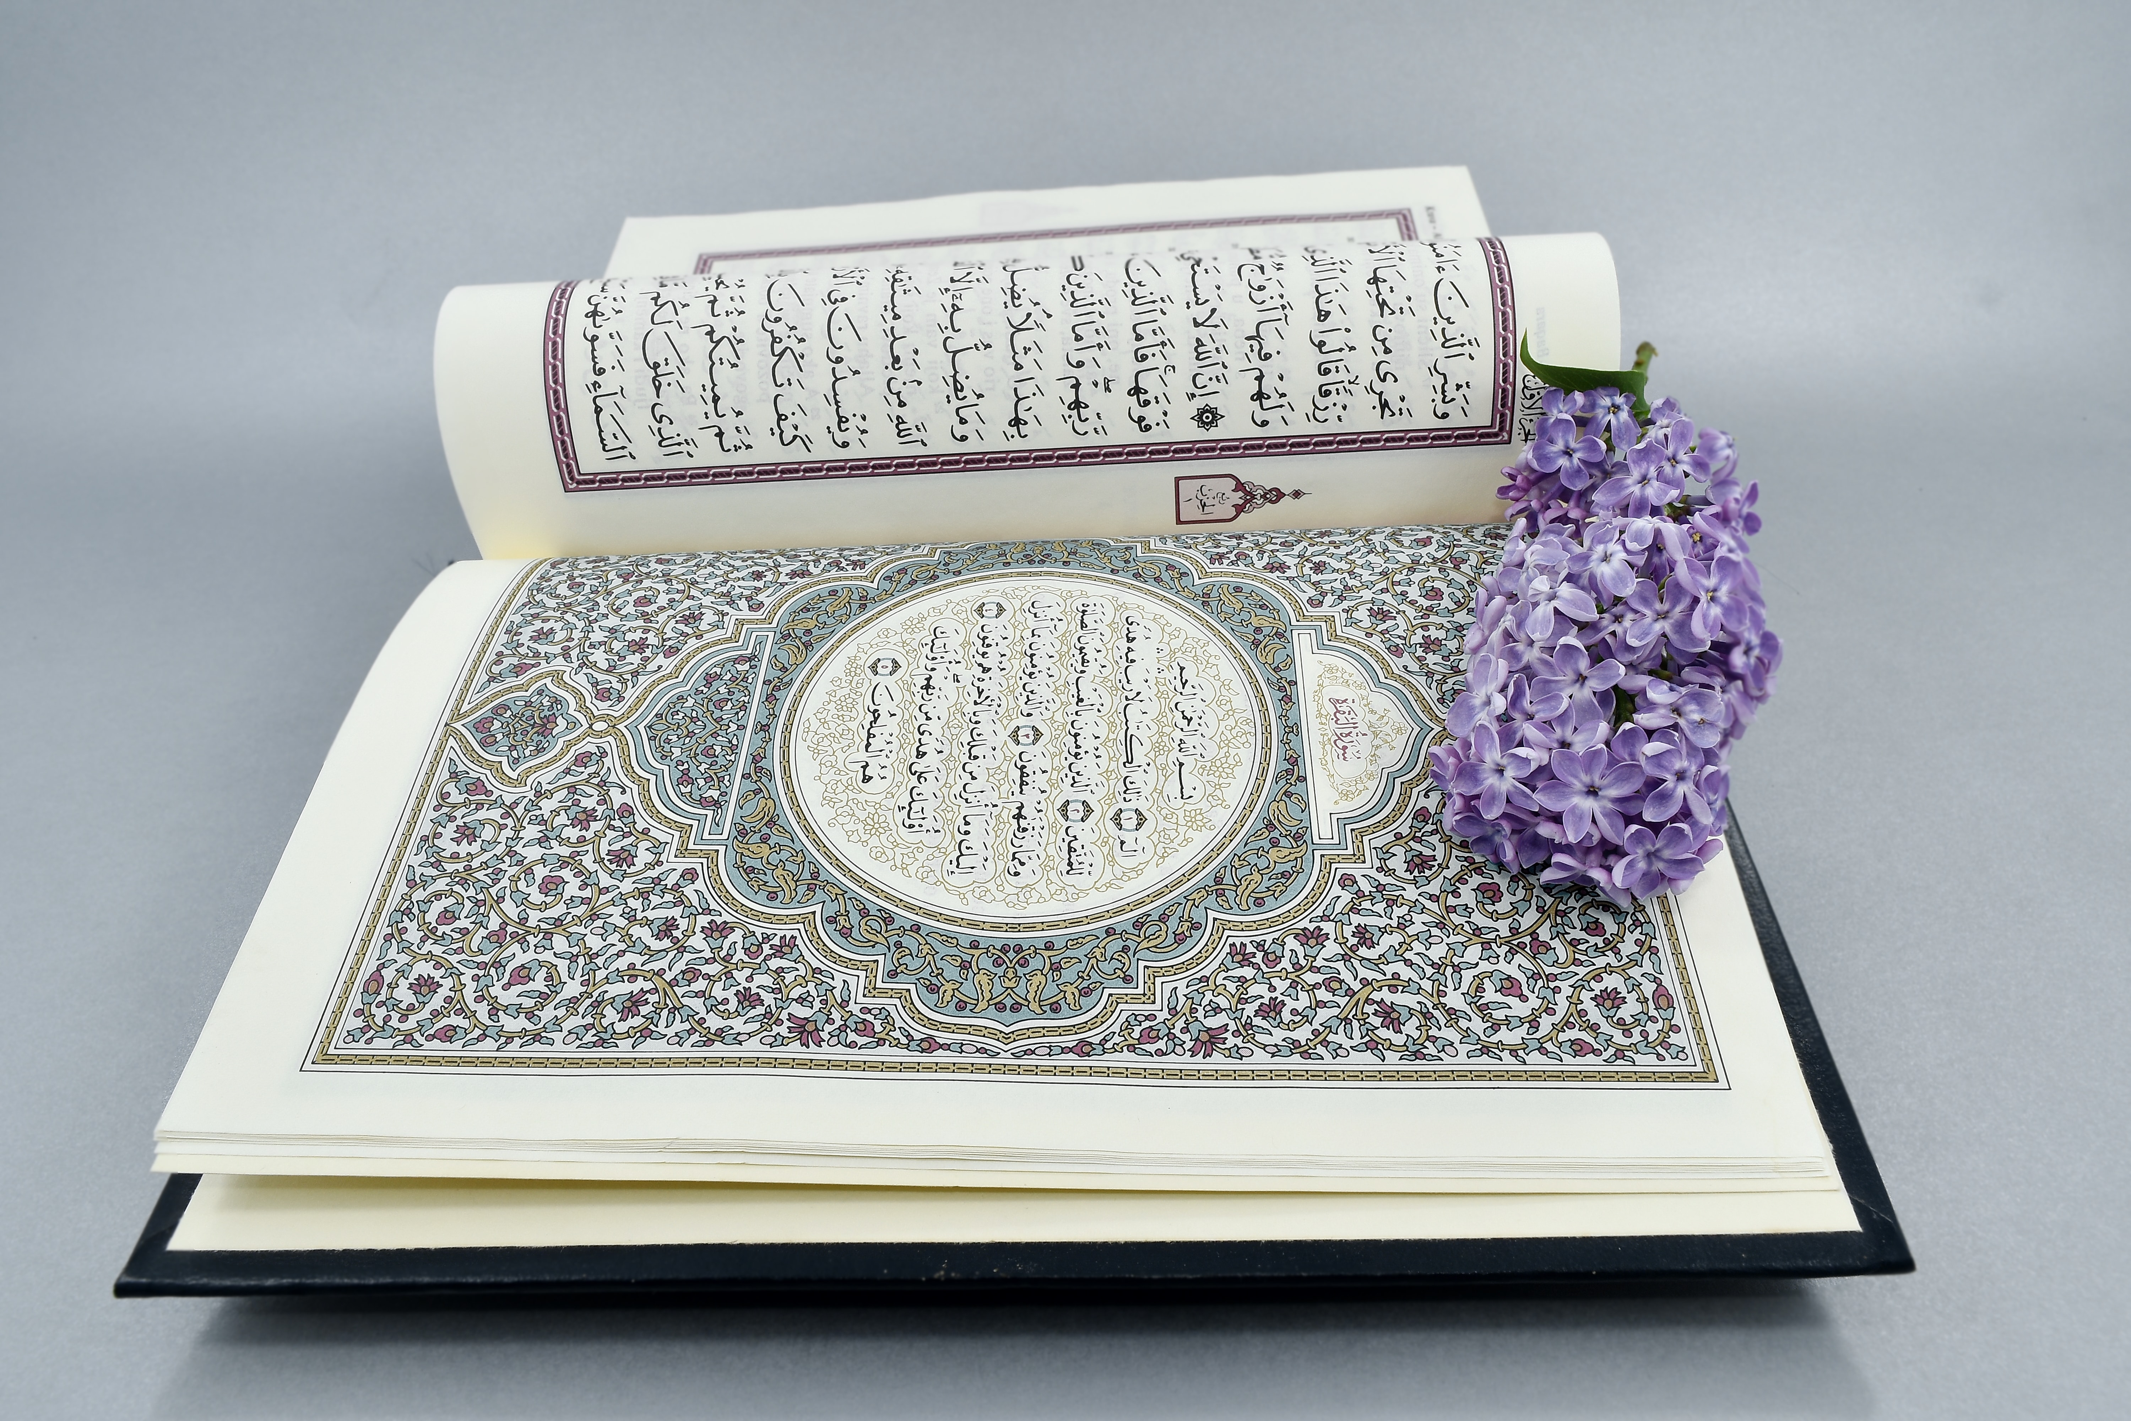
Seeking Guidance in the Qur’an Reflections on Surah Fatiha Ayah 6, Surah Baqarah Ayahs 2-5, and Surah Kahf Ayah 48

Slide 2
Hayat ve Ruh Physical Life & The Soul Sızıntı, June-July 1989, Volume 11, Issue 125-126
Hayat, ilâhî bir sırdır; mâhiyetini de ancak Hak sırlarına âşina olanlar bilir.
Mutlak hayat, bir bedenî yaşayıştır. Bedendeki hararet ve canlılık tamamen fıtrîdir ve alınan gıdaların kan ve enerjiye dönüşmesi seyri içinde hâsıl olur.
Cismânî hayatın gâyesi, hareket, canlılık ve bedenî bir kısım vazifeleri yerine getirmekten ibarettir ki, böyle bir hayat itibarıyla insanla hayvan arasında herhangi bir fark yoktur. Gerçek insânî hayat ise, içinde şuur, idrak ve ötelere açık olmanın da bulunduğu hayattır ki hakikî hayat da işte budur.
https://fgulen.com/tr/eserleri/olcu-veya-yoldaki-isiklar/hayat-ve-ruh
Notes:
Life is a divine secret; its essence is known only to those familiar with Divine secrets.
Absolute life is a bodily existence. The warmth and vitality in the body are entirely natural, and the conversion of consumed food into blood and energy occurs in the course of this process.
The purpose of bodily life is merely to perform movement, vitality, and some bodily duties, so in terms of such a life, there is no difference between humans and animals. However, true human life is one that includes consciousness, perception, and openness to the beyond; this is the real life.
Imagine life as a grand mystery, a puzzle waiting to be unraveled, known only to those familiar with divine secrets. Picture life not just as the beating of your heart or the air you breathe, but as something profound, something beyond mere existence. This life, it's not just about your body moving and functioning; it's about something deeper, something more meaningful.
Let's break it down. Your bodily life—the one you're living right now—is like a well-oiled machine, ticking away with the rhythm of your heartbeat and the flow of your blood. It's all natural, you see? Your body takes in food, transforms it into energy, and keeps you going day in and day out. But there's more to life than just this physical existence.
True human life, now that's something else entirely. It's not just about going through the motions; it's about being aware, conscious, and open to the wonders of the universe. It's like having a sixth sense, where you can feel the presence of something greater, something beyond the material world.
And then there's the soul—the essence of who you are. It's not something you can touch or see; it's more like a whisper in the wind, a gentle guiding force within you. Your soul, it's eternal, everlasting, connected to something far greater than yourself.
Now, imagine your soul and your body, hand in hand, embarking on this journey called life. Together, they navigate the highs and lows, the twists and turns, always striving to find meaning and purpose in the world around them.
But here's the thing: life isn't just about what happens here and now. It's about what comes next, what lies beyond the horizon. Your soul, it's destined for something greater, something beyond the confines of this world.
So, as you go about your day, remember this: life is a gift, a precious opportunity to explore, learn, and grow. Embrace it, cherish it, and above all, live it to the fullest.

Slide 3
Hayat ve Ruh Physical Life & The Soul Sızıntı, June-July 1989, Volume 11, Issue 125-126
“True life is the coexistence of spiritual and bodily life, representing the seed of genuine human life here and flourishing into heavenly life in the hereafter. Consciousness and purity are the results of spiritual life.”
https://fgulen.com/tr/eserleri/olcu-veya-yoldaki-isiklar/hayat-ve-ruh
Notes:
Imagine life as a grand mystery, a puzzle waiting to be unraveled, known only to those familiar with divine secrets. Picture life not just as the beating of your heart or the air you breathe, but as something profound, something beyond mere existence. This life, it's not just about your body moving and functioning; it's about something deeper, something more meaningful.
Let's break it down. Your bodily life—the one you're living right now—is like a well-oiled machine, ticking away with the rhythm of your heartbeat and the flow of your blood. It's all natural, you see? Your body takes in food, transforms it into energy, and keeps you going day in and day out. But there's more to life than just this physical existence.
True human life, now that's something else entirely. It's not just about going through the motions; it's about being aware, conscious, and open to the wonders of the universe. It's like having a sixth sense, where you can feel the presence of something greater, something beyond the material world.
And then there's the soul—the essence of who you are. It's not something you can touch or see; it's more like a whisper in the wind, a gentle guiding force within you. Your soul, it's eternal, everlasting, connected to something far greater than yourself.
Now, imagine your soul and your body, hand in hand, embarking on this journey called life. Together, they navigate the highs and lows, the twists and turns, always striving to find meaning and purpose in the world around them.
But here's the thing: life isn't just about what happens here and now. It's about what comes next, what lies beyond the horizon. Your soul, it's destined for something greater, something beyond the confines of this world.
So, as you go about your day, remember this: life is a gift, a precious opportunity to explore, learn, and grow. Embrace it, cherish it, and above all, live it to the fullest.

Slide 4
Our Request for Guidance
Guide us along the straight path
Notes:
This concept aligns with our supplication in Surah Fatiha where we seek guidance. Just as having a clear purpose and goal in knowledge leads to blessings and abundance, seeking guidance from the Almighty grants us clarity and direction in our lives. When we pray for guidance, we are essentially asking for a defined path to follow, akin to possessing an everlasting source of blessings. Conversely, wandering aimlessly without guidance can lead to confusion and despair, much like aimless thoughts causing doubt and uncertainty. Therefore, by seeking guidance in our prayers, we aim to navigate life with purpose and clarity, avoiding the pitfalls of uncertainty and confusion.
The phrase “guide us” is both a prayer and a supplication. It means to lead someone gently towards the goal.
Allah SWT shows us the straight path that leads to paradise, He kindly holds our hands and does not leave us alone with our misleading desires.
Guidance does not mean show us. Guidance here denotes that the Guide is with us during the way to help us until we reach our final destination.
In Surah Nisa, ayah 69, Allah describes those who have gained His favored with perfect guidance. He describes the Prophets, the truthful ones, the martrys, the witnesses, and the righteous ones.
The ulama describe each of the categories of people to be the following...

Slide 5
The Truthful Ones
Those who are loyal to Allah’s cause and truthful in whatever they do and say.
Notes:
In the Quran, Allah lauds the truthful believers, highlighting their sincerity and integrity in fulfilling their promises and commitments to Him, even in challenging circumstances. The successful believers, as described in Surah Al-Mu'minun, are characterized by their truthfulness in actions and words, alongside their dedication to fulfilling their trusts and commitments. Throughout the Quran, truthfulness is consistently praised as a fundamental attribute of believers, essential for their righteousness and closeness to Allah.

Slide 6
The Witnesses
Those who see hidden Divine Truths and testify thereto with their lives
Notes:
In the Quran, witnesses are described as those who uphold truth and justice impartially, providing testimony with honesty and integrity. Surah Al-Baqarah (2:282) emphasizes the importance of witnesses in financial transactions, instructing believers to call upon two witnesses to validate agreements.
Furthermore, Surah Al-Ma'idah (5:8) outlines the responsibility of witnesses to speak the truth, regardless of whether it is for or against themselves or their relatives. Allah emphasizes the significance of bearing witness justly and truthfully, ensuring fairness and integrity in legal proceedings and societal interactions.

Slide 7
The Righteous
In all their deeds and sayings are dedicated to setting everything right
Notes:
In the Quran, the righteous are described as those who fear Allah and strive to obey His commandments. Surah Al-Baqarah (2:177) outlines the qualities of the righteous, highlighting their belief in Allah, the Last Day, the angels, the scriptures, and the prophets, as well as their generosity towards others, especially those in need.
Surah Al-An'am (6:82) describes the righteous as those who avoid major sins and immoralities, showing mercy and compassion towards fellow human beings. Additionally, Surah Al-A'raf (7:156) mentions that Allah's mercy is near to those who follow the Messenger, the unlettered prophet, whom they find written in the Torah and the Gospel. Throughout the Quran, the righteous are portrayed as individuals who strive to live according to the teachings of Islam, embodying qualities of faith, compassion, and righteousness in their daily lives.

Slide 8
The Straight Path
Notes:
The leaders on the straight path are the Prophets. When we pray, we should remember how lofty and illuminated a group of people we follow. As importantly, we must not forget that we are raising the next generation of people and this verse should remind us that we have the opportunity to attain the same privilege.
When future generations recite Fatiha and say “guide us to the straight path of those whom You have favored” we can be included in the people they are referring.
Surah Baqarah – So, in Fatiha, we ask Allah SWT for guidance and then immediately following in Surah Baqarah, Allah tells us how to receive such guidance. There are many important things in these ayahs, but I want to point out something specific here and that is the use of the word muttaqin.

Slide 9
The God-Conscious, Pious People
Hocaefendi’s translation: This is the Book: there is no doubt about it. A perfect guidance for the God-revering, pious, who keep their duty to God. (Al-Baqarah 2:2)
Muttaqin = God-revering, pious
Notes:
Huda in this ayah is given in the infinitive form. Implying that guidance is a main goal to which we aspire, but it cannot be found if we do not exert some effort. The word though ends with a tanwin (an indefinite noun ending with the letter nun) making the word become hudan, which tells us its perfect meaning is intended.
Allah does not use the word “nas” here which means people. Allah uses the word muttaqin which means pious people seeking guidance. Hudan means guidance.
In other words, what is really being said is, “Therefore, there is no doubt that this Book is a transcending Divine guidance for the pious (the God-conscious). IT IS THE PERFECT GUIDANCE BECAUSE IT IS THEY WHO ARE READY TO COMPLY with both the commandments of the religion and the principles of nature.
Hocaefendi in his commentary on this ayah (the 2nd ayah of surahtul baqara says there are 4 main characteristics of someone who is pious. 1) they comply with the commandments of religion, 2) they comply with the principles of nature, 3) they are open to acknowledging the truth, and 4) they are not prejudiced. If we want to receive the perfect guidance Allah set out for us, we have to have these characteristics within us.
Complying with the Principles of Nature (ash-sharī‘atu’l-fitriyya):
This principle involves aligning with the natural order and principles inherent in creation, recognizing and respecting the laws and patterns that govern the natural world. It encompasses concepts of balance, sustainability, and stewardship of the Earth. Muslims are encouraged to live in harmony with nature, avoiding waste, exploitation, and harm to the environment.
Then Allah goes on to describe the characteristics of those who are considered the muttaqin, or those who are God-conscious, pious, and have taqwa. Does anyone know these characteristics?

Slide 10
Surah Baqarah Ayahs 3-5
This is the Book! There is no doubt about it¹—a guide for those mindful ˹of Allah˺, (ayah 2)
who believe in the unseen, establish prayer, and donate from what We have provided for them,
and who believe in what has been revealed to you ˹O Prophet˺¹ and what was revealed before you, and have sure faith in the Hereafter.
It is they who are ˹truly˺ guided by their Lord, and it is they who will be successful.
Notes:
Those who believe in the unseen, establish the prayer, spend out of what has been provided for them, believe in what was sent down to the prophets, and the hereafter. THEY ARE THE ONES WITH TRUE GUIDANCE and can be considered amongst the muttaqin.
So, let’s summarize quickly what it means to guided so far.
Allah describes in Fatiha and Baqarah that those who are guided are loyal to Allah’s cause and truthful in what they do and say, those who see the hidden Divine Truths and testify to with their lives, in all their deeds and sayings are dedicated to setting everything right, they believe in the unseen, establish their prayers, spend our what has been provided for them, they believe in the messages and books of the prophets, and the hereafter.
So, let me make a point to say this. Allah does not mention here, those who make the most money, or those who earn the highest degrees, or those who have the most friends, and most children, etc.. If you see here, the message is all about believing in the unseen, acting accordingly through prayers, and then taking care of those and the world around us.
But I want to point out one more thing in Ayah 5 of Surah Baqarah and that is the word muflihun.

Slide 11
Notes:
There are two words in Arabic that mean successful. One is faizun and one is muflihun which is used in this Ayah. The root of muflihun has several meanings, one of them is that of a farmer. Why is this important? A farmer spends a year preparing his farm for harvest. So, Allah SWT uses this word to tell us that success will come to those who earn it.

Slide 12
Surah Kahf, Ayah 46
"Wealth and children are the attractions of this worldly life, but lasting good works have a better reward with your Lord and give better grounds for hope." (Surah al-Kahf, 18:46)
Notes:
This verse from Surah al-Kahf highlights the contrast between the temporary allure of worldly possessions and the enduring value of good deeds. Our objective today is to understand how dedicating our lives and resources to the path of Allah can lead to eternal rewards.
Wealth and children are indeed the adornments of this worldly life. However, they are ephemeral, destined to decay and return to the earth. This reminds us of the temporary nature of our worldly possessions and the need to look beyond them.
Sermon: July 5, 1974, Alemizade Sırönü Mosque, Edremit – I highly recommend reading this when you can, but I want to give a few highlights here.

Slide 13
Baqiyatu vs Salihatu
"Wealth and children are the attractions of this worldly life, but lasting good works have a better reward with your Lord and give better grounds for hope." (Surah al-Kahf, 18:46)
Baqiyatu refers to acts dedicated to the Hereafter, such as prayers, fasting, and almsgiving.
Salihatu encompasses various aspects of worship, personal development, and societal contribution, all aimed at earning the pleasure of Allah and benefiting humanity
Notes:
HE says to achieve a fruitful and eternal journey, one must dedicate their life to seeking Allah's pleasure.
Engaging in daily acts of benevolence and imbuing each moment with the sacred names of Allah brings divine radiance to one's life.
Turning to Allah with heart, thoughts, and imagination ensures that the fleeting moments of this world are transformed into eternal significance.
He also says Prayers, charity, and good deeds illuminate both the past and future with divine light, and that Quran emphasizes that "lasting good works have a better reward with your Lord and give better grounds for hope.”
**Better 'Ṣāliḥātu' (Good Deeds)**:
1. **Prayer (Salah):**
- Regularly performing the five daily prayers with sincerity and devotion.
- Engaging in additional voluntary prayers (Nafl) and night prayers (Tahajjud).
2. **Fasting (Sawm):**
- Observing the fast during the month of Ramadan.
- Fasting on other significant days, such as the 6 days of Shawwal, Mondays and Thursdays, and the Day of Arafah.
3. **Almsgiving (Zakat and Sadaqah):**
- Giving the obligatory almsgiving (Zakat) to those in need.
- Engaging in regular voluntary charity (Sadaqah) to support various causes and individuals.
4. **Seeking Knowledge:**
- Pursuing both religious and secular knowledge to benefit oneself and others.
- Teaching and sharing knowledge with others, especially in ways that promote understanding and betterment.
5. **Kindness and Compassion:**
- Treating family, friends, and strangers with kindness and compassion.
- Providing support and assistance to those in need, including the elderly, sick, and disadvantaged.
6. **Good Character (Akhlaq):**
- Exhibiting good manners, honesty, patience, and humility in all interactions.
- Avoiding negative behaviors such as lying, gossiping, and harming others.
7. **Spreading Peace and Reconciliation:**
- Promoting peace and resolving conflicts within the community and beyond.
- Engaging in activities that foster unity and understanding among people.
8. **Environmental Stewardship:**
- Taking care of the environment by reducing waste, recycling, and conserving resources.
- Promoting and participating in activities that protect and preserve nature.
9. **Volunteering and Community Service:**
- Volunteering time and effort to support community projects and initiatives.
- Participating in efforts that improve the quality of life for others, such as building homes, providing education, and offering medical services.
10. **Maintaining Family Ties (Silat al-Rahim):**
- Keeping strong relationships with family members and fulfilling familial responsibilities.
- Providing support and care for parents, siblings, and extended family.
These deeds are considered better 'Ṣāliḥātu' as they encompass various aspects of worship, personal development, and societal contribution, all aimed at earning the pleasure of Allah and benefiting humanity.

