Slide 1
Tawakkul
Relying on Allah in Hardship & Ease

Slide 2
Surat’ul Baqarah Ayah 216
“…Perhaps you dislike something which is good for you and like something which is bad for you. And Allah knows, where you know not.”
Notes:
Question for thought today is: How do we overcome what seems beyond our comprehension and control? How do we overcome anxiety, fear of the unknown, and feeling isolated, while finding purpose and solace?

Slide 3
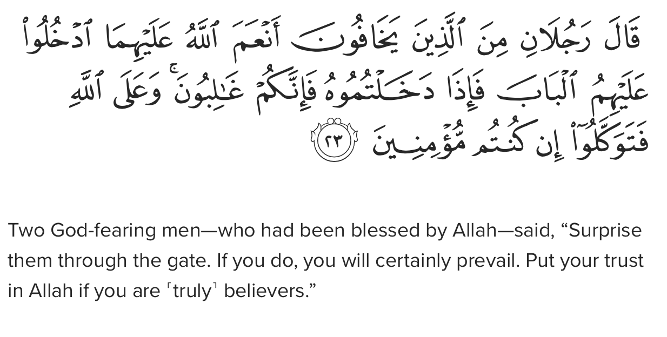
Ihdina Sirat’al Mustaqeem – Guide us to the Straight Path
1. Faith
2. Gratitude
3. Patience
4. Placing our Trust in Allah
Notes:
The straight path – what do we remember about it? It also has some requirements from us. We must have faith, gratitude, patience, and tawakkul or placing our trust in Allah. Tawakkul is among the greatest acts of worship along this path. As can be seen in this ayah from Surah Ma’idah ayah 23
Tawakkul becomes a means to Allah’s pleasure and reward (He says this in the Qur’an, 42:36) and it becomes a blessing that enables us to nurture and maintain our faith. It inspires hope, contentment with the Divine Decree and confidence during ALL times and situations, particularly during moments of fear and uncertainty.

Slide 4
Surah Talaq Ayah 3
Allah promises us that He will “provide for the believer from where he does not expect. And whoever relies upon Allah, then He is sufficient for them.”
Notes:
Ibn Qayyim said, “Tawakkul is half the religion. As for the other half, it is inabah (which means to return to Allah in all affairs and repentance).
Where does tawakkul live?

Slide 5
Tawakkul lives in our hearts
Tawakkul is an action of our hearts and is at the core of our spiritual well-being and practice.
Notes:
When used to its full potential, Tawakkul provides us with a lens through which we form our outlook and actions to bring about the best outcome. In Surah Ali Imran, ayah 159, Allah commands us, “and when you have decided, then rely upon Allah. Indeed, Allah loves those who rely upon Him.”
It is very human for us to struggle, be thrown off our tracks, be troubled with doubt, complain when there is no end in sight, and even be consumed with fear at times. Tawakkul becomes the means by which we right our course and stay on it, and bring about resolve and contentment.

Slide 6
A Great Dhikr to Memorize…
Notes:
The benefits of tawakkul are many, and among them is that you hand over to Allah whatever burdens your heart and mind. Realize that you are not broken, abandoned, or forgotten, but Allah has actually given you exactly what you need. Knowing this, the believer acknowledges with certainty and confidence, “and my success is not but through Allah. Upon Him I have relied, and to Him I return.” 11:88 – this is a great dhikr by the way :)

Slide 7
Three Types of People
To know Allah is to place your trust in Him.
1. A person who relies solely on Allah, without exerting any effort of their own. (This is contradictory to tawakkul in the Qur’an and Sunnah)
2. A person who takes means to achieve a desired outcome, but they rely solely on those means and not on Allah. (Take Prophet Nuh’s son for example)
3. Take the necessary means to achieve their desired outcome AND place their trust in Allah to grant them success. This is the tawakkul of our Prophet and every prophet before him.
This Photo by Unknown Author is licensed under CC BY-NC-ND
Notes:
So, How Do I Live Tawakkul?
To know Allah is to place your trust in Him.

Slide 8
Why was Maryam (as) instructed to shake the date tree?
Notes:
Likewise, people of tawakkul during anytime of fear and uncertainty remain steadfast in their hope in Allah to bring them through the test, while also making every effort to take necessary means or measures needed to achieve it. This includes increasing our acts of worship like istghfar, sadaka, and being of service to others to the best of our ability.

Slide 9
A Checklist of Reminders & Key Practices
1. Dua, Dua, Dua
2. Have Firm Resolve
3. Sincerely Believe in Allah’s Forgiveness
4. Hold Firmly to the 5 Daily Prayers
5. Internalize the Reality of the Unseen
6. Know That You are Equipped
7. Exercise Patience
8. Increase in Gratitude
9. Stay Optimistic
10. Have a Good Opinion of Allah
11. Know That Allah Loves Those Who Rely on Him
12. Perform Daily Adhkar
13. Engage in Dhikr
Notes:
We will discuss these parts over the next few weeks. But I want to touch on a few of things about each now and then we will move onto Parvina inshA.
Dua – Dua is the GREATEST act of worship and a significant component of tawakkul. I encourage you to develop an understanding of dua from the Qur’an and Sunnah, which we will focus on next week, and then pair them with your own words. Again, this will be our focus for next week inshA.
Have firm resolve – Quran 3:159 – this ayah gives us confidence and allows to remain focused on the goal ahead and maintain stability day after day. Imagine riding a jet ski in open water, keep moving at a steady speed and the water becomes a firm highway, but stop and go, and will be rocked by the waves onto an unsteady and undefined path.
Similarly, tawakkul closes the door to questions and doubts to inaction, stress, and dissatisfaction with oneself and others. Drop the bagge that slows you down and busy yourself with good deeds to avoid wasting time and then regret. Remember, tawakkul has 2 actions, one is that you believe it with your heart and the other involves seeking the means available.
The famous hadith reported by Anas ibn Malik about whether or not we should tie our camels relays this message to us very clearly.

