Slide 1
Prophet Ayyub
Affliction, Patience, Prayer
Reflections on The Second Gleam of the Risale-i Nur
Compiled by: Dr. Lyndsey Eksili

Slide 2
And ˹remember˺ when Job cried out to his Lord, “I have been touched with adversity, and You are the Most Merciful of the merciful.”
Notes:
Transliteration of the dua: Rabbi anni massaniyadur wa-antarhamurahimin
Here is a link to listen to its correct pronunciation: https://youtu.be/5HZEAptF5eg

Slide 3
The Unique tafsir of said nursi on the story of prophet ayyub (as)
Two Distinct Aspects:
He redefines patience & evil
He focuses on the turning point of the story (Ayyub’s dua)
Notes:
Ustad’s tafsir of on these ayahs are unique in two distinct aspects. First, he redefines evil and patience and then he focuses on the dua of Ayyub (as) as a turning point in the story.
We will first get a general introduction to the story in the Qur’an, and the analyze Nursi’s interpretation.

Slide 4
Ayyub in the Qur’an
Notes:
Like many other narratives in the Qur’an, the story of Ayyub is spread throughout, and only certain aspects of his venture are included or depicted. For this reason, it is important for us to focus on what was included.
Ayyub is described as among those who received revelation from Allah. He is mentioned as one of the “righteous, elected, and guided to the straight path.”
Specific mentions of Ayyub’s affliction. Are mentioned in two passages.
See: Surah 21, Ayahs 83-84, and Surah 38, ayahs 41-44

Slide 5
Ayyub in the Qur’an

Slide 6
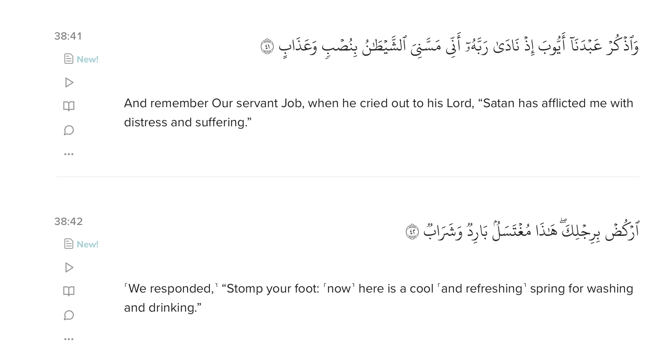
Ayyub in the Qur’an

Slide 7
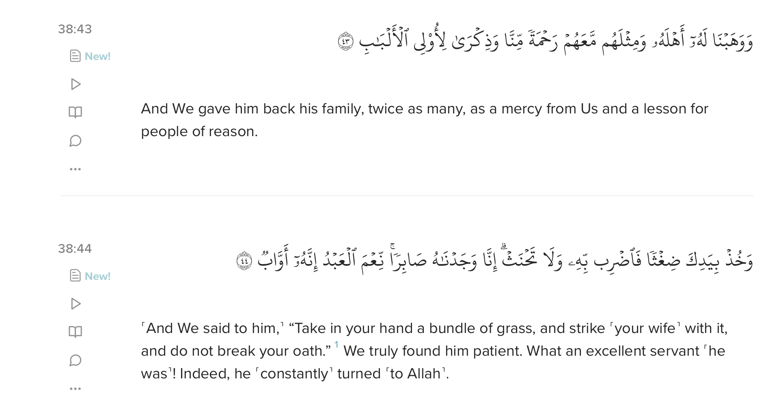
Ayyub in the Qur’an

Slide 8
Key points from these ayahs
Ayyub’s affliction involved his body and his family
He prayed to Allah, noting his distress, as well as complaining about shaytan
Allah answered him graciously
Ayyub fully recovered and was rewarded double the offspring he lost
His story is a reminder for all who worship
Ayyub was praised as one who proved to be patient, was an excellent servant, and continuously turned to Allah

Slide 9
Interesting observations
Complaints & Patience
Difference in Ayyub’s Prayers
Notes:
Ayyub’s patience and his cry unto Allah are mentioned side by side in 38:44 and from 21:83 and 38:41, it is clear that Ayyub’s turning to Allah involves a complaint. In other words, he was complaining, but he was also patient.
The difference between Ayyub’s prayers in 21:83 where he says affliction visited him or has befallen him. In 38:41, he says, “Satan afflicted me…”
So the question then becomes if sickness is created by Allah (Shaytan cannot create sickness) then why is he blaming or complaining about shaytan? Shouldn’t he know this as a prophet? This is where the tafsir of Nursi becomes especially helpful.

Slide 10
Ayyub’s Dua
Notes:
Nursi sees the stories of the prophets in the Qur’an as tips of an iceberg and says that they are specific cases under which universal meanings are concealed. In line with this tradition, he says that the dua made in the 2nd Gleam is one of the duas that we must then incorporate into our daily lives. He says that since his dua was so graciously accepted, this is a clue to us that it is a ‘successful’ and effective prayer. Then he moves into discuss the implications for us.
Let’s now read his introduction.

Slide 11
Introduction
Notes:
Read the introduction

Slide 12
The secret of Ayyub’s dua: A Sincere, disinterested, devout supplication “I have been touched with adversity, and You are the Most Merciful of the merciful.”
Notes:
Nursi keeps his background of the Qur’anic story to a minimum because he believed there is meaning behind the lack of detail in the Qur’an.
Ayyub’s dua was accepted because it was a pure, sincere, disinterested, and devout supplication. The lack of any direct request in the dua supports this.
Ayyub (as) only mentions he is in distress and that he trusts in Allah’s mercy. He makes no direct demands about recovering his health, his wealth, or his family.
So, what does it mean then to be unselfish or disinterested in making dua during distress?
Is it possible for a person to be disinterested in their own pain?
If so, is that then a virtue?
Does Nursi think that we shouldn’t care then about being in physical pain or losing our family? Isn’t that a rather inhuman approach? Fortunately, that is not what he is saying.

Slide 13
Human sensitivity & Vulnerability
O humanity! It is you who stand in need of Allah, but Allah ˹alone˺ is the Self-Sufficient, Praiseworthy (35:15)
Moreover, He is the One Who brings about joy and sadness (53:43)
Notes:
Nursi actually regards human sensitivity and vulnerability as humankind’s greatest talent because it constitutes the perfect background against which the bounties and gifts of Allah shine.
This is what makes human beings the best of creation, our ability to receive a whole spectrum of physical, emotional, and spiritual pleasures and pains.
This is a great privilege because it enables us to be an excellent mirror of the Divine Names.
In the ”Fruits of Belief”, Nursi says that in order to display His infinite Power & unlimited Mercy, Allah has made the human inherently and infinitely impotent and with unlimited want. And to display the infinite variety of the impress of His Names, He has created mankind like a machine receptive to pain and pleasure that can be perceived from an infinite variety of directions.

Slide 14
Pain and joy
Notes:
On the one hand, the human being has the ability to sense and enjoy a vast range of pleasures, both spiritually and bodily, but we are also receptive to misfortunes, anxieties, and pains which remind us of our utter weakness and makes us turn to Allah with our whole being.
(Read 3rd paragraph on page 19 in the book, or the second paragraph of the conclusion).
So Nursi is not suggesting that the secret to Ayyub’s dua lies in being indifferent because we are neutral when ill, we cannot love the manifestation of Allah’s names such as Healer, Provider, and Helper

Slide 15
So what does nursi mean when he says disinterested?
Notes:
Nursi recognizes our natural desire for health and comfort. He is worried about how we might misuse this desire. It is okay for us to dislike difficulties as long as we remember that Allah is the One who makes us dislike them.
This dislike has a purpose.

Slide 16
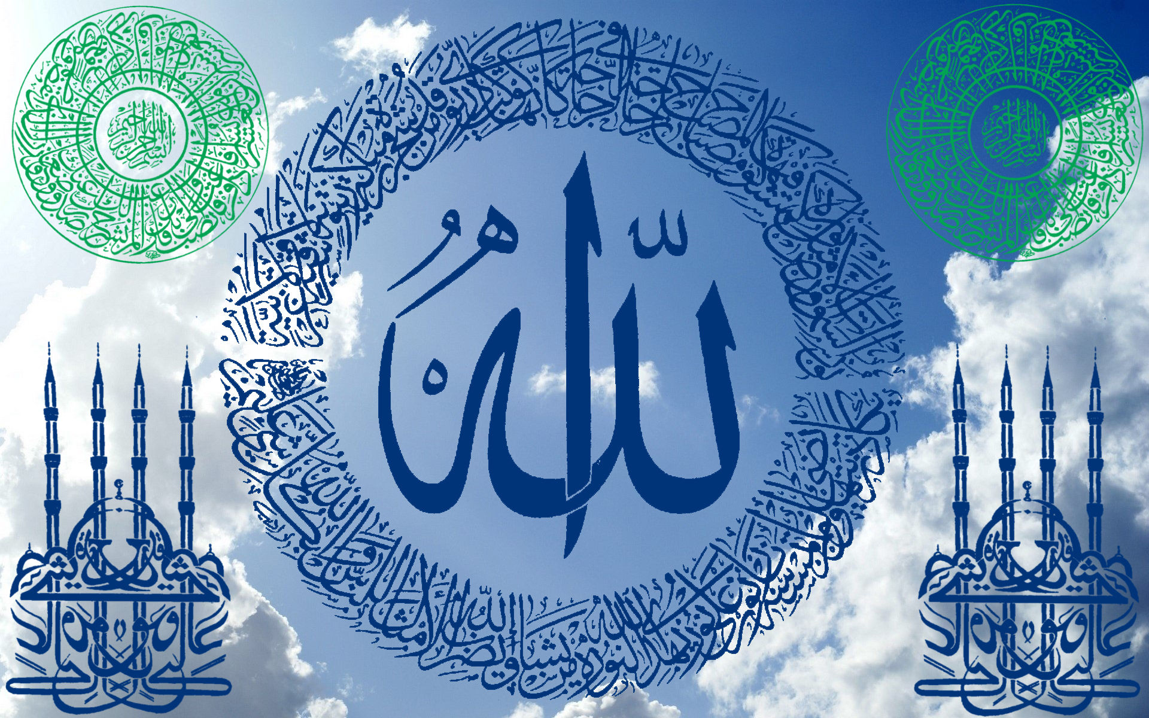
The purpose of dislike
Dislike helps us realize our need for Allah’s Mercy and to admit this with honesty and praise.
Notes:
If we forget this desire comes from Allah, we might mistakenly think that our wish for well-being is in conflict with Allah’s will, which gives us the illness. This could lead to wrongly believe that while we want to get better, Allah is against us by making us sick.
When we see it this way, it creates the insolvable problem of evil, making it seem like we have to choose between ourselves and Allah. We either have to selfishly seek comfort against Allah’s will or ignore our suffering, which goes against our nature.

Slide 17
Like hitting your hand on an anvil
Notes:
There’s no way out of this kind of problem: If God is against me, then I can’t win” – it will lead to this kind of mentality.
Nursi compares someone who criticizes Allah’s mercy to someone hitting their hand on an anvil and breaking their hand. The anvil remains unharmed, I only hurt myself. Thinking there is a conflict between my needs and the One who gave me those needs is like trying to take advantage on the anvil with a broken hand – it only damages the hand further.
Ayyub’s dua goes beyond this false narrative or false belief. He understood that his suffering didn’t mean Allah was against him. Nursi points out that without Allah, we have nothing. If we’re like orphans without a merciful Creator of Protector, if our lives here have no lasting value or meaning, and we are doomed to death without an afterlife, we are in serious trouble, even if he had all the health, wealth, and family in the universe.

Slide 18
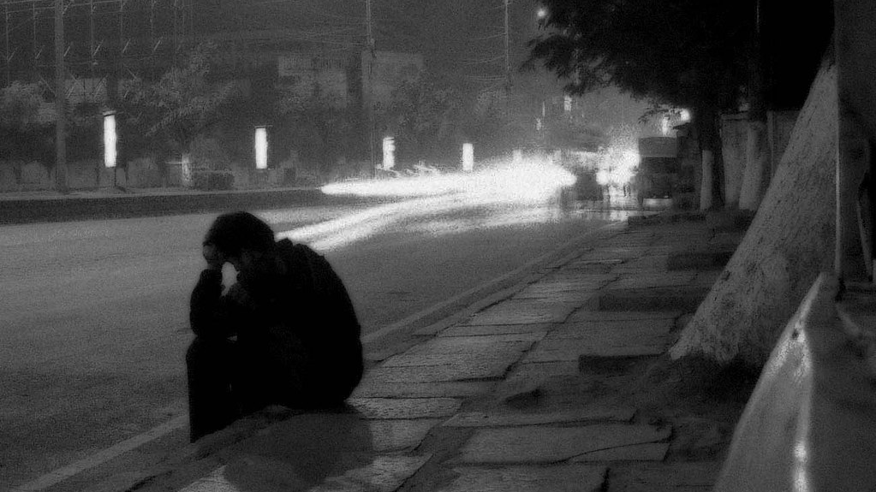
If we don’t find allah, the world becomes a cruel place
Notes:
Nursi then says if we don’t find Allah then the whole world becomes a never-ending cruel place. If you’re suffering from many woes, why complain about just one pain? So then, what is the solution?

Slide 19
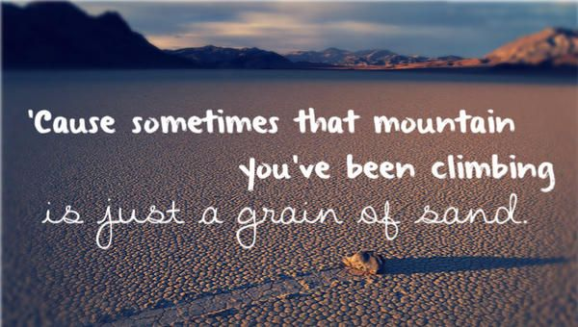
Make allah your refuge
Smile at your woes; then the woes will shrink and change
Notes:
The solution is to turn to Allah like Ayyub. Make Allah your refuge. Smile at your woes, then your woes will shrink and change. Ayyub is seeking refuge in Allah in this way, he turned to Allah not in accusation of a lack of Divine Mercy, but in patience, which comes from trusting in Allah’s mercy.

Slide 20
But is this kind of patience possible?
Since life reflects the Beautiful Names of Allah, whatever happens in life is beautiful
Notes:
But how is such patience truly possible, and how does it manifest? As Nietzsche pointed out, what really hurts is not the suffering itself but the meaninglessness of it. Prophet Ayyub (AS) could endure suffering—not by enjoying it or being unaffected, but by not falling into despair—because he knew it was neither meaningless nor cruel. Nursi provides deep insights on how, even though one wouldn't seek out suffering, one can accept it by trusting in God's mercy and wisdom.
One of Nursi's metaphors explains this well. He describes a great tailor who hires a poor man as a model to showcase his beautiful dressmaking skills. The tailor dresses the model in a beautiful garment, then changes it to display other styles. In this scenario, the model cannot complain about the discomfort of changing outfits because it's part of displaying the tailor's art. Similarly, God, the Peerless Creator, uses living beings to display His beautiful names. He changes their circumstances, including suffering and calamity, to reveal aspects of His mercy, wisdom, and beauty.
Thus, everything that happens to us, including calamities, serves to make God's divine art known. For example, the Divine Name Healer (Shafi) requires sickness, and the Divine Name Provider (Razzaq) calls for hunger and thirst. Nursi concludes, "since life reflects the Beautiful Names of God, whatever happens in life is beautiful." Therefore, there is no real evil, only apparent evil.
However, there is one exception: afflictions caused by one's own ill will. According to Nursi, the real affliction and the true evil are those that damage a person's relationship with their Creator. This is central to Nursi’s interpretation of Ayyub’s prayer.

Slide 21
First point: we have outer & inner illnesses
If our inner being was to be turned outward, and our outer being turned inward, we would appear more wounded and diseased than Ayyub (AS). For each sin that we commit and each doubt that enters our mind inflicts wounds on our heart and our spirit.
Notes:
If we could see our inner spiritual state as clearly as we see our physical bodies. Just as Prophet Ayyub (as) suffered from severe physical wounds and illnesses, we suffer from inner, spiritual diseases. If our inner selves were to be turned outward, revealing our spiritual wounds, we would appear more afflicted than Ayyub. Every sin we commit and every doubt that enters our mind leaves a wound on our heart and soul.
Prophet Ayyub's physical wounds threatened his temporary, worldly life. In contrast, our inner spiritual wounds threaten our infinitely longer, everlasting life. We need the supplication of Job thousands of times more than he did. Job's afflictions affected his heart and tongue, but the wounds from our sins and doubts harm the very core of our belief, disrupting our spiritual connection and the joy of religious recitations.
Sin infiltrates the heart, darkening and hardening it until the light of belief is extinguished. Each sin paves a path towards disbelief. Unless we swiftly seek God's forgiveness, these sins grow from tiny worms into snakes that gnaw at our hearts.
Consider this example: when someone secretly commits a shameful sin, they are overwhelmed by the fear of others finding out. The existence of angels and spiritual beings becomes unbearable to them, and they wish for evidence to deny their existence. Similarly, if someone commits a major sin deserving of Hell's punishment and doesn't seek God's forgiveness, they will desperately wish Hell didn't exist. If they find any reason to deny Hell's existence, they will cling to it.
People often feel distressed when reprimanded by their superiors. So, if someone neglects their duty of servanthood, like failing to perform daily prayers despite God's repeated commands, they will feel great distress and wish this duty didn't exist. This wish can grow into a desire to deny God, which implies enmity towards Him. If a doubt about God's existence arises, they may cling to it as proof, opening a wide door to spiritual destruction. This person doesn't realize that denying God brings spiritual troubles far worse than the slight discomfort of servanthood. While they agonize over a gnat's bite, they welcome a snake's bite.
These examples illustrate how sins and doubts rust our hearts, as mentioned in the verse, "But what they themselves have earned has rusted upon their hearts" (Quran 83:14).

Slide 22
But no! In fact, their hearts have been stained by all ˹the evil˺ they used to commit
Notes:
Imagine a piece of iron left out in the rain, slowly developing a layer of rust until it's entirely consumed and turns to dust. This is similar to what happens to a person’s heart when they commit many sins. The word "rana" in Arabic is derived from "rain" and means 'rust' or 'dust' or 'filth'. When someone repeatedly sins, it's like their heart gets covered with rust, just as iron does. This rust destroys their natural ability to distinguish right from wrong.
The Prophet Muhammad (peace be upon him) illustrated this through a profound metaphor. Sayyidna Abu Hurairah (may Allah be pleased with him) narrates that the Prophet said: "Surely, when the servant commits a sin, a black dot appears on his heart. If he repents, his heart is polished clean. However, if he continues to sin, the blackness continues to spread." This statement is backed by a verse from the Quran: "No! But that which they used to commit has covered their hearts with rust" (Quran 83:14). Various scholars and Hadith collectors, including Baghawi, Ahmad, Tirmidhi, Nasai, Ibn Majah, Ibn Hibban, and al-Hakim, have recorded this Hadith, and Tirmidhi has classified it as authentic.
In Arabic grammar, the particle "kalla" كَلَّا is used to express disapproval or to repel something false. In the verses preceding Quran 83:14, the disbelievers dismiss the Quranic verses as mere "tales of the ancients". The use of "kalla" in the present verse refutes this false notion. The verse indicates that the reason for their rejection is not based on logic or intellect; rather, their hearts have become blind due to the accumulation of sins. This blindness has eclipsed their innate ability to discern right from wrong, an ability that is naturally embedded in every human being. Their rejection of the Quran is not because it lacks truth, but because their hearts are rusted over with sin, preventing them from seeing the truth.
This rust, or spiritual filth, accumulates to the point where the heart becomes completely covered, losing its light and its innate capacity to distinguish between good and bad. This is why repentance is so crucial—it polishes the heart, removing the rust and restoring its natural state.

Slide 23
Second Point: Every challenge and illness we face is part of a bigger plan
Reason #1: Our bodies are beautiful garments crafted by Allah SWT. Like models, we demonstrate Allah’s various names.
Reason #2: Life gains meaning, refinement, and strength through challenges & illnesses.
Reason #3: Our world is a place of testing and service, not one of constant pleasure or immediate reward for good deeds.
Notes:
Know that every challenge and illness we face is part of a greater plan. According to Divine Destiny, as explained in "The Words" (Twenty-Sixth Word), we shouldn't complain about disasters and illnesses for several reasons:
First Reason: Think of your body as a beautiful garment crafted by God, showcasing His artistry. Our bodies are like models, demonstrating how God’s various Names manifest through us. For instance, when someone recovers from illness, it shows the manifestation of God's Name, "The All-Healing". Similarly, when hunger is satisfied, it shows "The All-Providing". God, as the Master of all dominion, can freely display His attributes through these changes and experiences in our lives.
Second Reason: Life gains meaning, refinement, and strength through challenges and illnesses. A life spent in constant ease and comfort doesn't truly fulfill its purpose and is almost like not living at all. It's through facing difficulties that life is perfected.
Third Reason: Our world is a place of testing and service, not one of constant pleasure or immediate rewards for good deeds.

Slide 24
Therefore, diseases and misfortunes—when they don't harm our faith and are patiently endured—actually enhance our service to God. Such experiences can turn each hour of worship into the equivalent of a whole day’s worth of worship. Instead of complaining, we should offer thanks for these opportunities to deepen our worship.
Notes:
Therefore, diseases and misfortunes—when they don't harm our faith and are patiently endured—actually enhance our service to God. Such experiences can turn each hour of worship into the equivalent of a whole day’s worth of worship. Instead of complaining, we should offer thanks for these opportunities to deepen our worship.
There are two types of worship: positive and negative. Positive worship includes the regular acts of devotion we perform, like prayers and good deeds. Negative worship occurs when someone faces misfortune or illness, recognizing their weakness and helplessness, and turns to God with sincere prayers and supplications. This form of worship is pure and free from hypocrisy. If a person endures their trials patiently and with gratitude, every passing hour of their suffering is counted as a full day of worship.

Slide 25
Third point: When we think about our past, we usually feel either regret or gratitude
Notes:
Let's explore the idea of reflecting on the past in our lives, a concept also discussed in "The Words". When we think about our past, we usually feel either regret or gratitude. We might say "All praise and thanks are for God," expressing relief and thankfulness, or we might feel pain and regret.
Why do we feel regret? Sometimes it comes from remembering the end of former pleasures. The end of something enjoyable can be painful, and sometimes, a temporary pleasure leads to lasting pain. Dwelling on these past pleasures can feel like reopening a wound, causing regret to resurface.
On the other hand, there's a special kind of pleasure that comes from the spirit when past temporary pains come to an end. This pleasure leads us to say, "All praise and thanks are for God." It's a natural tendency to feel relief when pain stops, and if we consider the rewards in the Hereafter for our misfortunes, we see things differently. Understanding that a short life filled with challenges can count as a long life of reward makes us not just patient but grateful. Therefore, we should say, "All praise and thanks are for God for every state, except for unbelief and misguidance."
People often say, "Hard times seem interminable (everlasting)." This feeling doesn't come from the distress itself but because difficult times often bring about significant, lasting results, much like how a long life can yield important outcomes.

Slide 26
Fourth Point: We shouldn’t waste the patience that Allah gave us
In essence, thankfulness increases Divine bounty, while complaints increase misfortune, leaving no reason for justified compassion.
Notes:
In the First Station of the Twenty-First Word, it's explained that if we don't waste the power of patience that God has given us on unnecessary fears and worries, this patience will be enough to handle any misfortune we face. However, if we waste our patience on past misfortunes or imagined future ones, rather than focusing on the present, we become overwhelmed. This happens when we are under the influence of groundless fears and anxieties, misunderstanding the nature of things and viewing this transient life as if it were eternal. Consequently, we find it difficult to cope with present misfortunes and start to complain. This kind of complaint is almost as if we are, God forbid, complaining about God Himself to others. This unjustified and even irrational behavior shows impatience.
Consider a past day filled with misfortune. The distress from that day is now gone, leaving only tranquility. The pain has vanished, and the pleasure from its cessation remains. The trouble has disappeared, and the reward endures. Therefore, instead of complaining, we should be thankful and joyful. We should not resent misfortune but embrace it. The part of our transient life that was marked by misfortune is now seen as an eternal, blessed life because of that very misfortune. Thus, worrying about past pains and wasting our patience on such concerns is foolish.
As for the future, since it hasn't arrived yet, worrying about potential diseases or misfortunes and showing impatience through complaints and stress is also foolish. This is as ridiculous as complaining now about future hunger or thirst and trying to prevent these possible afflictions by eating and drinking excessively. Such self-oppression is so absurd that those afflicted by it no longer deserve pity and compassion.
In essence, thankfulness increases Divine bounty, while complaints increase misfortune, leaving no reason for justified compassion.

Slide 27
Fifth point – three matters
First Matter: Some such misfortunes are merciful warnings from the All-Merciful One
Diseases, often seen as misfortunes, are actually favors from God and means of purification. A Prophetic Tradition says, “Just as a tree drops its ripe fruit when shaken, so too do sins fall away through the shivering of a fever.”
Second Matter: Physical misfortunes grow when seen as large and shrink when seen as small
Just like if we try to ward off an attacking swarm of bees, they become more aggressive, but if we ignore them, they disperse.
Third Matter: Each age has its own characteristics
Although illness causes some trouble in their brief, transient worldly life, it is beneficial for their eternal life. It counts as a form of worship.
Notes:
Fifth Point: Three Matters
First Matter: True and harmful misfortune is that which affects one's Religion and spiritual life. In such cases, one should always seek refuge in tears at the Divine Court and cry out for help. However, any misfortune that does not affect one's Religion or spiritual life is not truly a misfortune. Some such misfortunes are merciful warnings from the All-Merciful One. Consider a shepherd who throws a stone at his sheep when they stray into another's field; the sheep, understanding the stone as a warning, turn back gladly. Similarly, many apparent misfortunes are Divine warnings and admonitions; some serve as atonement for and forgiveness of sins, while others arise from heedlessness of religious duties and remind us of our human helplessness and weakness, providing us with peace and serenity.
Diseases, often seen as misfortunes, are actually favors from God and means of purification. A Prophetic Tradition says, “Just as a tree drops its ripe fruit when shaken, so too do sins fall away through the shivering of a fever.”
The Prophet Ayyub, upon him be peace, did not pray for the comfort of his soul but sought a cure for the purpose of worship when his disease began to prevent his remembrance of God with his tongue and reflection upon the truths of belief in his heart. We should also make our primary intention, when supplicating, the healing of our inward and spiritual wounds that arise from sinning.
If physical diseases hinder our worship, we may seek refuge at the Divine Court from them. However, we should seek refuge humbly and in supplication, not in a protesting or complaining manner. Since we are pleased with God as our Lord, we must accept all that He gives us as a manifestation of His Lordship.
Complaining in a way that suggests objection to Divine Destiny and Decree is akin to criticizing Divine Destiny and accusing God's compassion. Those who criticize Divine Destiny are metaphorically hitting their heads against an anvil and breaking them. Those who find fault with God's mercy will inevitably be deprived of it. Using a broken hand to take revenge will only cause further damage to the hand. Similarly, those who respond to misfortune with protest and complaint only compound their misfortune.
Second Matter:
Physical misfortunes grow when seen as large and shrink when seen as small. For example, we might think we see something at night. If we concentrate on it as if it were real, it grows bigger, but if we ignore it, it disappears. Similarly, if we try to ward off an attacking swarm of bees, they become more aggressive, but if we ignore them, they disperse. In the same way, physical misfortunes, when perceived as great and given attention, grow, and worry causes them to penetrate the body and take root in the heart, leading to inward affliction that perpetuates the physical misfortune.
However, if worry is removed through resignation to Divine Decree and reliance on God, the physical misfortune will gradually decrease, dry up, and disappear, just like a tree whose roots have been severed.
Said Nursi expressed this reality as follows:
"O helpless one, give up lamenting over misfortune and trust in God, For know that this lamenting is an error that causes trouble after trouble; If you have found the One Who makes you suffer, then know that misfortune is a gift that brings peace and happiness. But if you do not find Him, know that the whole world is A place of suffering and misfortune doomed to destruction. So, when you have such a great responsibility (as to be able to make this transient world the field of the Hereafter), Why do you lament over an insignificant misfortune? Come, put your trust in God and smile at the face of misfortune So that it may also smile, for as it smiles, it lessens and changes.”
If, when fighting, one smiles at the enemy, enmity, however bitter it may be, will lessen and change into reconciliation, and will even disappear. Just so, if one confronts misfortune with reliance on God, the result will be the same.
Third Matter:
Each age has its own characteristics. In this age of heedlessness of Divine orders, misfortune has changed its nature. It is not misfortune but rather a Divine favor for certain people at certain times.
Said Nursi said: I especially regard those afflicted with illness at this time as fortunate—provided their illness does not affect their faith or religious life. Therefore, I cannot oppose illness or certain other kinds of misfortune, nor can I feel pity for them. Whenever a sick young man visits me, I see him, in comparison to his peers, as more concerned with and devoted to his religious duties and the Hereafter. This makes me think that illness is not a misfortune for such people but rather a Divine favor. Although illness causes some trouble in their brief, transient worldly life, it is beneficial for their eternal life. It counts as a form of worship. If such a person recovers, they might not maintain the spiritual state they had during their illness and could fall into dissipation due to the intoxicating lures of youth and the dissoluteness of the present time.

Slide 28
Conclusion & takeaways
1. Human weakness shows Allah’s strength
2. We need good times & bad times
3. The Reflection of Allah’s qualities
4. Our lives tell a story
Notes:
Human Nature and Divine Attributes:
God has created humans with inherent weaknesses (helplessness and need) to display His own infinite power and mercy.
Humans are designed to experience a wide range of pains and pleasures, which allows them to understand and appreciate God's attributes.
Purpose of Pains and Pleasures:
Positive experiences (like good health and happiness) prompt humans to be thankful and perform their duties.
Negative experiences (like illness and suffering) activate other aspects of human nature, such as recognizing their own helplessness and need for God's help.
The Human Condition as a Reflection of Divine Names:
Just as the universe reflects God's attributes on a large scale, humans reflect these attributes on a smaller scale.
All experiences, both good and bad, serve to make humans more aware of God's presence and attributes.
The Role of Humans:
Humans, through their varied experiences, become like a "moving pen," writing their life's story and displaying God's attributes.
This means that every aspect of a human's life, including suffering and joy, contributes to fulfilling the purpose of their creation by reflecting and acknowledging God's attributes.
Human Weakness Shows God's Strength:
God made us weak and in need so that we can understand His great power and kindness.
Why We Have Good and Bad Times:
Good times (like being healthy and happy) make us thankful and help us do good things.
Bad times (like being sick or sad) remind us that we need God's help and make us more humble and aware of our need for Him.
Reflecting God's Qualities:
Just like a big painting shows the artist's skills, our lives show God's qualities. The whole universe does this on a big scale, and we do it on a small, personal scale.
Our Lives Tell a Story:
Every experience we have, whether good or bad, helps tell the story of our lives and shows different aspects of God’s qualities. This is why our lives are important and meaningful.
In essence, the conclusion is about understanding that every part of our lives, both the good and the bad, has a purpose. They help us appreciate God's greatness and fulfill the reason we were created.

Slide 29
sources
The Second Gleam, Risale-I Nur
Ibn Kathir, Jalalyn, Ibn Abbas, Qurtubi, and Ali Unal (ayahs 4:78, 6:84, 16:99, 21:83, 35:15, 53:43, 38:41-44, 53:43)
The Words, Said Nursi (21st word & 26th word)
The Fruits of Belief, Said Nursi
Hadith Sources: Tirmidhi, Hurairah, Nasai, Ibn Majah, Al-Hakim, Baghawi, Ahmad

