Slide 1
Seeking Guidance, Learning, & Problem Solving
Renew Seminar 2024
Dr. Lyndsey Eksili
Research assistant: Munise A. Akkafa

Slide 2
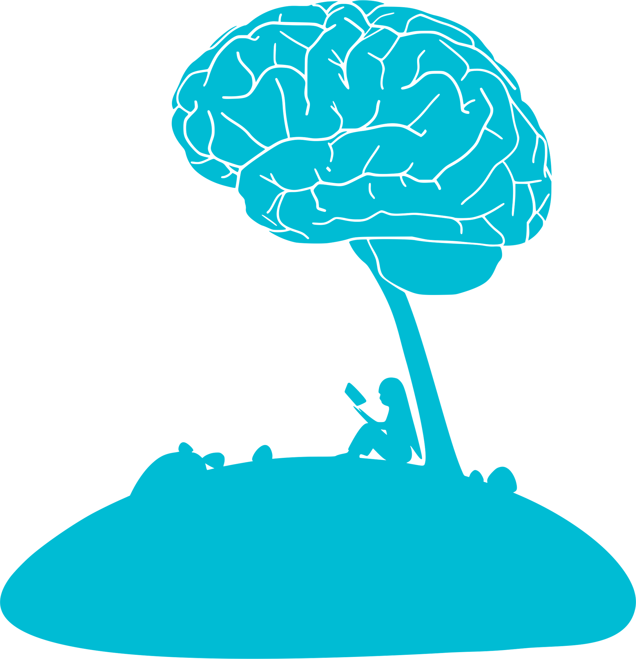
What is the mind? Why has it been bestowed upon us?
The mind is an essential part of the human being, responsible for several crucial functions:
Understanding: The ability to comprehend new information and skills
Learning: The process of acquiring new knowledge or skills
Knowing: Having awareness or familiarity with facts and concepts
Memorizing: Storing information for future recall
Recalling: Retrieving stored information when needed
Notes:
The mind is a powerful part of us that allows us to understand, learn, remember, and recall information. It acts like a library, constantly gathering and storing knowledge and experiences. The mind has several important components: it helps us think and make decisions (mental processes), drives us to act (will), processes our feelings (emotions), and allows us to sense and understand deeper spiritual truths (divine subtlety). Each of these components has a unique role. The will drives us to worship and do good deeds. Emotions help us feel love and compassion, especially towards God and others. The divine subtlety lets us perceive and connect with God's presence in a profound way. Finally, the true purpose of the mind is to seek and understand the knowledge of God. To keep our mind healthy and focused on its true purpose, we should fill it with useful and positive information, engage in activities that lead to greater understanding, and maintain a balance between thinking, feeling, and spiritual awareness. This helps us live a more meaningful and spiritually enriched life.
Think of the mind as a reservoir and library of conscious activities. It is continually nourished by streams of consciousness, meaning it constantly receives and processes new information. The mind archives all the knowledge it acquires and makes it available for evaluation by different faculties, such as reasoning and decision-making.

Slide 3
Components of the Conscience
The conscience helps distinguish between good and evil and experiences joy in goodness while suffering from wickedness. It has four main components, and each component has a primary purpose:
Divine Subtlety
Will
Mind
Emotions
Notes:
The conscience is a vital part of us that helps us distinguish between right and wrong and guides our moral and ethical behavior. It has four main components that are closely related to the mind: the divine subtlety, will, mind, and emotions. Each of these components plays a unique role. The divine subtlety allows us to sense and connect deeply with God's presence, providing spiritual insight and awareness. The will drives us to make decisions and take actions, especially those that align with worshiping and pleasing God. Emotions help us feel love, compassion, and empathy, guiding our interactions with others and our relationship with God. The mind, which processes thoughts and information, seeks to understand and gain knowledge, especially about God and His creation. Together, these components of the conscience work in harmony to help us live a balanced and righteous life. By nurturing and aligning these aspects with positive and spiritual goals, we can enhance our moral judgment, make better decisions, and deepen our connection with the divine, leading to a fulfilling and spiritually enriched life.

Slide 4
Divine Subtlety: Latife-i Rabbaniye
Spiritual Perception & Insight
Spiritual Perception: The ability to sense and recognize the presence and attributes of Allah in everyday life and in the universe.
Spiritual Insight: The deep understanding and inner knowledge that comes from a heightened spiritual awareness.
The Role of Latife-i Rabbaniye
Witnessing Allah (Müşahedetullah): The primary goal of Divine Subtlety is to witness and experience Allah’s presence. This goes beyond intellectual knowledge and enters the realm of direct, personal experience.
Connecting with the Divine: This subtlety allows for a personal and profound connection with Allah, enhancing one’s faith and devotion.
Notes:
Divine Subtlety is like practicing mindfulness with a specific focus on spiritual awareness and connection with God. It involves being fully present in the moment but also attuned to the divine presence and attributes in every aspect of life. Regular spiritual practices, such as prayer, meditation, and Dhikr, help develop this subtle awareness, leading to a life filled with spiritual insight, purpose, and a deep sense of closeness to the Creator.
Divine Subtlety, or Latîfe-i Rabbâniye, is a concept in Islamic spirituality that refers to a deeper, more refined aspect of the human soul. This component is concerned with spiritual perception and insight, allowing a person to connect with and perceive the divine presence more intimately.
Divine Subtlety, or Latîfe-i Rabbâniye, is a special part of our soul that helps us sense and understand the presence of God in a deep and meaningful way. It involves being very sensitive and aware of spiritual things, having a pure heart and mind, and understanding truths that go beyond ordinary knowledge. In everyday life, we can apply the characteristics of Divine Subtlety by engaging in regular spiritual practices like praying, meditating, and remembering Allah (Dhikr). These activities help keep our hearts and minds connected to God. We should also strive to keep our thoughts and hearts pure by seeking forgiveness for our mistakes and staying away from things that distract us from God. Spending time with good, righteous people and participating in community activities can support our spiritual growth. By reflecting on God's qualities and noticing the signs of His presence in our daily experiences, we can become more aware of and connected to Him. This way, Divine Subtlety helps guide our actions, decisions, and interactions, leading us to live a life full of purpose, wisdom, and a strong connection to our Creator.

Slide 5
Characteristics of Latife-i Rabbaniye
Refinement
Subtlety: As the name suggests, Latîfe-i Rabbâniye is subtle and delicate, often requiring refinement and purification of the heart to fully perceive it
Purity: To access this level of spirituality, one must strive for inner purity, removing negative influences and focusing on divine attributes.
Sensitivity
Awareness: This subtlety heightens one’s awareness of the spiritual dimensions of existence, making one more attuned to the signs of Allah in the world.
Sensitivity to the Divine: It makes a person more sensitive to spiritual experiences, leading to a deeper sense of awe and reverence for Allah.
Inner Knowledge
Intuitive Understanding: Divine Subtlety provides an intuitive understanding of spiritual truths that may not be accessible through ordinary intellectual means.
Inner Wisdom: It encompasses inner wisdom that guides a person in their spiritual journey and everyday decisions.
Notes:
Latîfe-i Rabbâniye, or Divine Subtlety, is like a special part of our soul that helps us sense and understand God's presence in a deep way. Here’s a simpler breakdown:
1. Refinement: This means keeping our hearts and minds clean from bad thoughts and actions so we can clearly feel and understand God's presence.
2. Subtlety: It’s about being very sensitive and aware of spiritual things that aren't always obvious. It’s like having a heightened sense of spiritual awareness.
3. Inner Knowledge: This is the deep understanding and wisdom about spiritual truths that comes from this awareness. It's knowing things about God and spirituality that we might not learn through regular thinking or study.
When we develop Latîfe-i Rabbâniye, it makes our mind and conscience more tuned in to God's guidance. This helps us make better decisions, live more purposefully, and feel closer to God.

Slide 6
Psychological Benefits of Latife-i Rabbaniye
Enhanced Emotional Well-Being
Greater Resilience and Coping Ability
Improved Focus & Clarity
Increased Empathy & Compassion
Enhanced Self-Awareness & Personal Growth
Reduction in Negative Behavioral Patterns
Neurobiological Insights
Notes:
Many of the psychological benefits associated with Latîfe-i Rabbâniye (Divine Subtlety) are supported by scientific research, particularly in the fields of psychology and neuroscience. Here’s how some of these benefits align with scientific findings:
Scientific Support for Benefits of Latîfe-i Rabbâniye
Enhanced Emotional Well-Being
- Research Findings: Studies have shown that regular engagement in spiritual practices such as prayer, meditation, and mindfulness can significantly improve emotional well-being. These practices reduce symptoms of anxiety and depression and increase overall emotional stability.
- Supporting Studies: A study published in *JAMA Psychiatry* found that individuals who engage in regular spiritual practices have lower rates of depression and anxiety.
Greater Resilience and Coping Ability
- Research Findings: Spiritual beliefs and practices are associated with greater resilience and better coping strategies. Individuals with strong spiritual beliefs often have a more positive outlook on life and are better equipped to handle stress.
- Supporting Studies: Research published in *Psychological Medicine* suggests that spirituality can act as a buffer against stress, providing individuals with a sense of meaning and purpose that enhances their resilience.
Improved Focus and Clarity
- Research Findings: Mindfulness and meditation practices improve cognitive functions, including focus and mental clarity. These practices help clear the mind of distractions, allowing for better concentration on tasks.
- Supporting Studies: A study in *Frontiers in Psychology* demonstrated that mindfulness meditation improves attention and cognitive flexibility, leading to enhanced focus and mental clarity.
Increased Empathy and Compassion
- Research Findings: Spiritual practices that foster empathy and compassion, such as loving-kindness meditation, have been shown to increase prosocial behaviors and emotional intelligence.
- Supporting Studies: Research in *Social Cognitive and Affective Neuroscience* found that loving-kindness meditation increases activity in brain regions associated with empathy and emotional processing.
Enhanced Self-Awareness and Personal Growth
- Research Findings: Self-reflection and spiritual practices contribute to greater self-awareness and personal growth. These practices encourage individuals to examine their thoughts, behaviors, and motivations, leading to continuous self-improvement.
- Supporting Studies: A study in *The Journal of Positive Psychology* found that self-reflection practices enhance self-awareness and contribute to personal growth and well-being.
Reduction in Negative Behavioral Patterns
- Research Findings: Mindfulness and spiritual practices help reduce negative behaviors by promoting self-control and mindfulness. These practices encourage individuals to be more aware of their actions and their consequences.
- Supporting Studies: Research in *Clinical Psychology Review* indicates that mindfulness-based interventions are effective in reducing substance abuse and other harmful behaviors.
Neurobiological Insights
- Research Findings: Neuroimaging studies have shown that spiritual practices can lead to structural and functional changes in the brain. These changes are associated with improved emotional regulation, increased compassion, and enhanced self-awareness.
- Supporting Studies: Studies published in *NeuroReport* and *Cerebral Cortex* found that meditation and spiritual practices strengthen neural pathways related to emotional regulation and self-awareness.

Slide 7
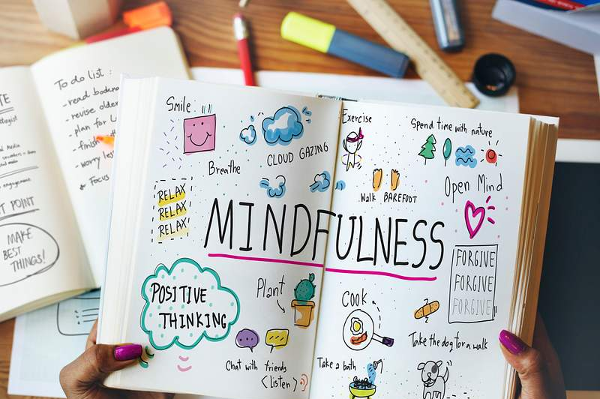
Practical Applications of Latife-i Rabbaniye
Mindfulness & Meditation: Regular mindfulness and meditation practices can enhance Divine Subtlety by increasing spiritual awareness and emotional regulation.
Reflective Journaling: Keeping a journal to reflect on spiritual experiences and insights can deepen self-awareness and promote personal growth.
Community Engagement: Participating in spiritual gatherings and community activities fosters empathy, compassion, and a sense of belonging.
Contemplation of Nature: Spending time in nature and contemplating its beauty as a manifestation of the divine can enhance spiritual awareness and inner peace.
Notes:
Practical Applications
1. Mindfulness and Meditation: Practices such as mindfulness and meditation are scientifically proven to enhance emotional regulation, focus, and empathy.
2. Reflective Journaling: Journaling has been shown to improve self-awareness and personal growth, as supported by research in psychology.
3. Community Engagement: Engaging in community and social activities fosters a sense of belonging and enhances emotional well-being, supported by social psychology research.
4. Contemplation of Nature: Spending time in nature has been linked to reduced stress and improved mental health, as documented in environmental psychology studies.
Many of the psychological benefits of Latîfe-i Rabbâniye (Divine Subtlety) are supported by scientific research. These benefits include enhanced emotional well-being, greater resilience, improved focus and clarity, increased empathy and compassion, heightened self-awareness, and reduced negative behaviors. By integrating practices that cultivate Divine Subtlety into daily life, individuals can achieve a more balanced, fulfilling, and psychologically enriched existence, supported by both spiritual wisdom and scientific evidence.

Slide 8
Component Number Two: Willpower (irade)
Refers to the inner drive or determination that compels a person to act and make decisions, particularly in pursuit of spiritual and moral goals. It is the force that directs one’s actions towards the worship and service of Allah.
Three Key Aspects: 1. Determination & Resolve
2. Purposeful Action
3. Control & Discipline
Notes:
Irade, or will, is the inner strength that helps us make decisions and take actions, especially those that align with our spiritual and moral values. It’s like a force inside us that keeps us committed to our goals, even when things get tough. Willpower helps us live intentionally, making conscious choices that lead us towards worshiping and serving Allah. It involves self-discipline, which means controlling our desires and impulses to follow Islamic teachings and avoid sinful behavior.
To strengthen our will, we can practice regular worship, like praying (Salah) and fasting (Sawm). These activities build discipline and self-control. Setting clear spiritual goals, such as learning more about the Qur'an or improving our character, gives our will direction and purpose. Developing positive habits, like regular exercise and healthy eating, also builds willpower. It’s important to avoid negative influences and surround ourselves with supportive people who encourage our spiritual growth. Having a mentor or a spiritual guide can provide additional support and advice.
In everyday life, irade helps us make deliberate, positive choices. For example, we can choose to be kind instead of getting angry or patient instead of frustrated. It helps us establish routines that include time for prayer and reflection, face and overcome challenges with resilience, and continuously work on personal growth and self-improvement. By strengthening our will, we can live a more purposeful, disciplined, and spiritually enriched life.

Slide 9
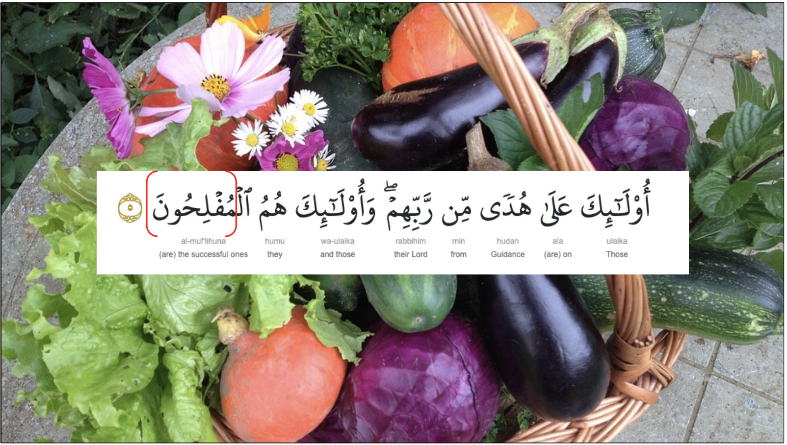
Notes:
Using will, or irade, properly is like a farmer working diligently all year to ensure a successful harvest. Just as the farmer must consistently tend to their crops—planting, watering, and protecting them from weeds and pests—our will requires regular effort and discipline. By engaging in spiritual practices, setting clear goals, and maintaining positive habits, we cultivate and strengthen our willpower. This continuous effort, much like the farmer's, leads to a bountiful spiritual harvest, where we achieve personal growth, stronger faith, and a deeper connection with Allah.

Slide 10
Additional Points about Irade
Role in Overcoming Sin: Resistance & Repentance
Connection with Patience (Sabr): Endurance & Long-term Goals
Impact on Relationships: Consistency, Forgiveness, & Compassion
Notes:
Using irade, or will, properly is crucial in overcoming sin and resisting temptations. A strong willpower enables a person to seek sincere repentance and make genuine efforts to turn away from past sins. Irade is closely linked with patience (sabr), as it provides the endurance needed to face hardships and stay steadfast in faith. This connection helps maintain focus on long-term spiritual goals, even when immediate results are not visible. In relationships, a strong will leads to consistency in character, fostering trust and reliability. It also aids in practicing forgiveness and compassion, essential for maintaining healthy relationships.
Examples from Islamic tradition, such as the life of Prophet Muhammad (PBUH), demonstrate the use of will in overcoming challenges and remaining committed to the path of Allah. Many Islamic scholars and saints showed extraordinary willpower in their pursuit of knowledge and spiritual excellence. Developing and exercising willpower also brings psychological benefits, enhancing self-esteem and confidence while helping to manage stress by providing a sense of control over one's actions and decisions.
In modern applications, irade can be used for setting and achieving personal and professional goals, as well as establishing and maintaining healthy habits, such as regular exercise and balanced nutrition. This continuous effort, similar to a farmer tending to their crops, leads to a bountiful spiritual harvest, resulting in personal growth, stronger faith, and a deeper connection with Allah. By understanding and nurturing irade, individuals can achieve a more disciplined, fulfilling, and spiritually enriched life.

Slide 11
The Psychological Benefits of Irade
1. Enhancing Self-Esteem and Confidence
2. Stress Management & Resilience
3. Delayed Gratification
4. Better Decision Making
5. Improved Mental Health
6. Neurological Insights
Notes:
1. Enhancing Self-Esteem and Confidence: One of the key psychological benefits of strong willpower (irade) is the enhancement of self-esteem and confidence. When individuals set goals and consistently work towards achieving them, they experience a sense of accomplishment. This achievement boosts their self-esteem and reinforces their belief in their abilities. The process of setting and achieving goals, even small ones, creates a positive feedback loop that strengthens overall self-confidence.
2. Stress Management and Resilience: Willpower plays a significant role in stress management and resilience. People with strong willpower can better cope with stress because they have developed the ability to regulate their emotions and maintain focus on their goals despite challenges. According to research by psychologist Walter Mischel, famous for the "marshmallow test," individuals who demonstrate strong self-control and willpower in childhood are better equipped to handle stress and achieve success later in life. These findings highlight the long-term benefits of developing willpower early on.
3. Delayed Gratification: The ability to delay gratification is another critical aspect of willpower that has profound psychological benefits. Delayed gratification involves resisting the temptation of an immediate reward in favor of a larger, later reward. Research by Mischel and his colleagues has shown that the ability to delay gratification is linked to better academic performance, healthier relationships, and greater emotional stability. This concept is central to many modern theories of self-regulation and personal development.
4. Better Decision Making: Willpower contributes to better decision-making by enabling individuals to consider long-term consequences rather than opting for short-term gains. This aligns with the theories of psychologist Daniel Kahneman, who distinguishes between fast, automatic thinking (System 1) and slow, deliberate thinking (System 2). Willpower helps activate System 2, leading to more thoughtful and rational decisions. By exercising willpower, individuals can override impulsive tendencies and make choices that are more aligned with their values and long-term goals.
5.Improved Mental Health: Strong willpower is also associated with improved mental health. Individuals who practice self-discipline and control are less likely to engage in harmful behaviors such as substance abuse or overeating. They are better able to manage their time, reduce procrastination, and maintain healthy routines, all of which contribute to lower levels of anxiety and depression. Research has shown that self-control and willpower are predictive of overall psychological well-being.
6. Neurobiological Insights: Modern research in neurobiology has provided insights into the mechanisms of willpower. Studies using functional MRI (fMRI) have shown that willpower involves specific brain regions, particularly the prefrontal cortex. This area of the brain is responsible for executive functions such as planning, decision-making, and impulse control. Strengthening these neural pathways through practices that enhance willpower can lead to more effective self-regulation and cognitive control.

Slide 12
Practical Applications of Willpower
Mindfulness & Meditation: Practices like mindfulness and meditation can enhance willpower by increasing awareness and self-regulation. Research has shown that regular meditation can strengthen the prefrontal cortex, improving focus and self-control.
Physical Exercise: Regular physical exercise has been linked to improved willpower. Exercise not only boosts physical health but also enhances mental discipline and resilience.
Setting SMART Goals: Setting Specific, Measurable, Achievable, Relevant, and Time-bound (SMART) goals helps individuals create clear and attainable objectives, making it easier to exercise willpower and track progress.
I recommend setting both short- and long-term goals!
Notes:
In modern applications, strengthening willpower can be achieved through various strategies:
- Mindfulness and Meditation: Practices like mindfulness and meditation can enhance willpower by increasing awareness and self-regulation. Research has shown that regular meditation can strengthen the prefrontal cortex, improving focus and self-control.
- Physical Exercise: Regular physical exercise has been linked to improved willpower. Exercise not only boosts physical health but also enhances mental discipline and resilience.
- Setting SMART Goals: Setting Specific, Measurable, Achievable, Relevant, and Time-bound (SMART) goals helps individuals create clear and attainable objectives, making it easier to exercise willpower and track progress.
The psychological benefits of irade, or willpower, are extensive and well-supported by modern theories and research. Enhancing self-esteem and confidence, managing stress, improving decision-making, and promoting better mental health are some of the key advantages. By understanding and applying strategies to strengthen willpower, individuals can achieve greater personal and professional success, leading to a more balanced and fulfilling life.

Slide 13
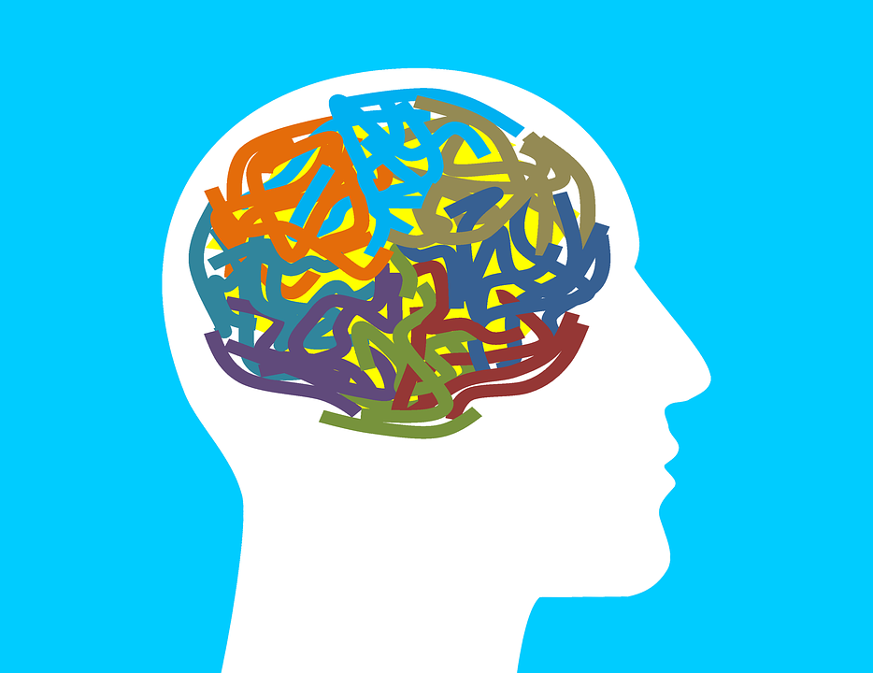
Understanding the Mind (Zihin)
The mind (zihin) is a crucial component responsible for understanding, learning, knowing, memorizing, and recalling information. It acts as a reservoir and library of consciousness, constantly nourished by streams of thoughts and experiences. The mind's true purpose is to gain knowledge of Allah (marifetullah) and to apply this knowledge in daily life.

Slide 14
Marifetullah
Marifetullah refers to the knowledge and recognition of Allah, encompassing a deep understanding of His attributes, creation, and commands.
It is derived from the Arabic word "ma'rifah," meaning knowledge or awareness, combined with "Allah," indicating that this knowledge specifically pertains to the divine.
Notes:
Key Aspects of Marifetullah
Attributes of Allah:
Names and Qualities: Understanding the 99 names (Asma ul-Husna) and attributes of Allah, such as Al-Rahman (The Most Merciful) and Al-Hakim (The Most Wise).
Divine Actions: Recognizing how Allah's attributes manifest in the world, such as His mercy, justice, and wisdom in creation and events.
Creation:
Signs in Nature: Observing and reflecting on the natural world as a manifestation of Allah’s creativity and power.
Human Existence: Understanding the purpose of human life and the role of humans as stewards of Allah’s creation.
Commands and Guidance:
Qur'an and Hadith: Studying the Qur'an and the sayings of the Prophet Muhammad (PBUH) to gain insight into Allah’s guidance for living a righteous life.
Shariah: Understanding Islamic law and its principles as a framework for ethical and moral conduct.

Slide 15
Importance of Marifetullah
Strengthening Faith: Deeper Belief & Spiritual Connection
Guiding Actions: Moral Compass & Purposeful Living
Inner Peace & Contentment: Trust in Allah & Spiritual Fulfillment
Notes:
Importance of Marifetullah
Strengthening Faith:
Deeper Belief: A profound understanding of Allah’s attributes and actions strengthens one’s faith and trust in Him.
Spiritual Connection: Enhances the personal relationship with Allah, leading to greater devotion and worship.
Guiding Actions:
Moral Compass: Knowledge of Allah provides a moral compass, guiding ethical behavior and decision-making.
Purposeful Living: Understanding the divine purpose for human life motivates individuals to live with intention and meaning.
Inner Peace and Contentment:
Trust in Allah: Knowing that Allah is wise and merciful helps individuals find peace in His decrees and trust in His plans.
Spiritual Fulfillment: Deepening one’s knowledge of Allah brings a sense of fulfillment and satisfaction.

Slide 16
How to Seek Marifetullah
Study
Study Qur’an & Hadith
Engage
Engage in Reflection & Contemplation
Practice
Practice Dhikr
Seek
Seek Knowledge
Company
Righteous Companions & Community Involvement
Notes:
Study Religious Texts:
Qur'an: Regular reading and reflection on the Qur'an to understand its teachings and messages.
Hadith: Studying the sayings and actions of the Prophet Muhammad (PBUH) to gain practical insights into living a life that pleases Allah.
Engage in Reflection and Contemplation:
Nature and Creation: Observing the natural world and contemplating its signs that point to the Creator.
Personal Reflection: Reflecting on one’s life experiences and how they relate to Allah’s guidance and wisdom.
Practice Dhikr (Remembrance of Allah):
Regular Dhikr: Engaging in the regular remembrance of Allah through reciting His names and attributes.
Mindful Prayer: Performing prayers with mindfulness and concentration to deepen the connection with Allah.
Seek Knowledge:
Religious Education: Participating in classes, lectures, and study groups focused on Islamic teachings.
Continuous Learning: Committing to lifelong learning about Allah and His attributes through reading, listening, and studying.
Good Company:
Righteous Companions: Surrounding oneself with people who encourage and support spiritual growth.
Community Involvement: Engaging in community activities that foster a deeper understanding of faith and connection with Allah.
Marifetullah is the deep knowledge and recognition of Allah, encompassing an understanding of His attributes, creation, and commands. It is essential for strengthening faith, guiding actions, and finding inner peace. By studying religious texts, engaging in reflection, practicing Dhikr, seeking knowledge, and surrounding oneself with righteous companions, one can develop and deepen their Marifetullah, leading to a more fulfilling and spiritually enriched life.

Slide 17
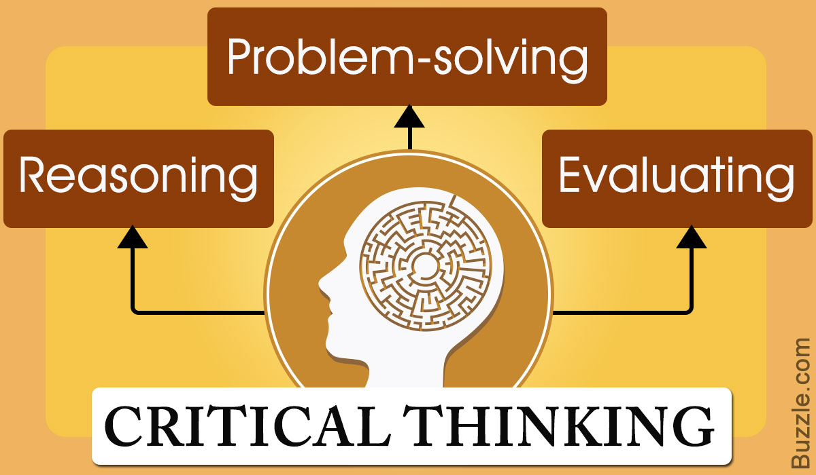
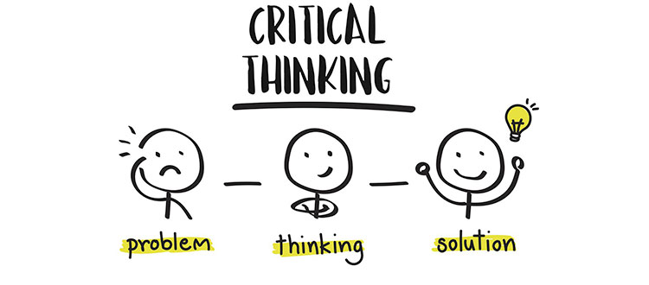
Additional Points About the Mind
Connection to the Heart (Qalb)
Reflection on Divine Signs (Ayat)
Critical Thinking & Reasoning
Creativity & Innovation
Time Management & Organization
Adaptability & Flexibility
Self-Regulation
Empathy & Social Skills
Stress Management & Mental Resilience
Notes:
Role in Spiritual Development
Connection to the Heart (Qalb):
The mind and heart are interconnected. A purified heart can lead to a clearer, more focused mind, while a disciplined mind can help purify the heart. Spiritual practices like prayer, Dhikr, and meditation nurture both the heart and mind, fostering overall spiritual growth.
Reflection on Divine Signs (Ayat):
The mind is essential for contemplating the signs of Allah in the universe. Reflecting on natural phenomena, human experiences, and historical events can deepen one’s understanding of Allah's attributes and wisdom.
Intellectual Development
Critical Thinking and Reasoning:
The mind enables critical thinking and reasoning. Engaging in intellectual discussions, reading diverse perspectives, and practicing logical analysis strengthens these abilities, helping individuals make sound, informed decisions.
Creativity and Innovation:
The mind is also the seat of creativity and innovation. Encouraging creative thinking and problem-solving can lead to new ideas and solutions in various fields, including science, art, and technology.
Practical Skills and Lifelong Learning
Time Management and Organization:
Effective use of the mind involves developing practical skills like time management and organization. These skills help individuals balance their spiritual, personal, and professional responsibilities efficiently.
Adaptability and Flexibility:
A well-nurtured mind is adaptable and flexible, capable of adjusting to new situations and challenges. This adaptability is crucial in a rapidly changing world.
Emotional Intelligence
Self-Regulation:
The mind plays a key role in self-regulation, helping individuals manage their emotions, impulses, and behaviors in line with their values and goals.
Empathy and Social Skills:
The mind’s ability to understand and empathize with others is vital for building strong, healthy relationships. Developing social skills through active listening, communication, and empathy enhances personal and professional interactions.
Mental Health and Well-Being
Stress Management:
Techniques such as mindfulness, meditation, and relaxation exercises help manage stress, promoting mental health and well-being.
Mental Resilience:
Building mental resilience involves strengthening the mind’s ability to cope with adversity and recover from setbacks. Practices like cognitive-behavioral techniques and positive thinking contribute to greater mental resilience.
The mind (zihin) is a multifaceted component of human existence, integral to spiritual, intellectual, and emotional development. By understanding and nurturing the mind through various practices and skills, individuals can achieve a balanced and fulfilling life. Emphasizing the interconnectedness of the mind with spiritual and practical aspects of life highlights its comprehensive role in personal growth and well-being.

Slide 18
Research on the Mind
1. Studies using functional MRI (fMRI) have shown that regular meditation can increase gray matter in the brain, enhancing areas involved in learning, memory, and emotional regulation.
2. Mindfulness: Numerous studies have demonstrated that mindfulness practices improve mental clarity, focus, and emotional regulation. Mindfulness helps reduce stress, anxiety, and depression by promoting present-moment awareness and self-regulation.
3. Problem-Solving and Cognitive Flexibility: Engaging in problem-solving activities and intellectual discussions enhances cognitive flexibility and critical thinking skills. Research has shown that these activities can delay cognitive decline and improve overall brain function.
Notes:
Neuroscience & Cognitive Function: Research shows that the brain can reorganize itself by forming new neural connections throughout life. This concept, known as neuroplasticity, underscores the importance of lifelong learning and mental exercises in maintaining cognitive health. Studies using functional MRI (fMRI) have shown that regular meditation can increase gray matter in the brain, enhancing areas involved in learning, memory, and emotional regulation.

Slide 19
Research on Marifetullah
Impact of Spiritual Beliefs on Mental Health: Research in spiritual psychology has found that strong spiritual beliefs and practices are associated with lower levels of depression, anxiety, and stress. Belief in a higher power provides a sense of purpose and meaning, enhancing overall well-being.
Religious Coping Mechanisms: Studies have shown that religious coping mechanisms, such as prayer and trust in Allah, improve resilience and the ability to handle life’s challenges. These practices provide emotional support and a sense of comfort during difficult times.
Reflective Practices: Reflective practices, such as contemplating nature and personal experiences, enhance self-awareness and spiritual growth. Research indicates that these practices promote a deeper understanding of oneself and one’s place in the universe, contributing to psychological well-being.
Community and Social Support: Engaging in religious communities and activities fosters a sense of belonging and social support, which are crucial for mental health. Research highlights the positive impact of social connections and communal worship on emotional and psychological well-being.
This Photo by Unknown Author is licensed under CC BY-NC

Slide 20
Practical Applications for the Mind (Zihin)
Regular Study & Lifelong Learning: Regular reading and studying of the Qur’an and Hadith & Engaging in continuous learning in various fields
Reflection & Contemplation: Setting aside time each day to reflect. Observe the natural world to recognize and appreciate Allah
Mental Exercises: Engage in puzzles, reading, and intellectual discussions. Practice mindfulness and meditation to improve focus, clarity, and emotional regulation
Healthy Lifestyle: Balanced diet and exercise
Notes:
Regular Study and Lifelong Learning:
Religious Study: Regular reading and studying of the Qur'an and Hadith to deepen understanding of Islamic teachings.
Secular Education: Engaging in continuous learning in various fields to keep the mind active and informed.
Reflection and Contemplation:
Daily Reflection: Setting aside time each day to reflect on personal actions, thoughts, and spiritual state.
Contemplation of Nature: Observing the natural world to recognize and appreciate the signs of Allah.
Mental Exercises:
Problem-Solving Activities: Engaging in puzzles, reading, and intellectual discussions to challenge and stimulate the mind.
Mindfulness and Meditation: Practicing mindfulness and meditation to improve focus, mental clarity, and emotional regulation.
Healthy Lifestyle:
Balanced Diet and Exercise: Maintaining a healthy diet and regular physical activity to support cognitive function and overall well-being.

Slide 21
Practical Applications of Marifetullah
Regular Worship & Dhikr
Study of Religious Texts
Reflection & Contemplation
Community Engagement
Notes:
Regular Worship and Dhikr:
Mindful Prayer: Performing prayers with mindfulness and concentration to deepen the connection with Allah.
Dhikr: Engaging in the regular remembrance of Allah through reciting His names and attributes.
Study of Religious Texts:
Qur'an and Hadith: Consistent study and reflection on the Qur'an and the sayings of the Prophet Muhammad (PBUH) to gain insights into Allah’s guidance.
Reflection and Contemplation:
Personal Reflection: Reflecting on one’s life experiences and how they relate to Allah’s guidance and wisdom.
Contemplation of Creation: Observing and contemplating the beauty and complexity of Allah’s creation to gain insights into His attributes and greatness.
Community Engagement:
Righteous Companions: Surrounding oneself with people who encourage and support spiritual growth.
Community Activities: Participating in community activities that foster a deeper understanding of faith and connection with Allah.
Practical applications and research on the mind (zihin) and Marifetullah demonstrate their profound impact on personal and spiritual development. Engaging in regular study, reflection, mental exercises, and maintaining a healthy lifestyle supports cognitive function and mental health. Developing Marifetullah through mindful worship, Dhikr, study of religious texts, and community engagement enhances spiritual awareness, emotional well-being, and resilience. Both spiritual and scientific perspectives affirm the benefits of nurturing the mind and deepening one’s knowledge of Allah, leading to a more balanced, fulfilling, and enriched life.

Slide 22
Emotions
Love of Allah (Muhabbetullah)
Compassion & Empathy
Patience & Resilience (Sabr)
Gratitude & Contentment (Shukr and Hamd)
Notes:
Emotions (His) in Islamic spirituality refer to the feelings and responses that arise within us due to various stimuli, including our interactions with others, our thoughts, and our experiences. Emotions play a significant role in our spiritual and mental well-being, guiding our reactions and behaviors.
Key Aspects of Emotions
Love of Allah (Muhabbetullah):
Primary Goal: The ultimate purpose of our emotions is to foster a deep and abiding love for Allah. This love guides our actions and decisions, aligning them with divine will.
Expressions of Love: This can be expressed through worship, gratitude, and acts of kindness towards others.
Compassion and Empathy:
Towards Others: Emotions like compassion and empathy are essential in building strong, supportive relationships. They enable us to understand and share the feelings of others, fostering a sense of community and mutual support.
Service to Others: Acts of charity and service are manifestations of these emotions, helping us fulfill our social and religious obligations.
Patience and Resilience (Sabr):
Enduring Hardships: Emotions like patience help us endure difficulties and maintain our faith during challenging times. Patience is considered a key virtue in Islam, enabling believers to stay resilient and hopeful.
Perseverance: It encourages perseverance in the face of obstacles, fostering a strong and steadfast spirit.
Gratitude and Contentment (Shukr):
Appreciation: Gratitude for Allah’s blessings enhances our emotional well-being and contentment with what we have.
Positive Outlook: This emotion promotes a positive outlook on life, reducing feelings of envy and dissatisfaction.

Slide 23
Cultivate Positive Emotions
Regular Worship & Dhikr
Reflection & Contemplation
Community Engagement
Healthy Lifestyle
Notes:
How to Cultivate Positive Emotions
Regular Worship and Dhikr:
Prayer: Regular prayer strengthens our connection with Allah, fostering love, gratitude, and patience.
Remembrance: Engaging in Dhikr helps maintain a calm and peaceful state of mind, promoting positive emotions.
Reflection and Contemplation:
Gratitude Journaling: Writing down things we are grateful for can help reinforce positive emotions and a sense of contentment.
Contemplation of Allah’s Attributes: Reflecting on Allah’s mercy, wisdom, and generosity helps deepen our love and appreciation for Him.
Community Engagement:
Acts of Charity: Volunteering and helping others cultivate compassion and empathy, enhancing our emotional well-being.
Supportive Relationships: Building and maintaining supportive relationships within the community fosters a sense of belonging and mutual support.
Healthy Lifestyle:
Physical Health: Regular exercise and a balanced diet positively impact our emotional state, reducing stress and promoting overall well-being.
Mindfulness Practices: Practicing mindfulness and meditation helps manage stress and enhances emotional regulation.

Slide 24
Psychological Benefits of Positive Emotions
Reduction in Anxiety & Depression
Stress Relief
Improved Relationships, Empathy, Compassion & Conflict Resolution
Coping with Adversity
Optimism
Brain Health & Neuroplasticity
Notes:
Psychological Benefits of Positive Emotions
Enhanced Mental Health:
Reduction in Anxiety and Depression: Positive emotions like gratitude and love reduce symptoms of anxiety and depression, promoting mental health.
Stress Relief: Emotions such as patience and contentment help in managing stress effectively.
Improved Relationships:
Empathy and Compassion: Cultivating empathy and compassion strengthens personal and social relationships, providing emotional support.
Conflict Resolution: Positive emotions help in resolving conflicts amicably, fostering harmony and understanding.
Greater Resilience:
Coping with Adversity: Emotions like resilience and patience help individuals cope with adversity, enhancing their ability to bounce back from challenges.
Optimism: A positive emotional outlook fosters optimism, contributing to overall life satisfaction.
Neurobiological Benefits:
Brain Health: Positive emotions stimulate the release of neurotransmitters like dopamine and serotonin, which are crucial for maintaining mood balance and overall brain health.
Neuroplasticity: Engaging in practices that foster positive emotions can enhance neuroplasticity, improving cognitive function and emotional regulation.
Emotions (His) play a crucial role in our spiritual and mental well-being. By cultivating positive emotions like love for Allah, compassion, patience, and gratitude, we can enhance our emotional health and foster stronger relationships. Engaging in regular worship, reflection, community activities, and maintaining a healthy lifestyle supports the development of these emotions. The psychological benefits of nurturing positive emotions are well-supported by research, leading to improved mental health, greater resilience, and overall life satisfaction. Integrating these practices into daily life helps create a balanced, fulfilling, and spiritually enriched existence.

Slide 25
Applying Islamic Spiritual Principles and Positive Emotions to Problem Solving
Conflict at Work: Imagine you are facing a conflict at work. A colleague has misunderstood your actions and accused you of something you didn’t do. This situation has created tension, affecting both your emotional well-being and work performance.

Slide 26
Conflict at Work
1. Divine Subtlety (Latife-i Rabbaniye)
Spiritual Insight: Use your spiritual awareness to sense the deeper aspects of the conflict. Recognize any underlying emotional or spiritual issues that may be influencing your friend’s behavior
Inner Purity: Approach the situation with a pure heart, free from negative emotions like anger or resentment. This purity helps you stay focused on finding a resolution that is pleasing to Allah.
Intuitive Understanding: Rely on your intuition and spiritual insight to guide your actions and words during the resolution process. This can help you respond with empathy and wisdom.

Slide 27
Conflict at Work
2. Mind (Zihin): Understanding and Reflective Thinking
Understanding: Use your mind to fully understand the situation. Analyze the conflict objectively and try to see it from your friend’s perspective.
Reflective Thinking: Reflect on past experiences where you successfully resolved conflicts with friends. Consider the lessons learned and how they can be applied here.
Marifetullah: Reflect on Allah’s guidance in handling interpersonal conflicts. Remembering Allah’s attributes such as mercy, justice, and wisdom can help you approach the situation with fairness and compassion.

Slide 28
Conflict at Work
2. Will (Irade): Determination and Discipline
Determination: Decide to resolve the conflict with patience and perseverance. Use your willpower to stay committed to finding a solution, despite any discomfort or challenges.
Discipline: Maintain self-control in your interactions with your friend. Avoid reacting impulsively or defensively.

Slide 29
Conflict at Work
3. Emotions: Managing and Channeling Emotions
Love of Allah (Muhabbetullah): Approach the situation with the intention of pleasing Allah by acting justly and compassionately.
Compassion and Empathy: Show empathy towards your friend. Understand that they might be stressed or have their own pressures, which led to the misunderstanding.
Patience (Sabr): Exercise patience throughout the resolution process. It might take time to clear up the misunderstanding and restore a positive relationship.
Gratitude (Shukr): Be grateful for the opportunity to practice patience and improve your conflict resolution skills. This mindset can help maintain a positive attitude.

Slide 30
Practical Steps in Problem Solving
1. Initial Reflection and Planning: Take a moment to reflect on Allah’s guidance and your own experiences. Plan your approach, considering how to communicate effectively and empathetically.
2. Engaging in Constructive Dialogue: Arrange a calm, private setting to discuss the issue with your friend. Start the conversation with a positive attitude and express your willingness to resolve the issue. Use “I” statements to express your feelings and perspective without sounding accusatory (e.g., “I felt hurt when…”).
3. Active Listening and Empathy: Listen to your friend’s side of the story without interrupting. Show empathy by acknowledging their feelings and concerns.
4. Finding Common Ground and Solutions: Identify areas of agreement and common goals. Collaborate on finding solutions that address both your concerns and those of your friend.
5. Seeking Support and Advice: If needed, seek advice from a trusted mutual friend or a mentor who can offer a fresh perspective and guidance. Engage in prayer and ask Allah for wisdom and patience in resolving the conflict.
6. Continuous Reflection and Improvement: After resolving the conflict, reflect on the process and identify what worked well and what could be improved. Use this experience to enhance your problem-solving skills for future challenges.
Notes:
By applying the principles of the mind, will, emotions, and divine subtlety in a real-life problem-solving scenario with a friend, you can handle conflicts effectively and with emotional intelligence. Understanding the situation through reflective thinking, using willpower to stay disciplined and determined, managing emotions with compassion, patience, and gratitude, and utilizing spiritual insight and awareness align with Islamic teachings and promote a positive resolution. This holistic approach not only resolves the conflict but also contributes to personal growth, stronger friendships, and a spiritually enriched life.

Slide 31
Summary of Key Points
Today, we have explored how to seek guidance, learn, and solve problems from an Islamic perspective, with a focus on social-emotional health and well-being. We delved into the teachings of Imam Ghazali, Said Nursi, and Fethullah Gulen, and how their wisdom can be applied to our everyday lives. Specifically, we examined:
The Mind (Zihin): Understanding and reflective thinking, emphasizing continuous learning and critical analysis.
Divine Subtlety (Latîfe-i Rabbâniye): Developing spiritual awareness and insight to guide our actions and decisions.
Willpower (Irade): Cultivating determination and discipline to remain steadfast in our goals and actions.
Emotions: Managing and channeling emotions like love, compassion, patience, and gratitude to enhance our relationships and overall well-being.
Marifetullah: Seeking deep knowledge and recognition of Allah to strengthen our faith and guide our actions.

Slide 32
Sources
The Qur’an: 7:200-201; 41:36; 9:119 and Tafsirs of Ali Unal, Said Nursi, Imam Qurtubi and Ibn Kathir
Hadith: Tirmidhi; Ahmad ibn Hanbal; An-Nasa’I Collections
Al-Ghazali. The Alchemy of Happiness. Translated by Claud Field, Kazi Publications, 1991.
Al-Ghazali. The Revival of the Religious Sciences (Ihya Ulum al-Din). Translated by Fazlur Rahman, Islamic Book Trust, 2013. Al-Ghazali.
The Book of Knowledge. Translated by Nabih Amin Faris, Islamic Book Trust, 2009.
Nursi, Said. The Words. The Seventeenth Word.
Nursi, Said. The Gleams. The Seventeenth Gleam, Fourteenth Note.
Nursi, Said. The Letters. The Sixteenth Letter, Third Point.
Gulen, Fethullah. The Essentials of the Islamic Faith. The Fountain, 2005.
Gulen, Fethullah. Key Concepts in the Practice of Sufism. The Fountain, 2010.
Gulen, Fethullah. Pearls of Wisdom. The Fountain, 2005.
Gulen, Fethullah. Kırık Testi 7, Ölümsüzlük İksiri, Kırık Testi 4, Ümit Burcu, Kırık Testi 14, Buhranlı Günler Ümit Atlasımız, Kırık Testi 12, Yenilenme Cehdi, Kırık Testi 3, Gurbet Ufukları.

